Slide 1
Residency Questionnaire eForm Instructions
Office of the University Registrar

Slide 2



How to Locate the eForm
Log into AccessUH
Select the myUH Self Service icon
Select Academic Records Tile
The Residency Questionnaire tab is located on the left side of the screen.
Click the drop down to see the forms available for submission.

Slide 3
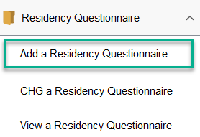
Residency Questionnaire eForm
Click the Add a Residency Questionnaire option to submit a new questionnaire.

Slide 4
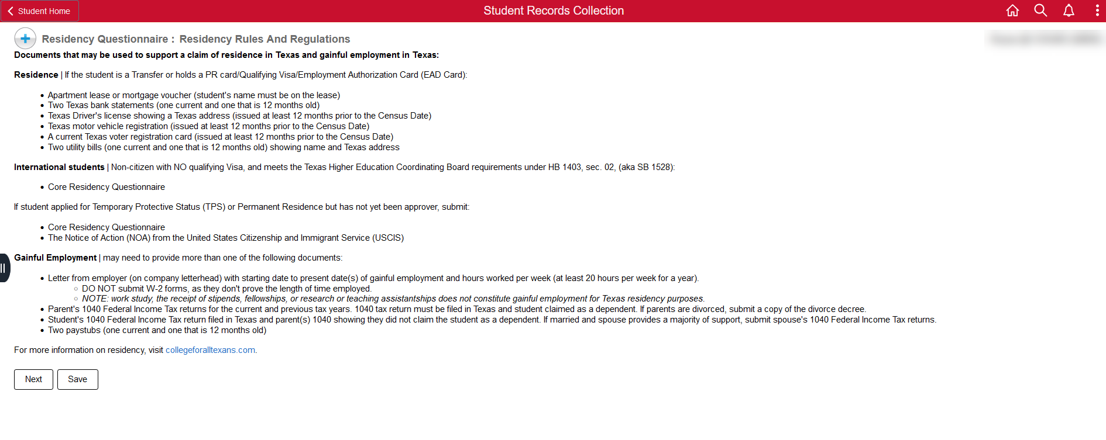
Submitting a New Questionnaire
In the dropdown menu, select 'Add a Residency Questionnaire' to begin submitting your request for a residency review. The first screen that appears will detail Residency Rules and Regulations for the state of Texas. Be sure to read through the information for acceptable forms of documentation.

Slide 5
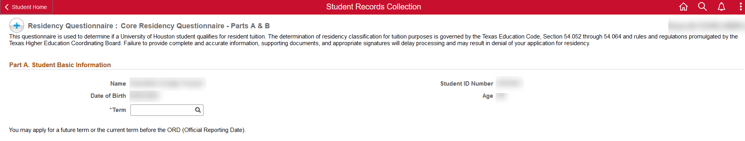
Submitting a New Questionnaire-cont.
Confirm that your information is correct and select the desired term for your residency review.
  Please note that you will only be able to apply for residency for future or current terms before ORD (Official Reporting Date). For more information on the ORD for the term, please view the academic calendar available in uh.edu.

Slide 6
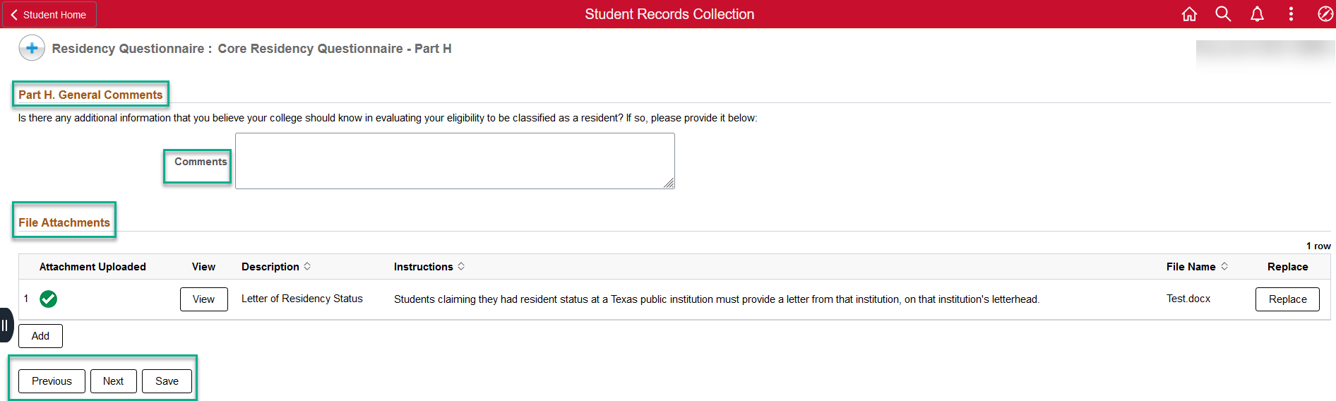
Submitting a New Questionnaire-cont.
Complete the questionnaire and provide requested documents. You will have the option to save the form if you need to come back to it later.
After completing the questions, you will have an option to add comments regarding your residency and confirm all uploads.

Slide 7
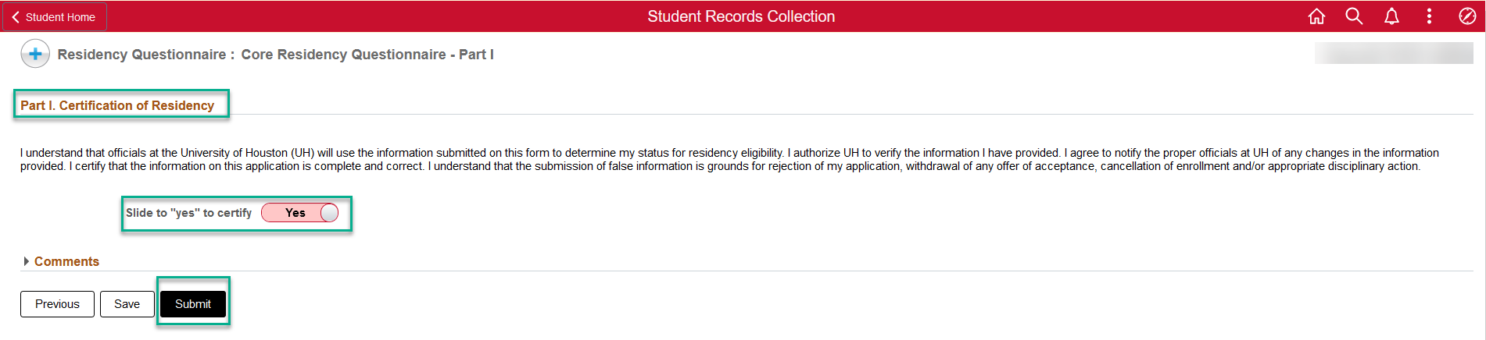
Submitting a New Questionnaire-cont.
Certify that all information is accurate by sliding the option to Yes.
Click Submit to send the document for the Office of the University Registrar to review. Please allow 7-10 business days for processing. Processing time may increase during peak enrollment season.
Important: If you would like to make edits to a submitted or saved form, please select CHG a residency questionnaire. You can also view the form to see the answers that submitted.

Slide 8
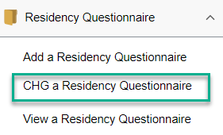
Residency Questionnaire eForm
Click the CHG a Residency Questionnaire option to edit a saved questionnaire. You will need to input your Student ID and term to recover the form with your previous answers.

Slide 9
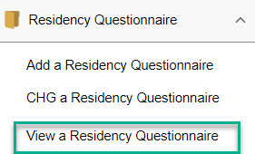
Residency Questionnaire eForm
Click the View a Residency Questionnaire option to review a submitted questionnaire. You will need to input your Student ID and term to view the form with your submitted answers.

Slide 10
Questions?
Please contact the Office of the University Registrar (OUR)
Phone: 713-743-1010, option 7
Email: residency@uh.edu

