Slide 1
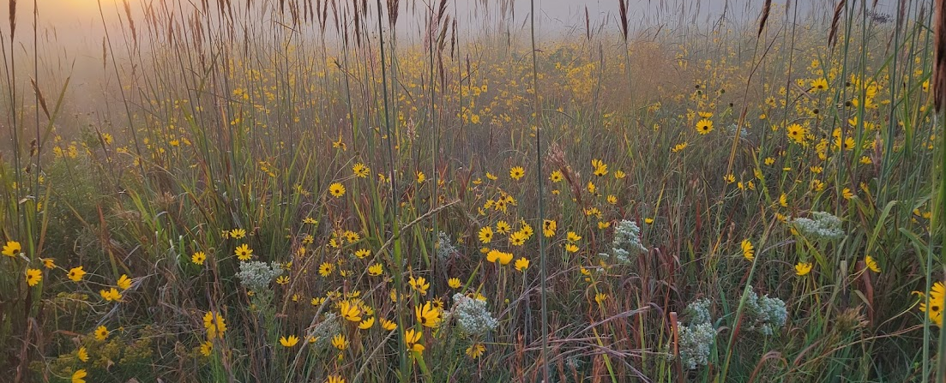
Soil Carbon Measurement and Monitoring as a Tool of Restoration Progress
April 17, 2024
Notes:
-Greeting & acknowledgement
-Introduction
-We’ll be discussion the potential to use soil organic carbon as a measure of ecosystem restoration

Slide 2
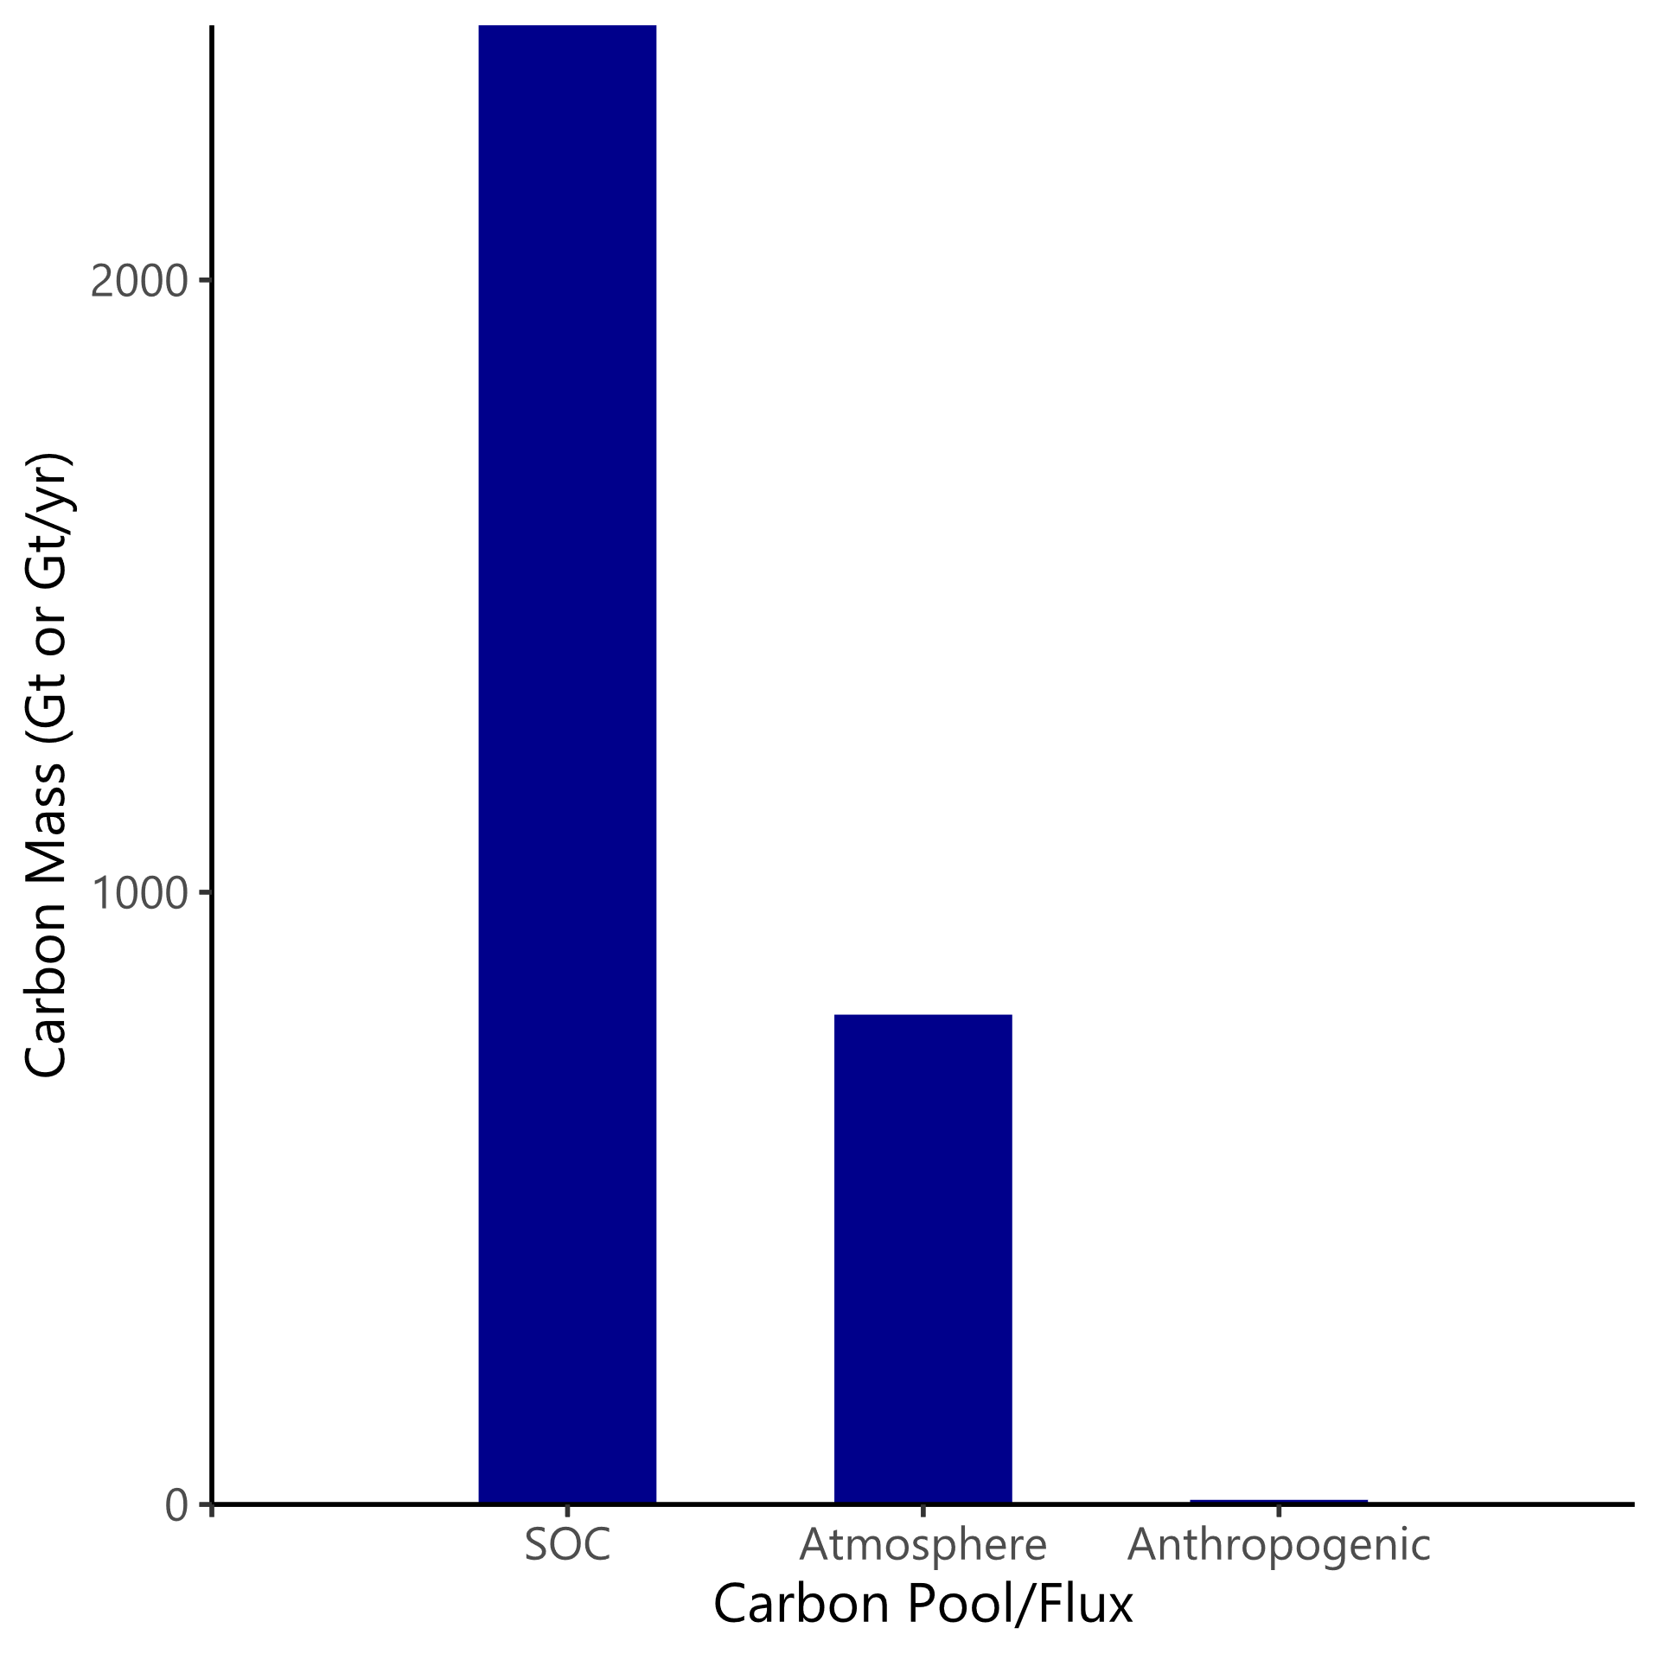
Global Soil Organic Carbon
Global soil organic carbon (SOC) stock estimates average 133.4 (±15.8) tonnes/hectare, total between 2376–2456 Gt¹
Atmospheric carbon is estimated around 800 Gt²
Anthropogenic sources between 6-8 Gt/yr²
Potential to sequester 1-2 Gt C/yr (3.4-6.8 Gt CO₂e) in global grasslands³
Notes:
-Starting out broadly to look how soil carbon around the world compares to the atmospheric pool
-133 tonnes/hectare, total of 2400 Gt
-Anthropogenic source on same graph to show how large to pool of SOC is
-What role grasslands play in the potential for mitigating our climate impact

Slide 3
SOC in Texas Coastal Prairies
Similar to general findings
  SOC percents overlap well with national averages
  SOC stocks: Two studies within Houston area - 133-171 t/ha on the same site (UHCC)
    Another site (Lawther-Deer Park Prairie) averaging 84 t/ha with a different soil type
Notes:
-Texas coastal prairies as a potentially important grassland ecosystem regarding carbon dynamics
-How do the UHCC and Deer Park sites compare to the national averages?

Slide 4
SOC in a restoration context
Central Texas agricultural fields converted to grasslands in vertisols (common in coastal prairies as well) sequestered carbon at a rate of 443 kg/ha/yr⁴
  After 60 years, still significantly lower than remnant prairies
SOC can take 100+ years to resemble remnant ecosystems, but SOC accumulation accelerates under imposed high diversity, late successional conditions compared to natural succession^{4,5}
SOC has been observed to decrease in grasslands following invasion⁶
Notes:
-A chronosequence in central TX observing 0 (still agriculture), 6, 26, and 60 yrs after conversion to “grassland”
-Another study in Minnesota, took native perennials ~50 yrs to become dominant, but this study the SOC probably will take 100+ yrs to resemble remnants, so SOC could be a long-term indicator of restoration
-Accelerating SOC accumulation under high diversity, late successional conditions compared to unmanaged succession
-“Grassland” was mainly native grass species but included King Ranch bluestem and Johnson grass in this study
-

Slide 5
Factors affecting soil carbon – Abiotic & Anthropogenic
Climate, soils
  Slow changes that are difficult or impossible to alter
Human agricultural practices
  Estimated loss of 116 Gt from soils since the start of agriculture and accelerating since 1850⁷
Notes:
-Abiotic factors that affect soil carbon
-Climate and soils are very important, but we won’t focus on them during this presentation because management/restoration practices can’t affect them significantly
-Agriculture has caused a major loss of SOC, estimated around 116 Gt since the initiation of agriculture, with ~60 Gt of that just since 1850

Slide 6
Factors affecting soil carbon – Biotic
Native vegetation status
  Non-native species (NNS) appear to accumulate more aboveground carbon, but sequester less carbon in the soil⁸
  NNS alter belowground communities, increasing respiration, herbivory, and decreasing arbuscular mycorrhizal fungi, leading to greater soil carbon respiration⁹
  NNS reduce diversity by outcompeting native species
Vegetation biodiversity
  Belowground NPP, sequestration, and soil microbiome diversity increase with plant species diversity^{10,11}
  SOC shown to increase more quickly with more diverse plant communities⁵
8. Poeplau, C., & Don, A. (2014). Soil carbon changes under Miscanthus driven by C₄ accumulation and C₃ decompostion – toward a default sequestration function. Global Change Biology Bioenergy, 6, 327-338.
9. Waller, L. P., Allen, W. J., P., B. I., Condron, L. M., França, F. M., Hunt, J. E., . . . Dickie, I. A. (2020). Biotic interactions drive ecosystem responses to exotic plant invaders. Science, 368, 967-972.
10. Jackson, R. B., Lajtha, K., Crow, S. E., Hugelius, G, Kramer, M. G., & Pineiro, G. (2017). The Ecology of Soil Carbon: Pools, Vulnerabilities, and Biotic and Abiotic Controls. Annual Review of Ecology, Evolution, and Systematics. 48, 419-445
11. Thompson, G. L. & Kao-Kniffin, J. (2016). Diversity Enhances NPP, N Retention, and Soil Microbial Diversity in Experimental Urban Grassland Assemblages. PLoS ONE. 11(5) 1-17
Notes:
-Many biotic factors affect SOC, including soil biota and aboveground megafauna, but most restoration practices focus on plant community mgmt.
-Non-native vegetation can cause simultaneous increases and decreases to SOC
-Often greater aboveground accumulation in NNS, particularly trees and shrubs—something to keep in mind regarding TX coastal prairies
-However, increased respiration due to changes in the belowground bacterial and AMF communities frequently decreases the SOC sequestration rate
-Diversity is often reduced by the more competitive non-native/invasive species
-More diverse plant communities have been shown to sequester carbon at a higher rate than monoculture/less diverse systems

Slide 7
Soil carbon effects on invasive species
Adding carbon to soils generally has a negative impact on invasive species growth^{12,13}
SOC may play a role in resistance to invasion in remnant grassland ecosystems
Notes:
-SOC itself appears to alter the competitiveness of NNS when added to soil
-Most likely, this effect is due to the loss of N in the soil as soil microbial communities use both the C and N to grow
-The higher SOC found in remnant ecosystems may play a role in making those systems resilient against invasion
-Still much unknown in this field
-We’ll take a look at some ecotypes of the Texas Coastal Prairies and major invasives that threaten them

Slide 8
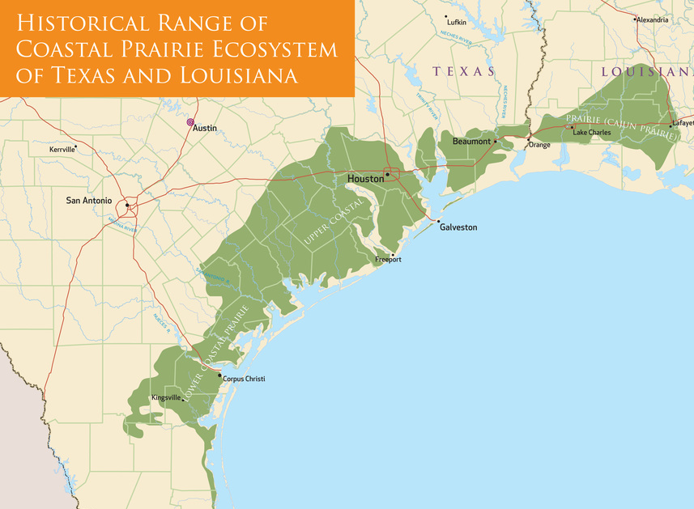
Gulf Coast Prairies and Marshes Ecoregion
Historic & Current Extent:
  ~9 million ac historically, from Corpus Christi to Louisiana’s Cajun Prairie
  <1% remains and another 15-20% is degraded but restorable.
Tallgrass Prairie & Wetlands – “a sea of grass”
  -Deep clayey soils, low topographic relief – an expansive living sponge to hold and infiltrate water and sustain a diverse plant mix
  -Provide abundant ecosystem services – climate, hydrology, habitat, recreation, spiritual. Critical habitat for dozens of wildlife species.
Historic Land Use Change & Current Threats
  -Conversion to cropland and urban expansion (res/comm/ind),
  -Decimated by overgrazing and degraded by fire suppression and resulting woody invasion by native and invasive species (Chinese tallow) further encroaching on habitat
Image: Native Prairie Association of Texas, 2024
Notes:
I’m sure we are all familiar with the Texas Coastal Prairie, since we are here at the Coastal Prairies Restoration Practitioners Forum.
I won’t go into too much detail about the prairie, but I did want to run through the species diversity that we see out here so that we can keep it in mind as it relates to soil carbon.
This diversity is often due to the dense clay soils and the flatter landscape that can retain a lot of water.
This allows for lots of both upland and wetland plants to grow almost everywhere across the prairie, which Andrew Sipocz is going to touch on later regarding managing the Wetland and Coastal Prairie Matrix on this landscape.

Slide 9
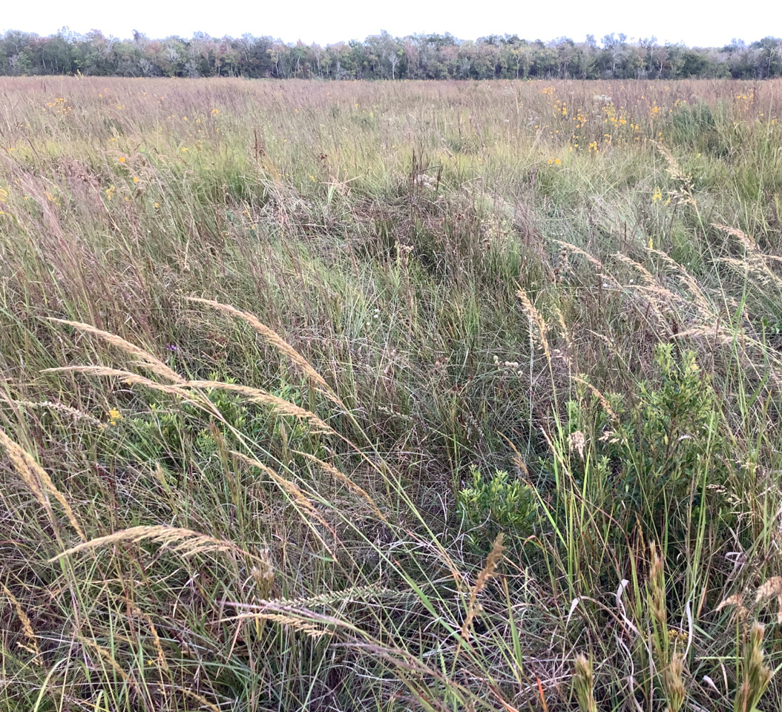
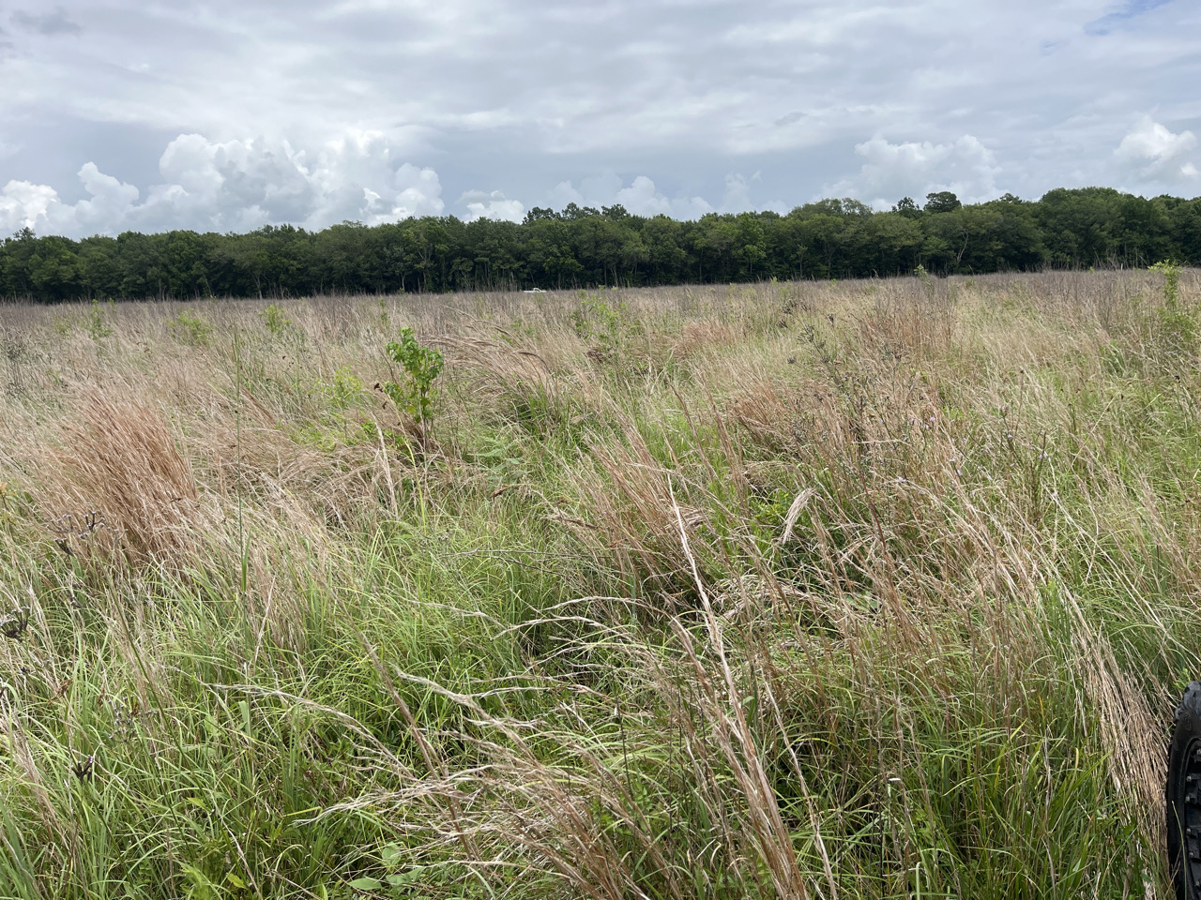
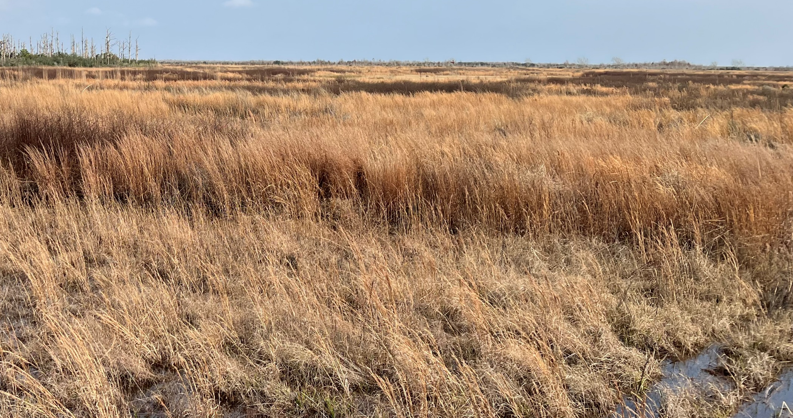
Coastal Prairie Species
Notes:
Dominant native grasses often include tall and midgrasses like little and bushy bluestems, Indiangrass, switchgrass, tall dropseed, tridens.
Lower layers of grasses will have brownseed paspalum, bristlegrass, carpetgrass, rosettegrass.
And especially on wetter landscapes or in wetter picrotopography there will be multiple species of Rhynchospora beaksedges, other native sedges/rushes/spikerushes,fumbrys

Slide 10
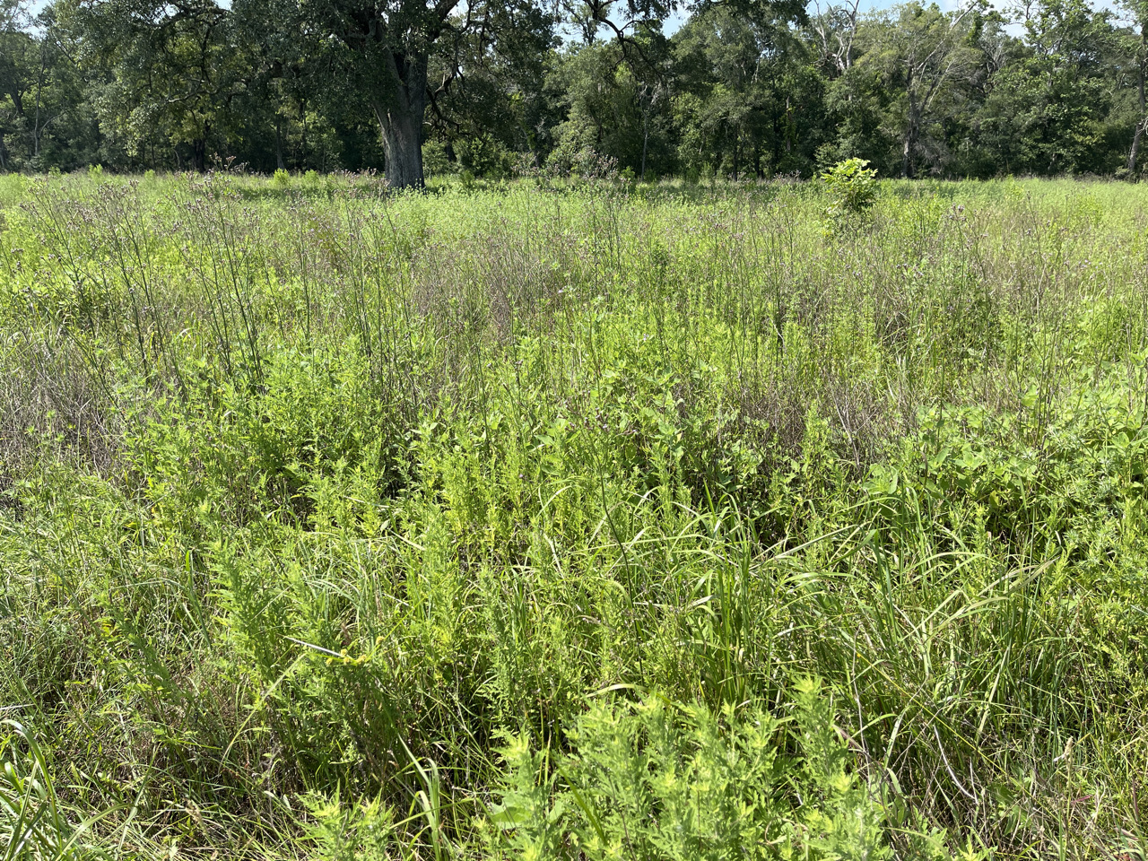
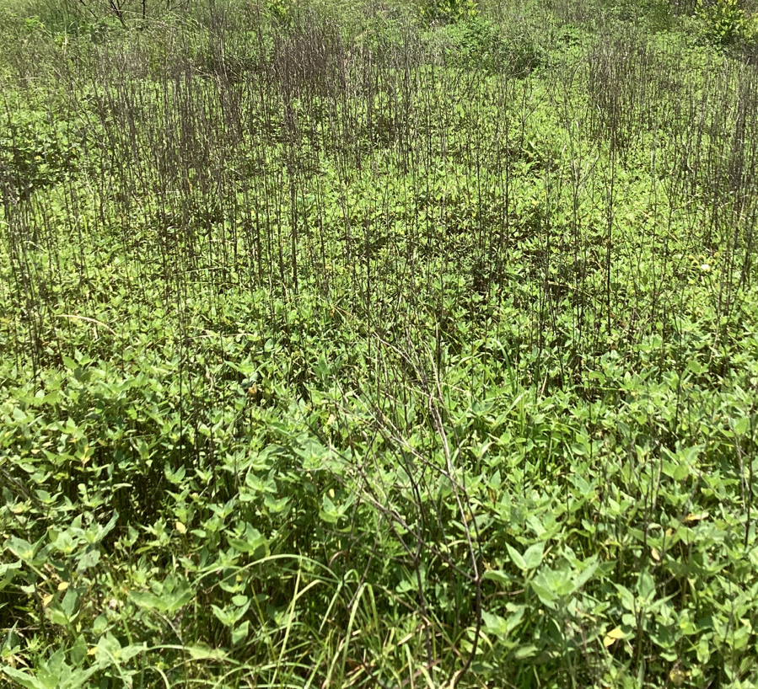
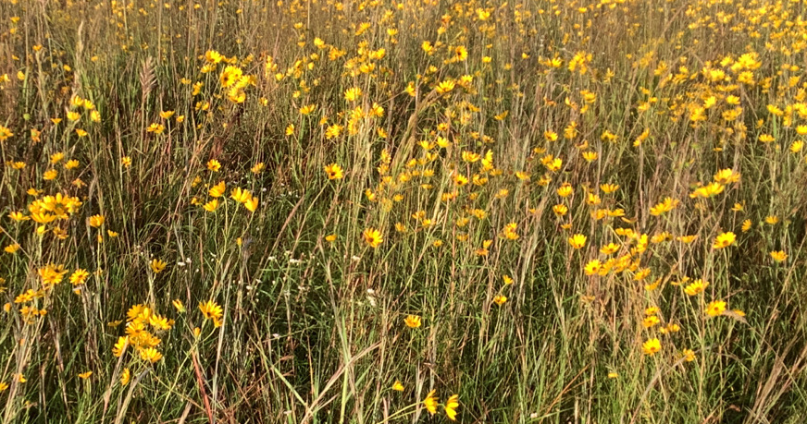
Coastal Prairie Species
Notes:
Dominant native forbs often are mainly asteracaeas including annual sumpweed, ragweeds, goldenrods, gayfeathers, saltmarsh aster, blackeyed Susan, coreopsis.
Mixed in and under that there will be mimosa, guara, clovers, dewberries, milkweeds, bedstraw, geranium, coneflowers, eryngiums, the list goes on.

Slide 11
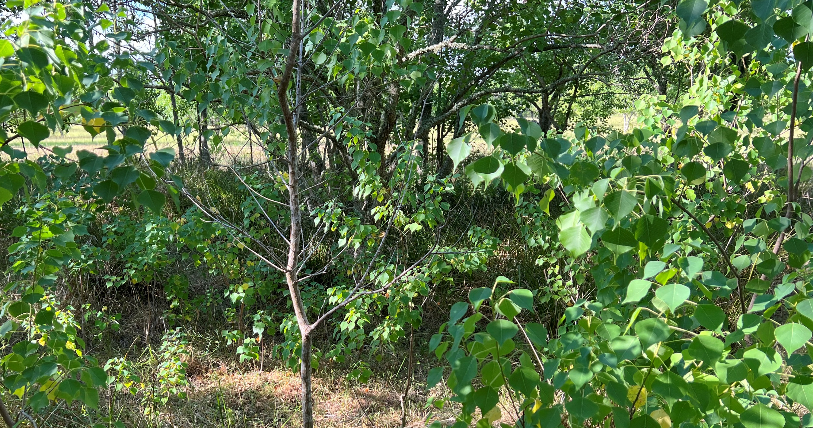
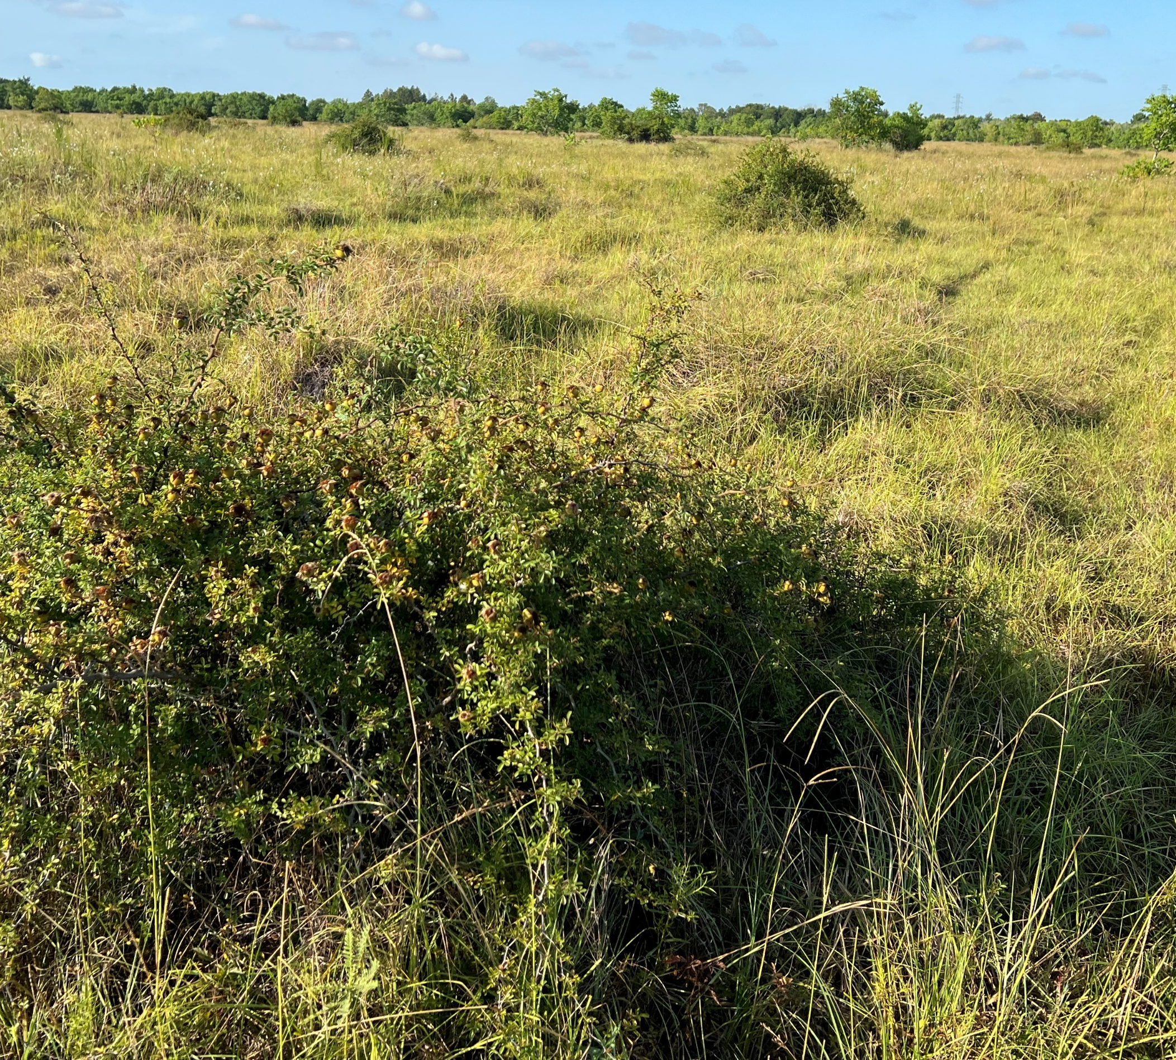
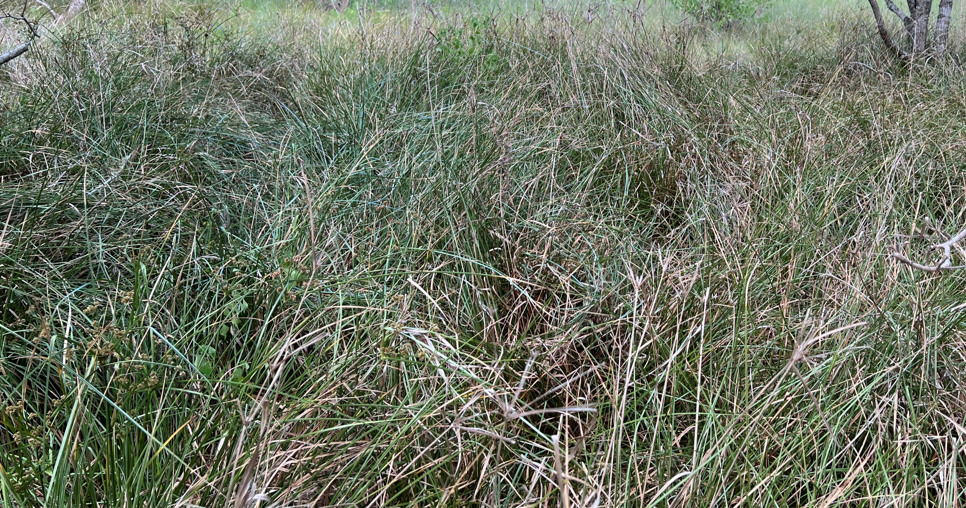
Coastal Prairie Species
Notes:
Then there are the invasive species that grow amongst or often take over these areas.
Chinese tallow, deeprooted sedge, Macartney rose, baccharis, smutgrass, Johnson grass, KR, torpedograss, alligatorweed, and we’ll still see some huisache and mesquite up this way though not as much as further west.
I’m looking forward to Trey’s talk later about Running off Macartney Rose so we can get some insight on that.
Some of these species from my previous slide aren’t actually listed as “invasive” by the Texas Department of Agriculture but we all still hate most of them.

Slide 12
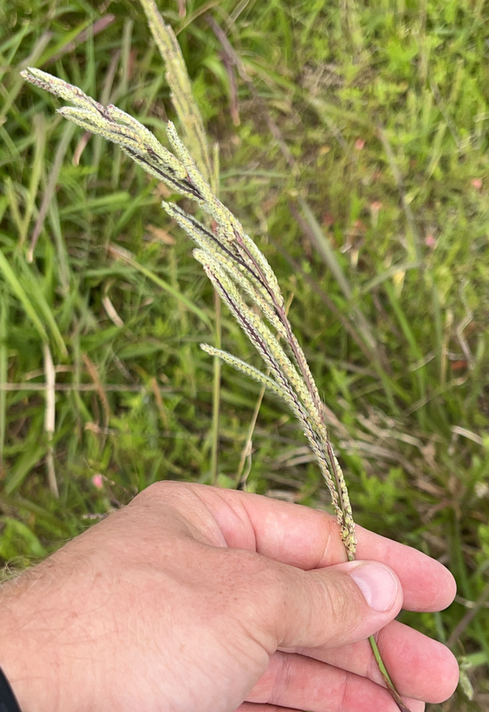
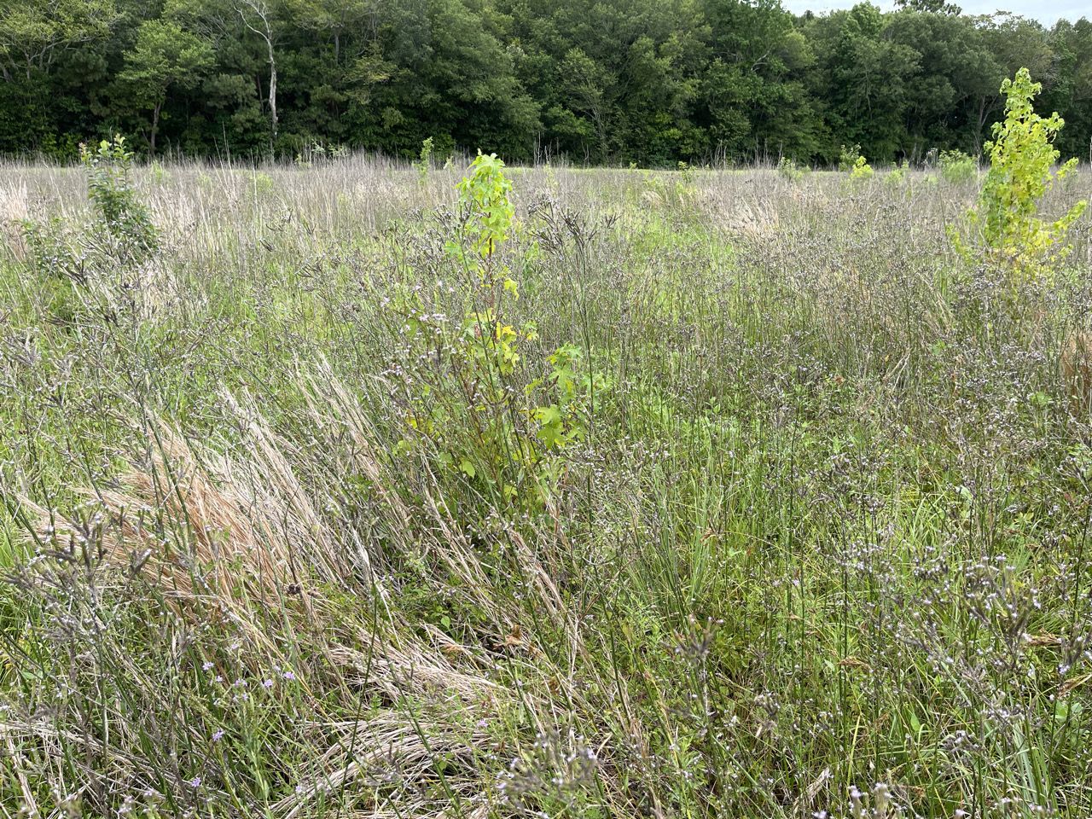
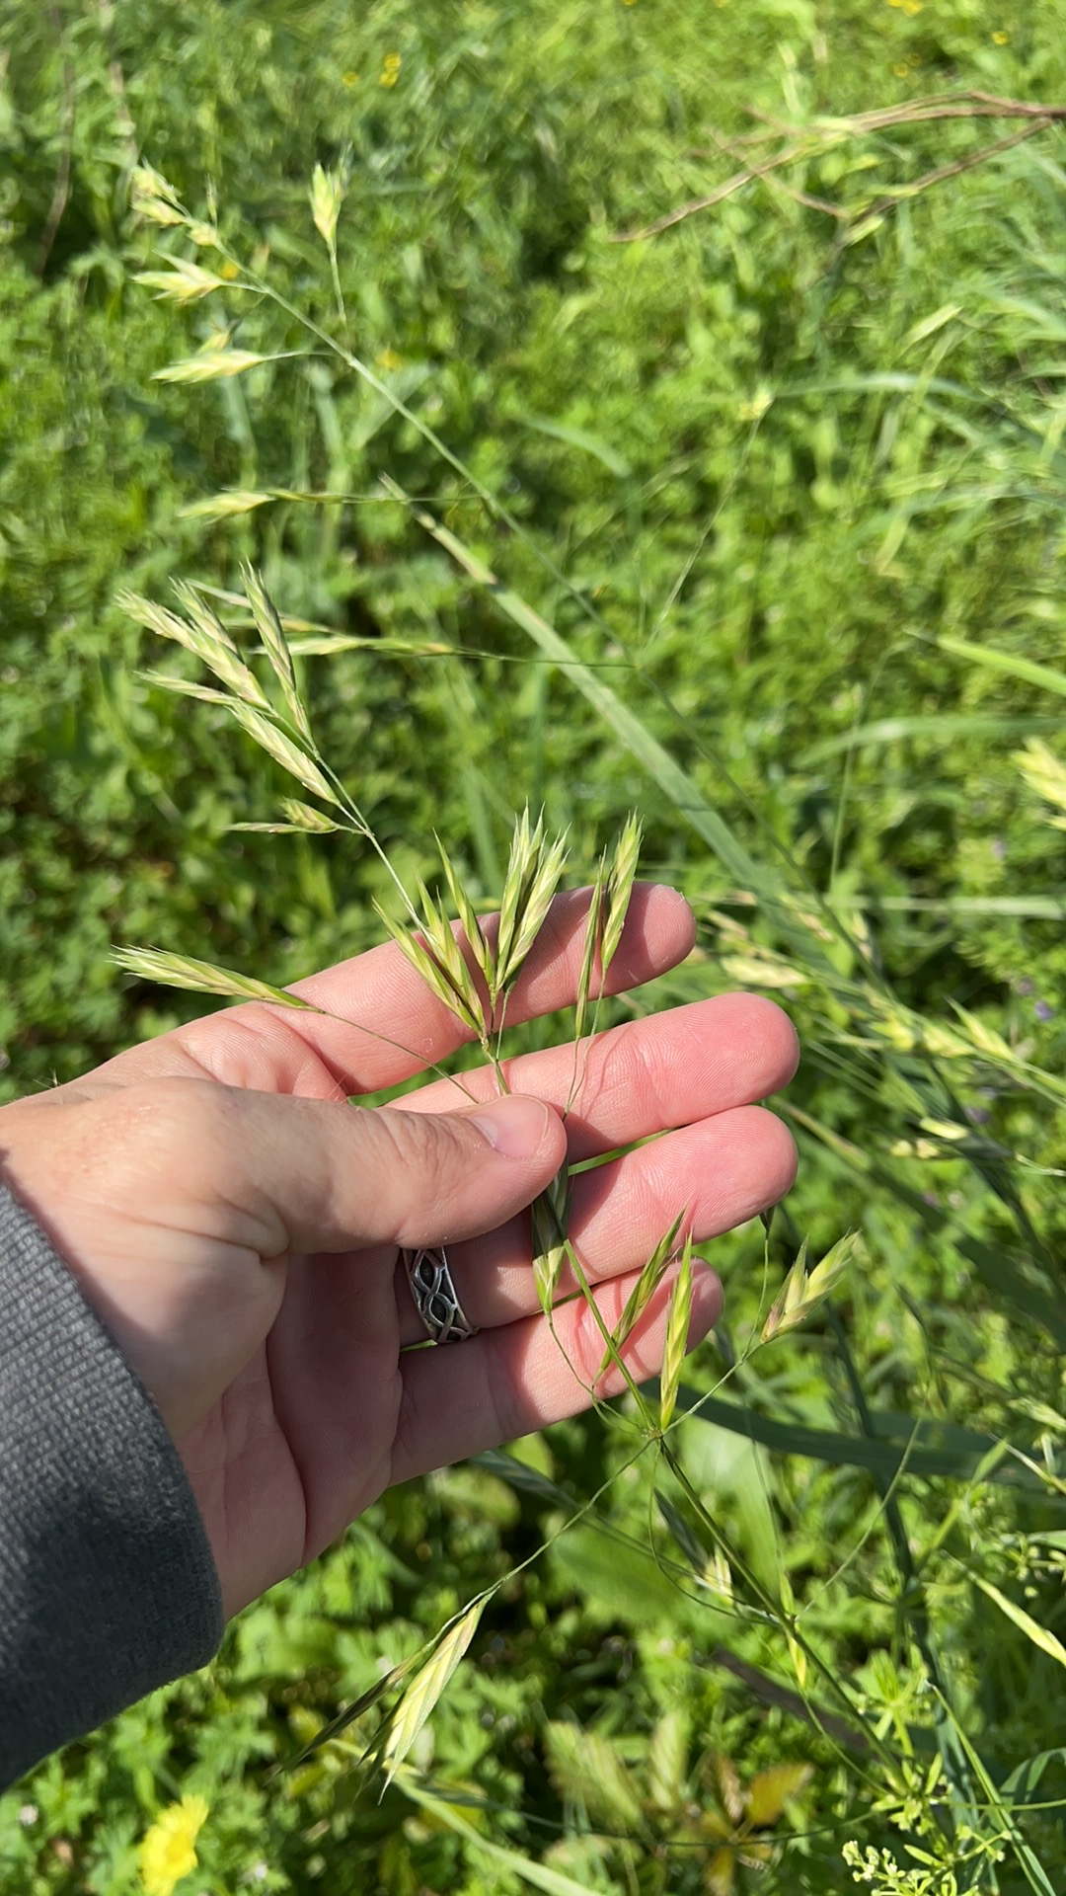
Coastal Prairie Species
Notes:
Other common non-natives that we often see but aren’t necessarily considered “invasive” include forage grasses like Bermuda, bahia, and perennial rye.
I’ve also seen lots of areas of Brazilian vervain, rescue brome, Vasey’s grass.
These mainly tend to be problematic only when you have certain levels of “native cover” that you are attempting to achieve, but you have this presence of “non-native” “not-invasive” species taking some of that coverage.

Slide 13
SOC as a metric of restoration progress
Can comparisons of SOC between remnant and restored ecosystems act as a tool for restoration progress?
Notes:
(Hunter read this part to transition)
-So now that we have looked at the native vegetation ecotypes and gotten a brief explanation of Soil Organic Carbon, our questions is:
What role can measurements and monitoring of SOC play in monitoring the progress of restoration, if any?

Slide 14
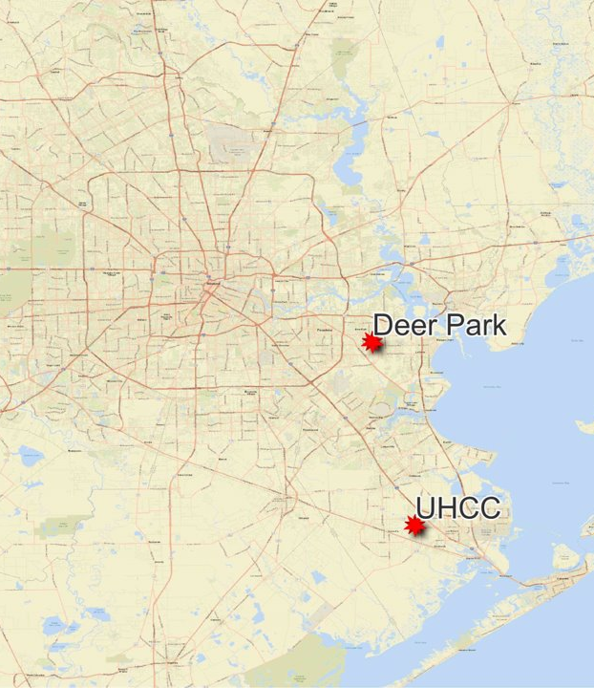
UHCC and Lawther-Deer Park Prairie
UHCC (La Marque, Galveston Co., TX)
  -925-acre site is a hub for coastal prairie restoration, research, training, and education. It was designated “Texas Institute for Coastal Prairie Research and Education” by the Texas Legislature in 2017.
  -Former Camp Wallace military base (~1940-1960), then acquired by UH in 1960 and established as UHCC by 1972.
  -Aumann Prairie, Southwest Prairie, and South-Central Prairie are unbroken remnants (e.g. never tilled) and recognized by USFWS and TPWD as high quality remnant native prairies, with 364 plant species identified.
Lawther - Deer Park Prairie (Deer Park, Harris Co., TX)
  -51-acre High Quality Remnant Prairie – a “platinum prairie”
  -Discovered in 2011 by local birder and naturalist Don Verser and protected after extensive fundraising campaign led by Bayou Land Conservancy in 2013.
  -Donated to Native Prairie Association of Texas, who stewards the site
  -Jason Singhurst’s (TPWD) 2018 study describes 6 plant community associations and 346 plant species.
  -Used as a reference site in the UHCC Soil Carbon & Vegetation study.
Notes:
In 2022, RES was contracted to perform the field work and sampling services of the existing carbon stocks at the UHCC, Evelyn’s playground and where we first had this forum.
We also surveyed the Lawther Deer Park Prairie to serve as a reference site.

Slide 15
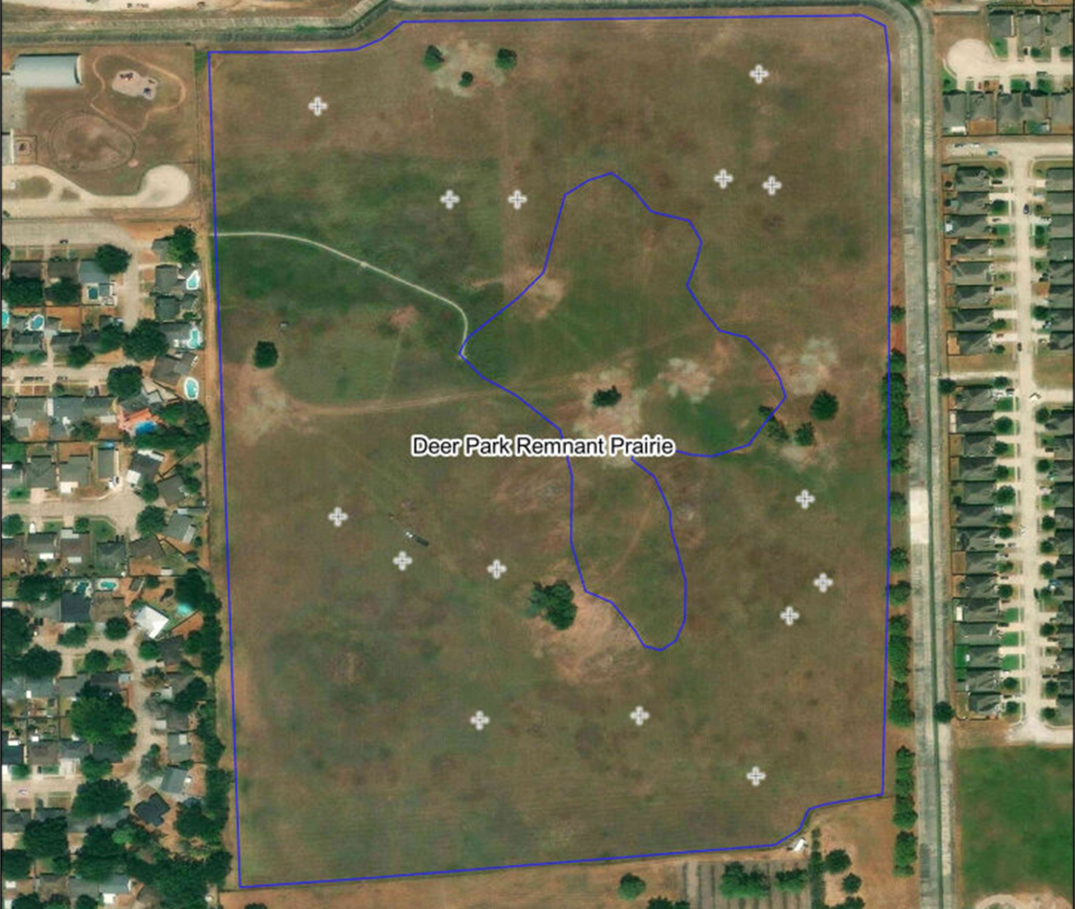
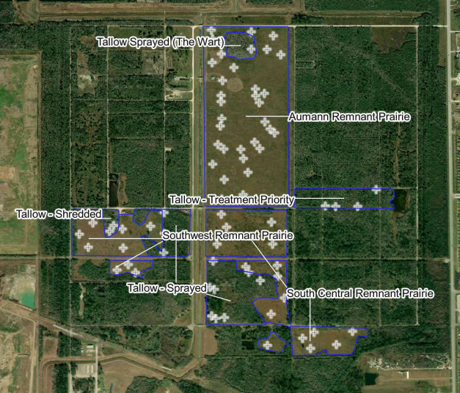
Sampling Procedure
Notes:
92 soil samples were randomly allocated across study area, with 77 points across 217 acres at UHCC and 15 points across 51 acres at the Lawther Prairie.
Sampling locations were randomly generated at approximately one point for every 2.5 acres.
We attempted to take soil core samples as close to these points as equipment would allow, but in some of the wooded sections we were not able to drive the equipment in.
Soil cores were the week of Oct 10, 2022. Vegetation data was taken then and the week of May 22, 2023.

Slide 16
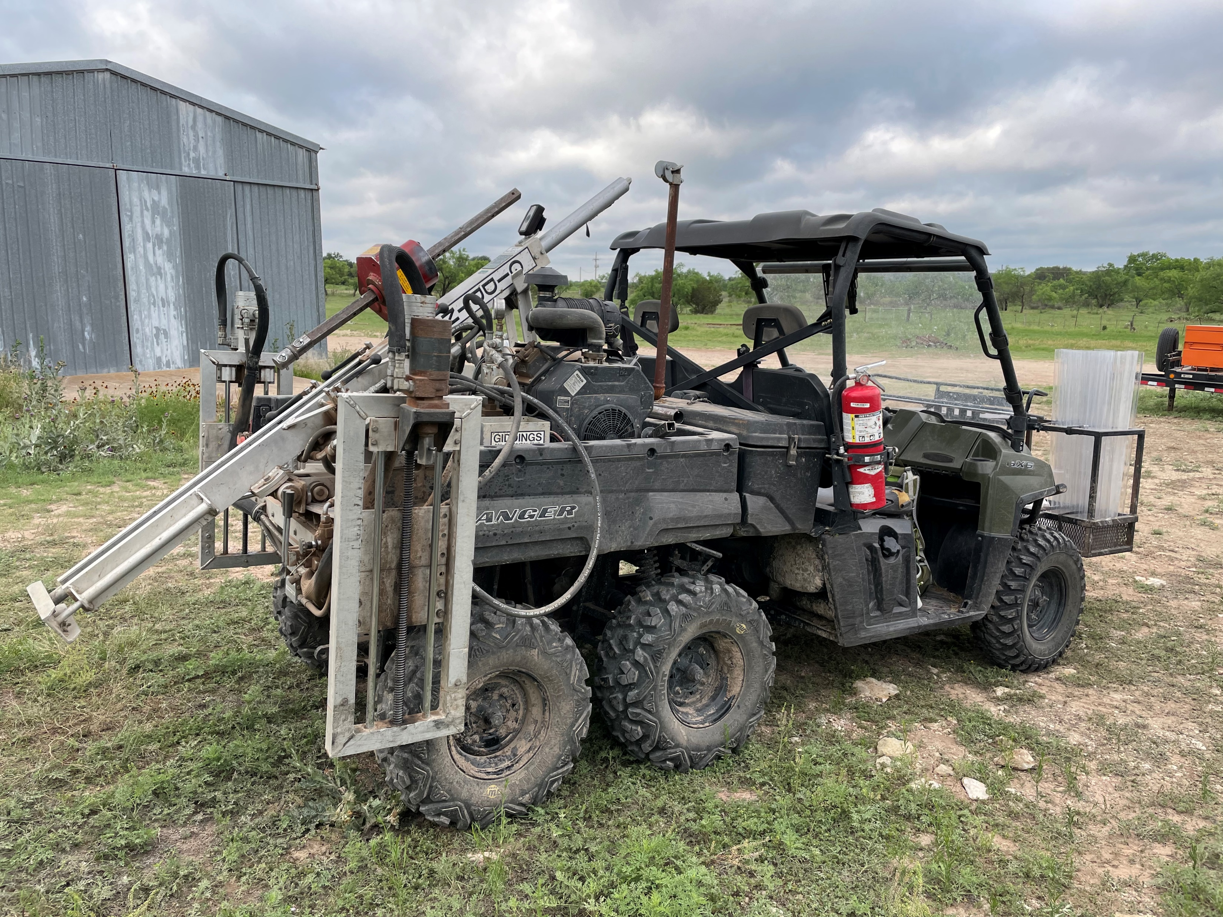
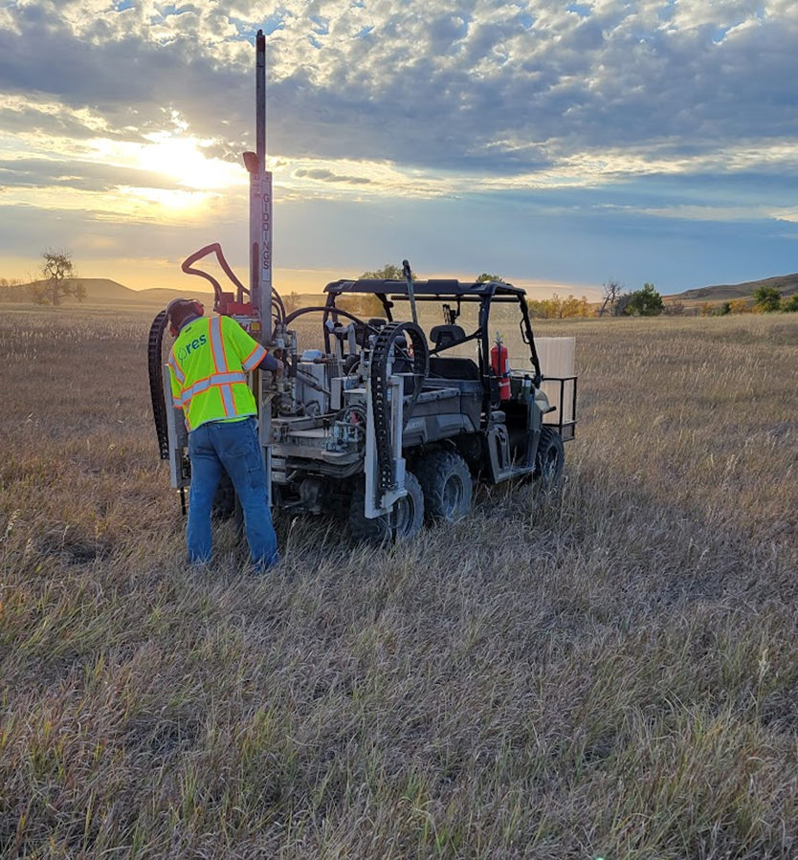
Sampling Procedure

Slide 17
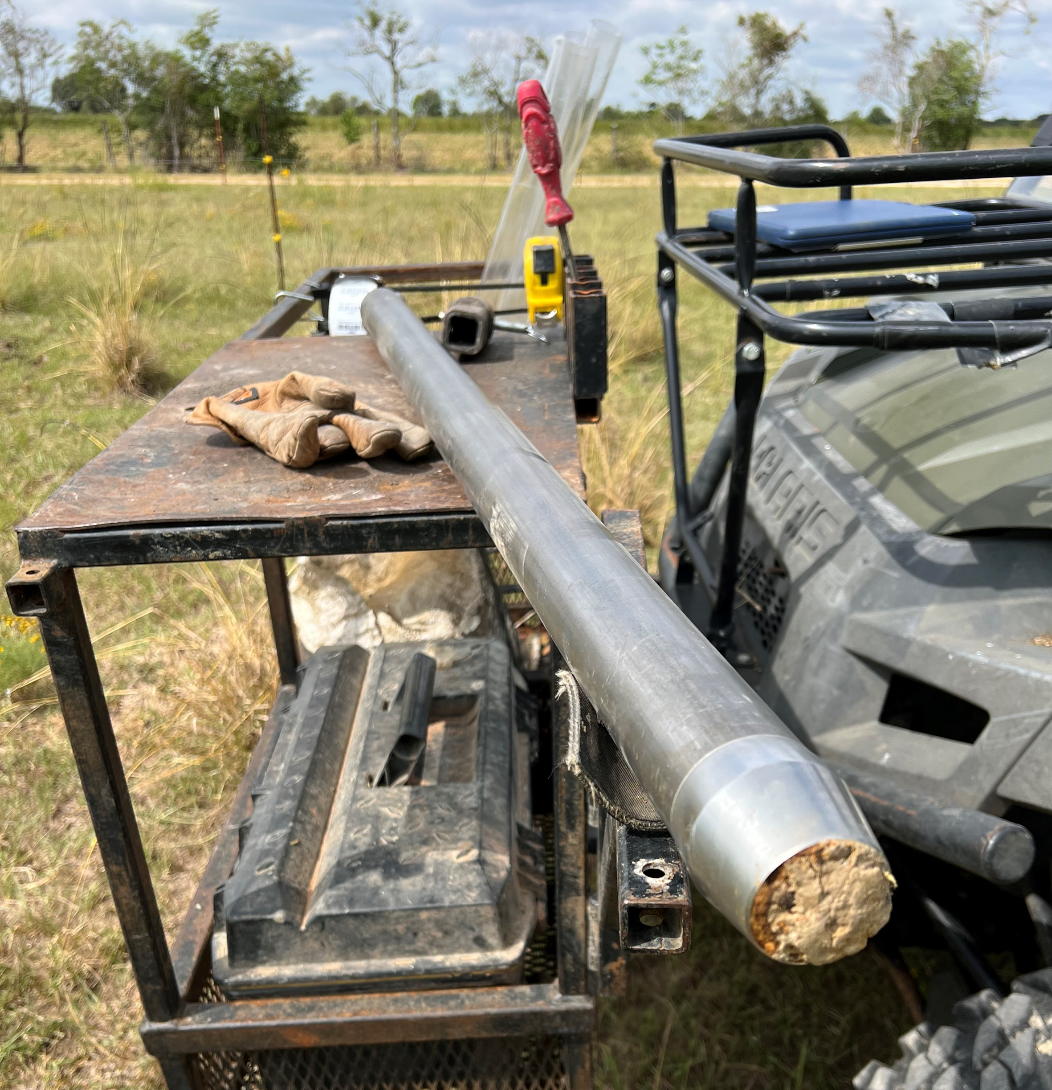
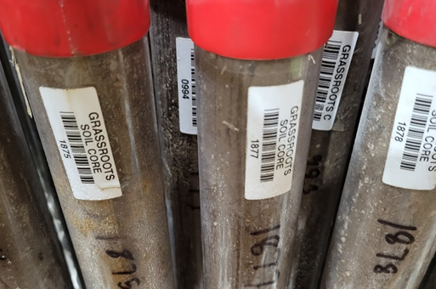
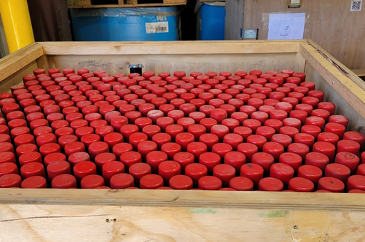
Sampling Procedure
Notes:
Details about the soil core sampling process.
Then they were sent to Cquester Analytics in Fort Collins, CO to do all the testing.

Slide 18
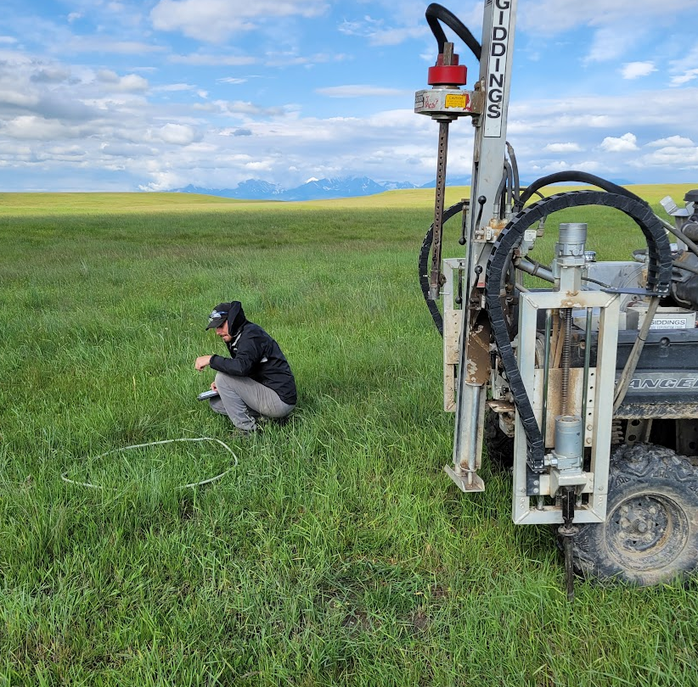
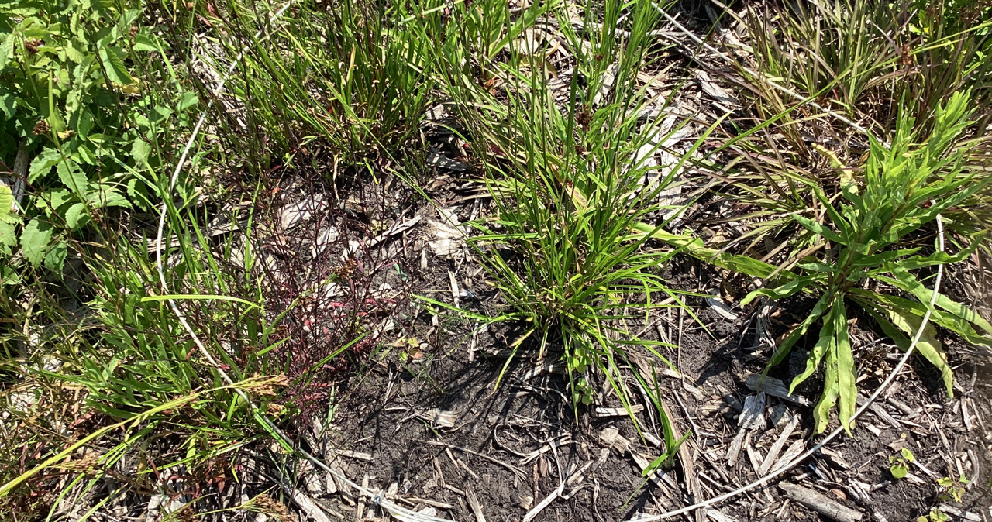
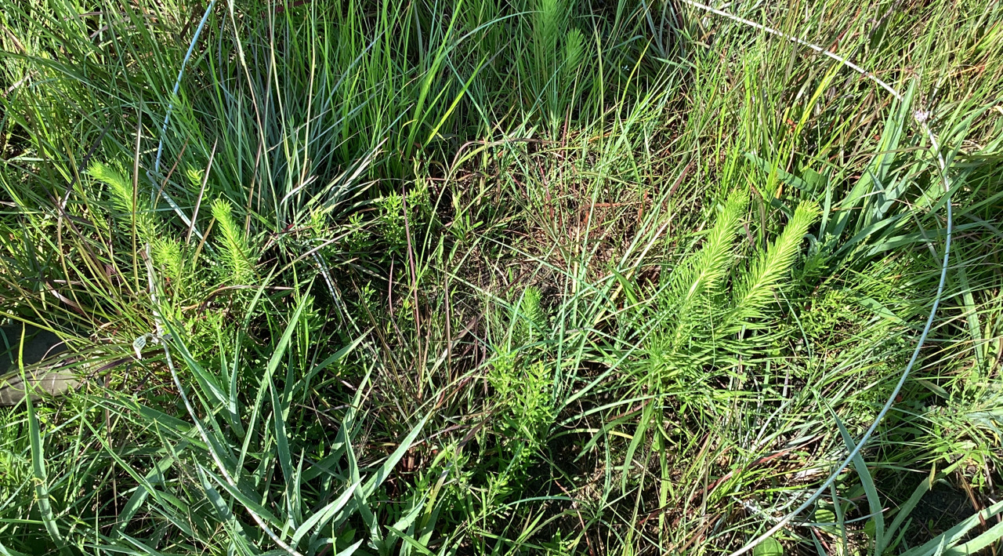
Sampling Procedure
Notes:
Fall and spring sampling effort for vegetation.
Listed all plant species within the 1-meter hoop and recorded absolute cover, as well as cover of bare soil, fine and coarse litter, and rock.
Later all of the species were further organized by plant type, growth duration, native status, and wetland indicator so they could have associated values for different analyses.

Slide 19
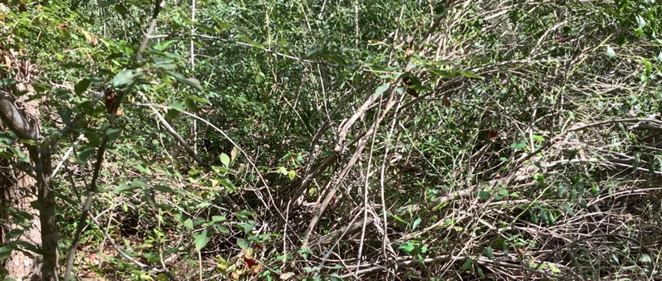
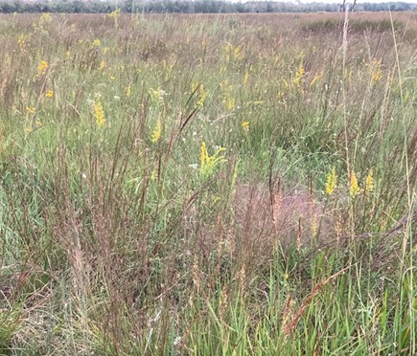
Sampling Procedure – Tallow dominated vs Remnant
Floristic Quality Index (FQI) = 7.5
FQI = 76
Notes:
-Tallow dominated included privet, etc
-FQI – measure of the native “quality” of an ecosystem. Larry Allain to discuss in more detail and some of the strengths and drawbacks next
-Even tallow-dominated units often contain native spp, not like an agriculture-to-remnant comparison

Slide 20
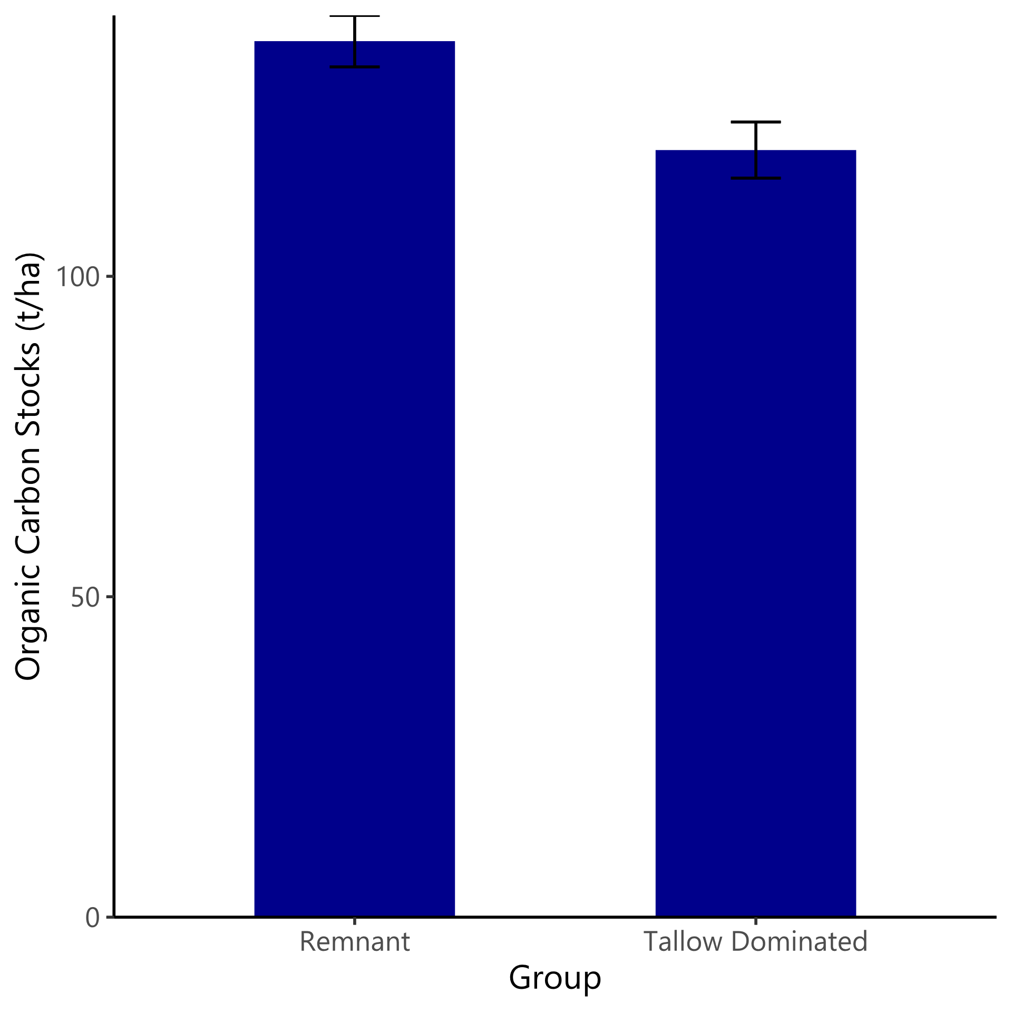
Results of SOC in Remnant vs Tallow-dominated zones
F_{1,75} = 5.175, p = 0.026
UHCC only
Notes:
Significant difference between the groups
Not easy to tell if the difference is due to invasion or whether invasion is due to lower SOC

Slide 21
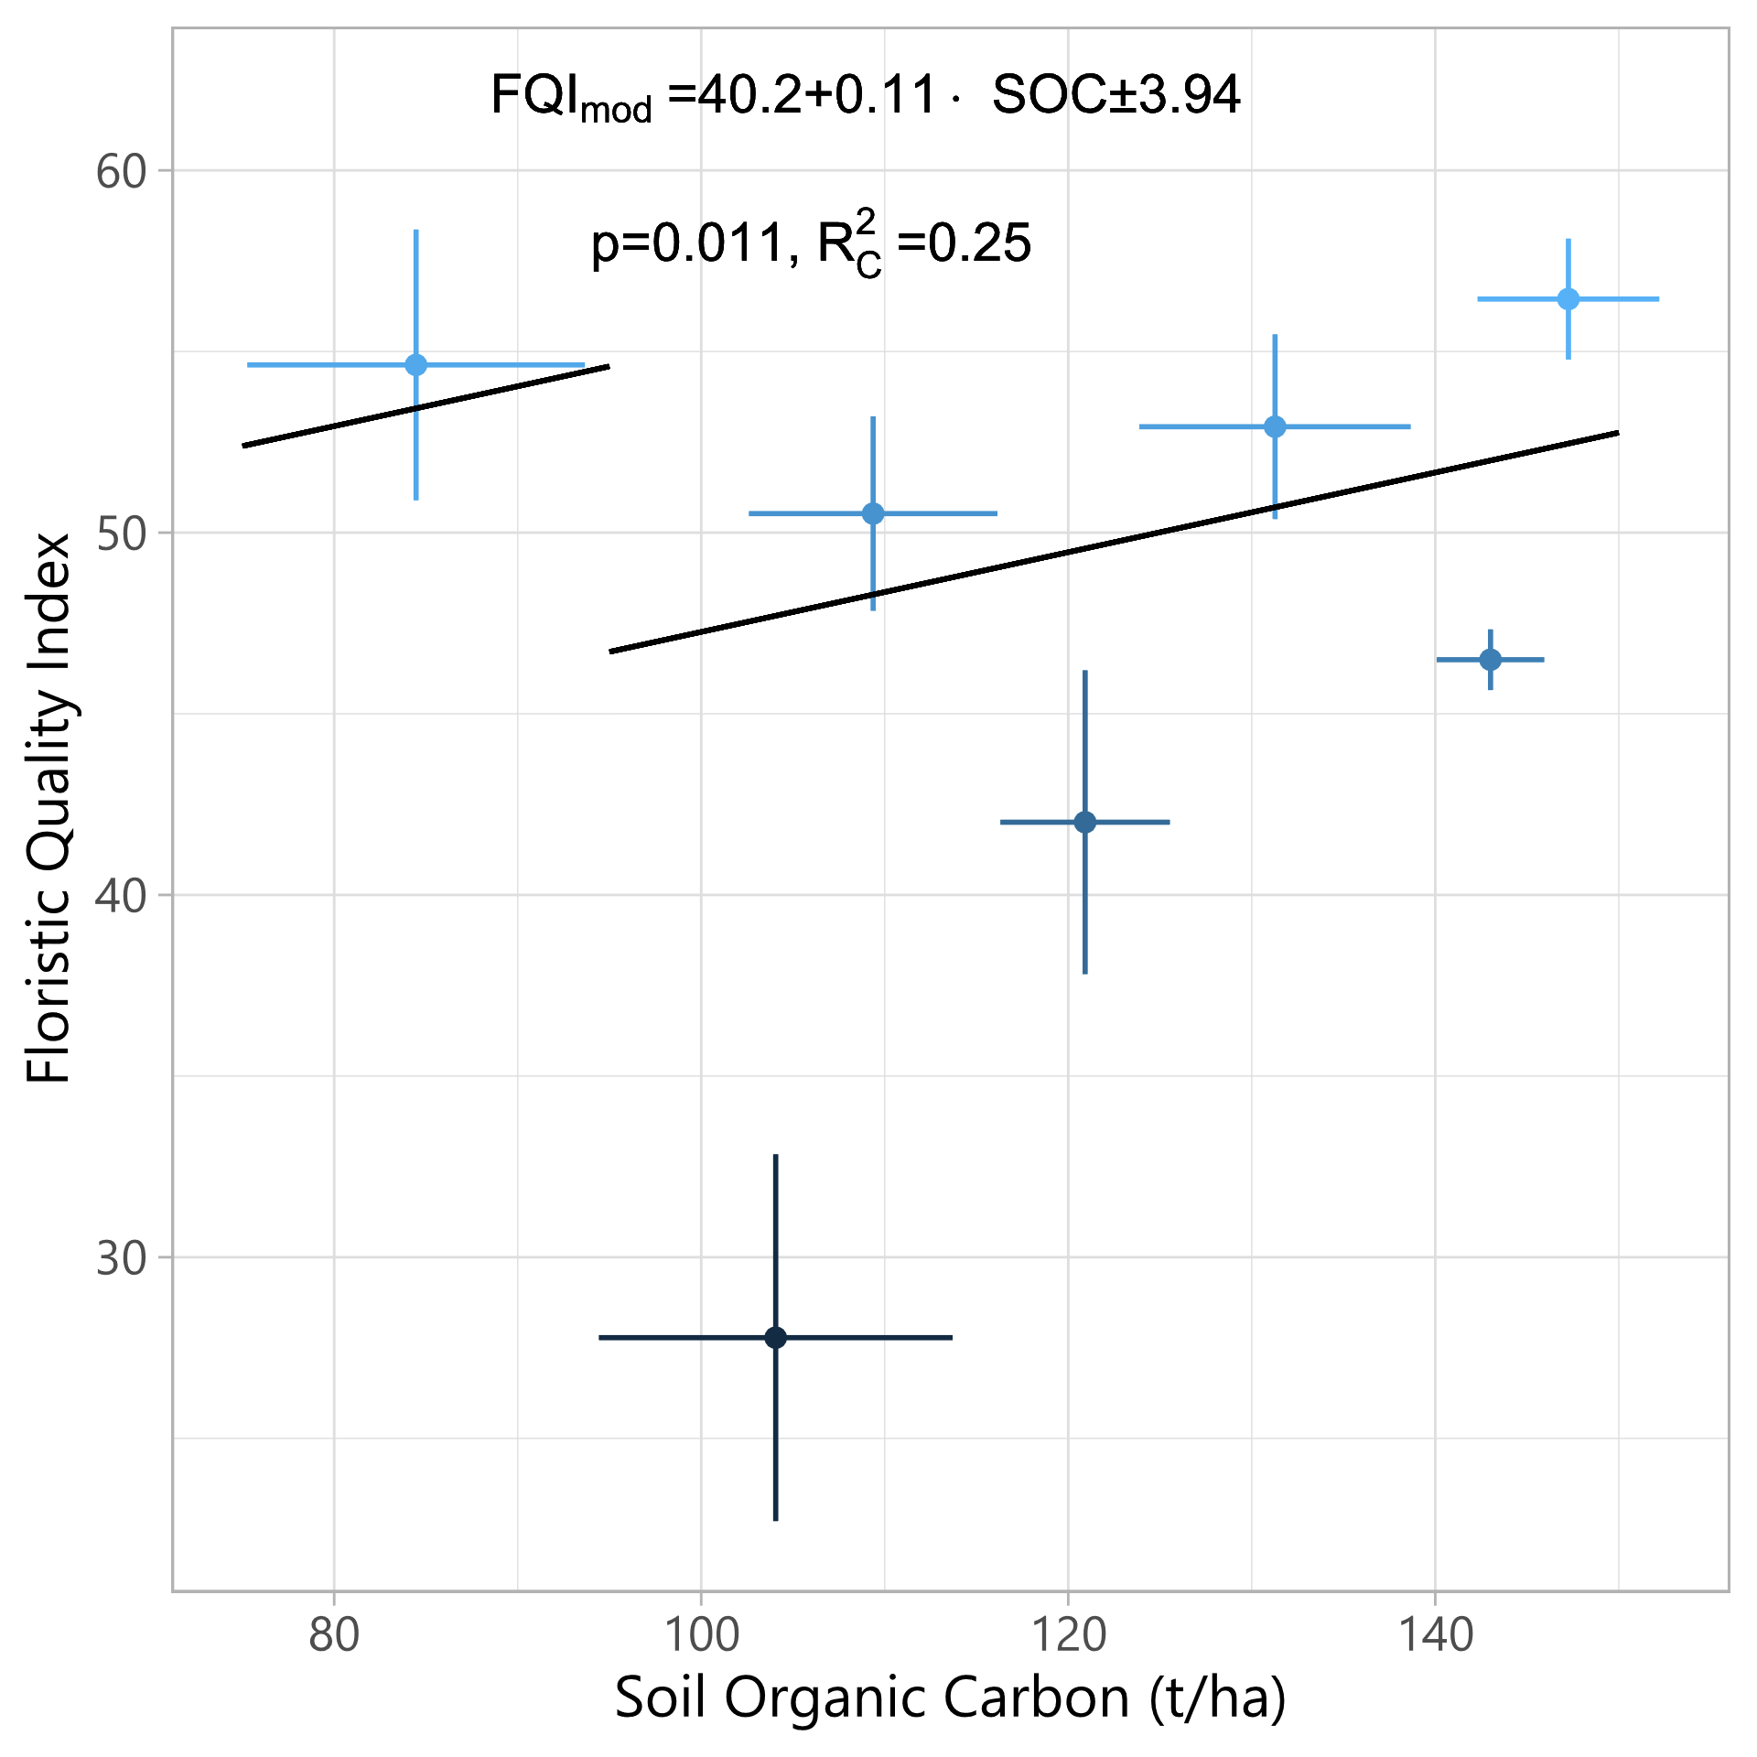
Relationship between SOC and FQI
Other factors:
  Pimple (mima) mounds and prairie potholes
  Recent management actions
  Oyster shells
  Short-term study
Notes:
Significant, but very weak relationship
Other factors that might affect this relationship:
-Micro-variations in topography and/or soil types
-Recent management actions: SOC changes on longer time scales than vegetation. SOC may lag FQI by years or even decades
-Oyster shells used for roads and parking lots. High Ca may affect SOC dynamics.
Is SOC an indicator of restoration success, or does higher quality indicate higher existing SOC?
More research is needed to understand the relationship
Chicken or egg? Does FQI drive SOC or the other way around?

Slide 22
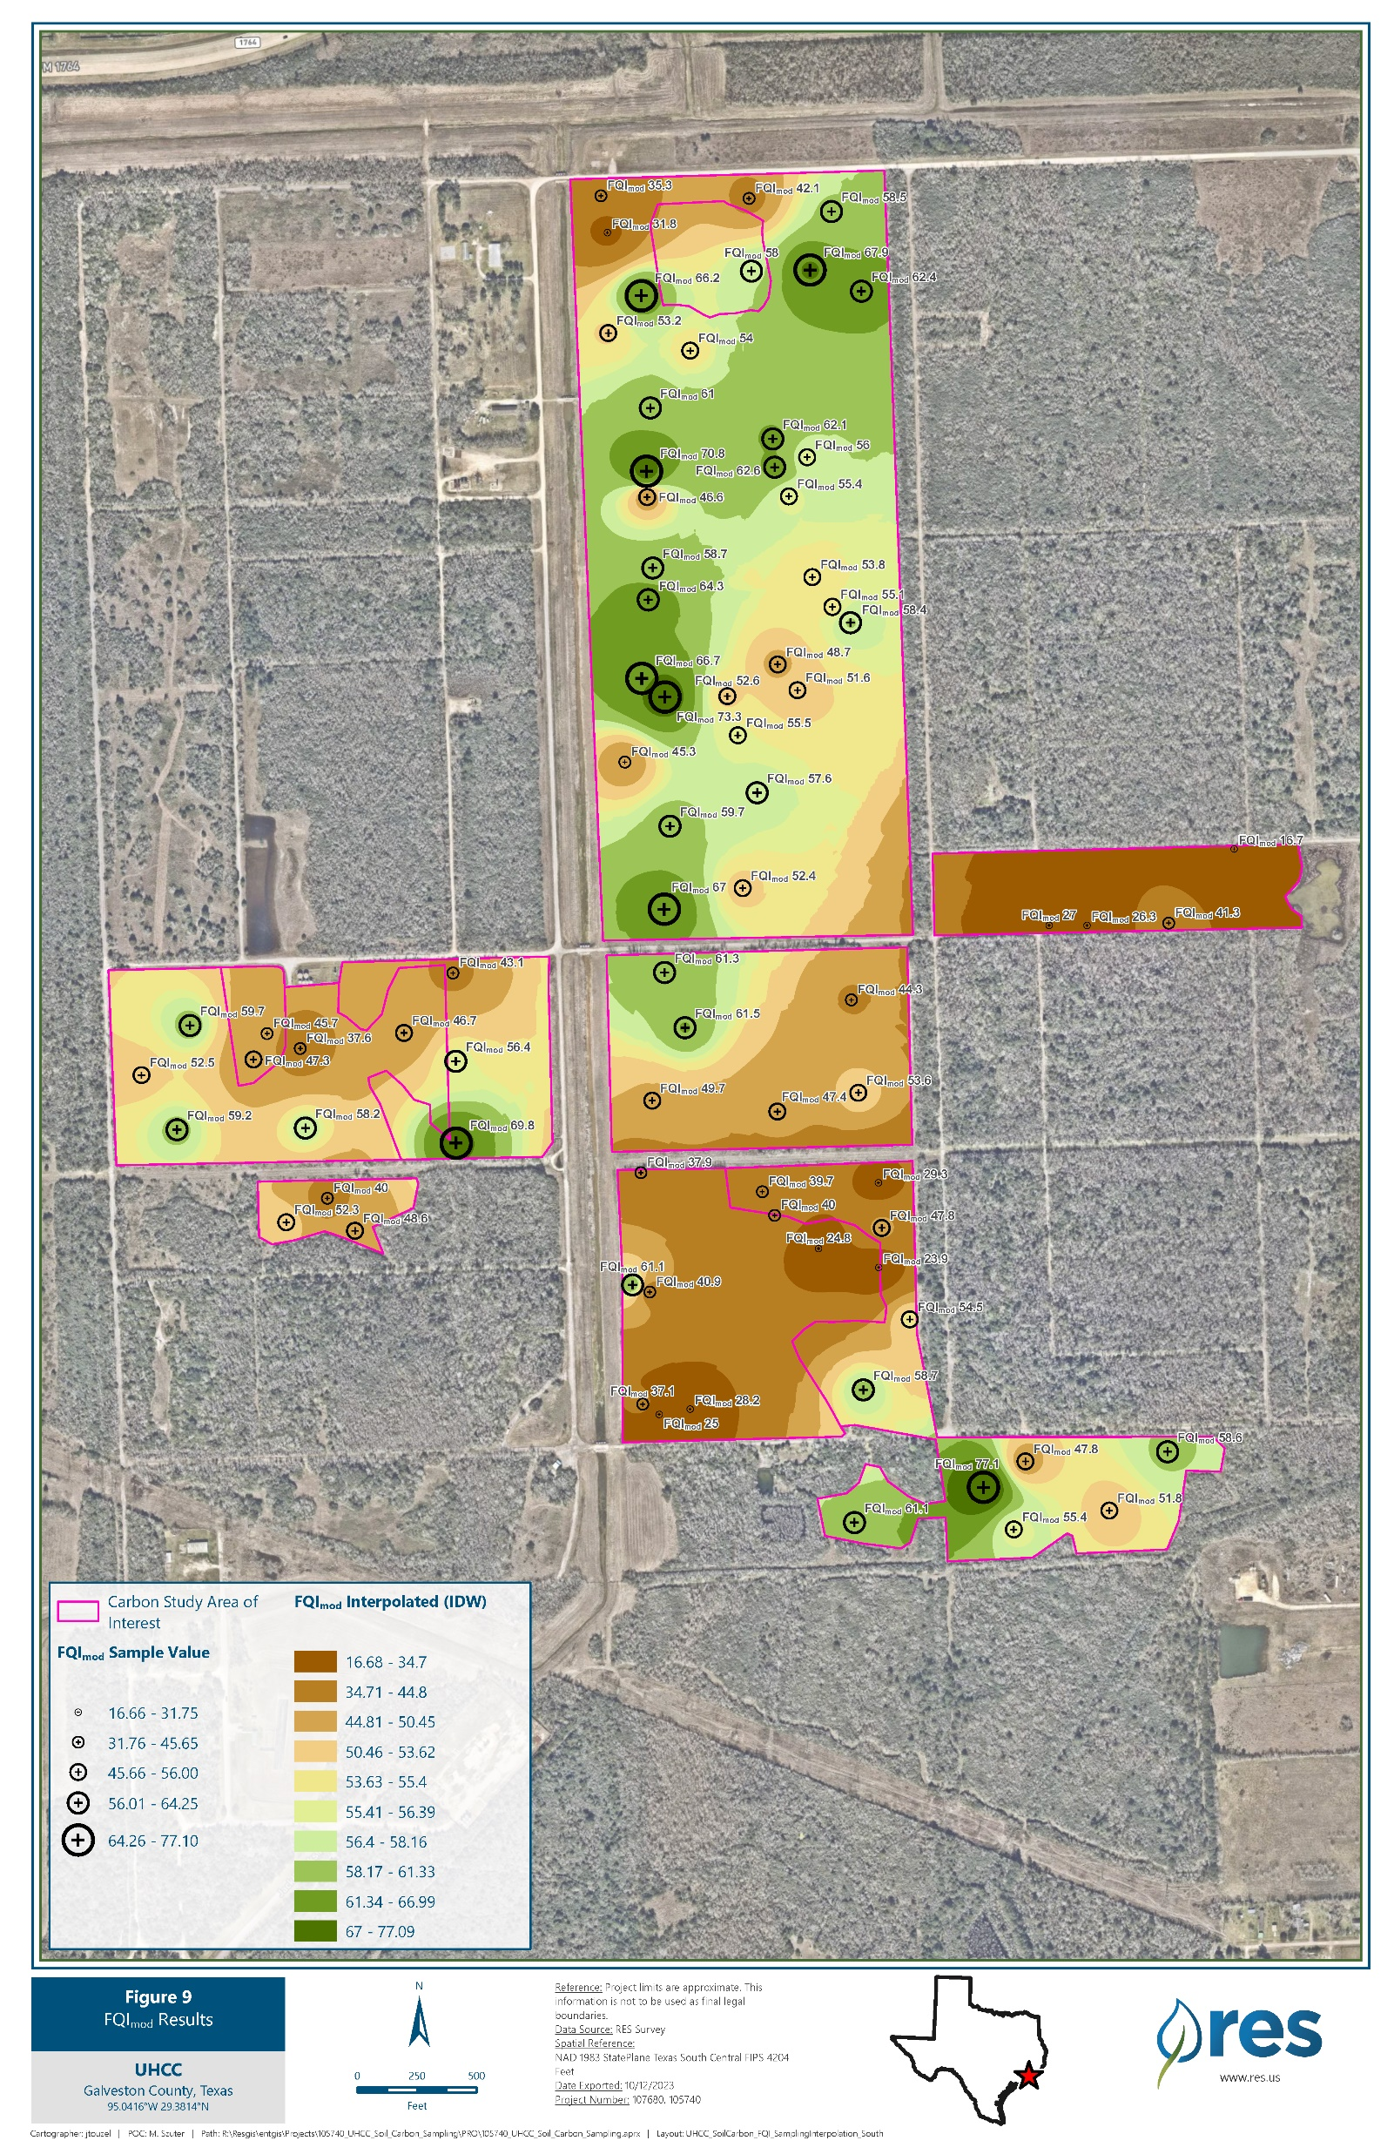
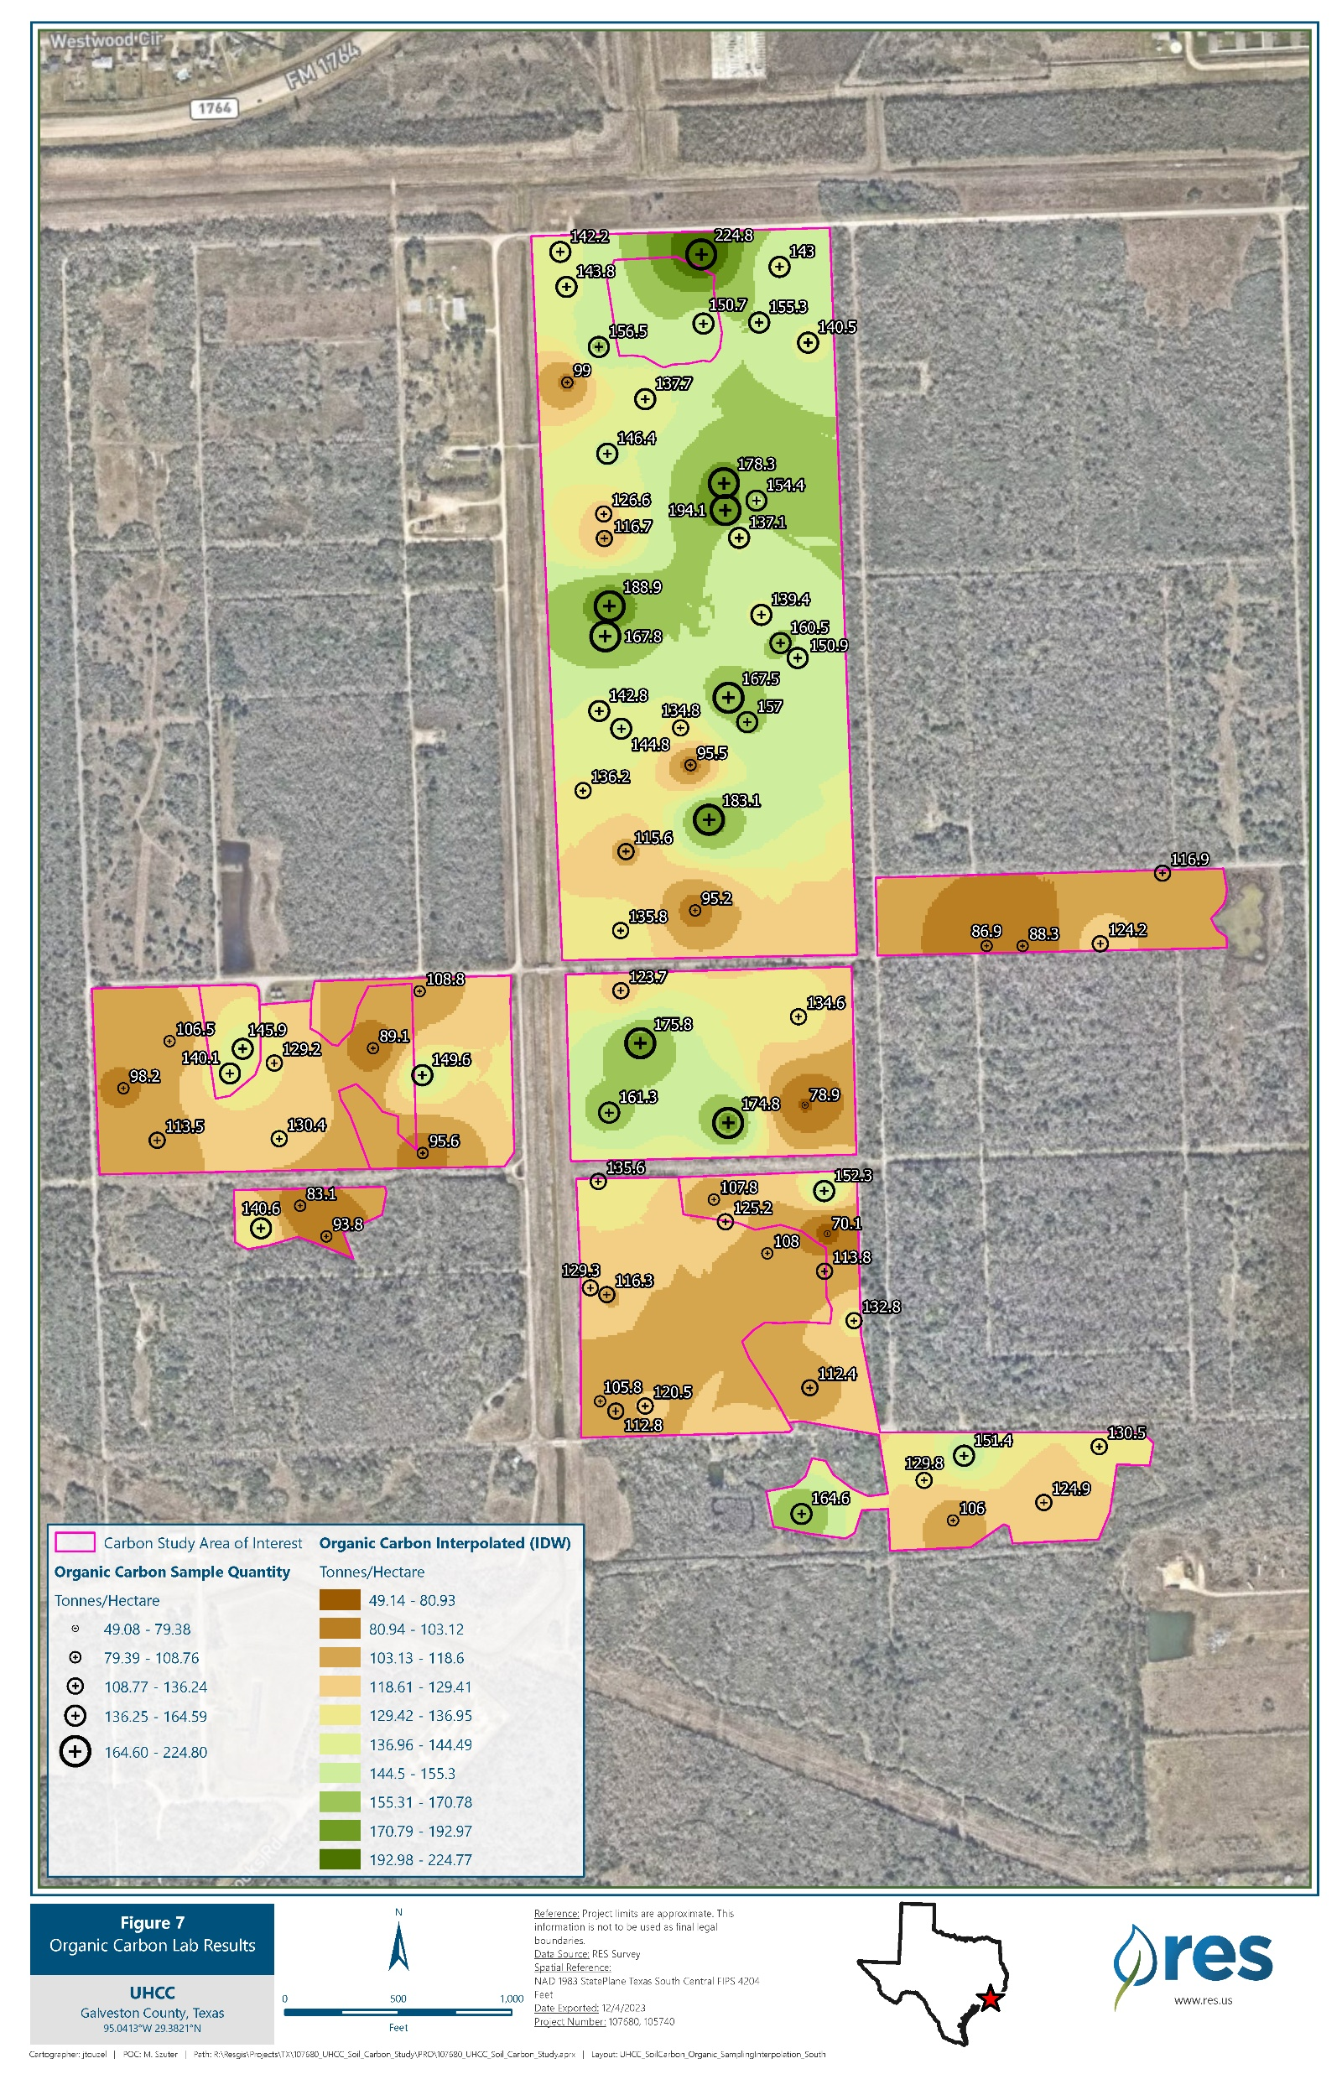
Spatial distribution of FQI and SOC (UHCC)
FQI
SOC
Notes:
-Describe the spatial distribution: green is higher and brown is lower.

Slide 23
Spatial distribution of FQI and SOC (Deer Park)
FQI
SOC
Notes:
-More difficult to see the relationship at Deer Park, possibly due to the different soil types (transition)

Slide 24
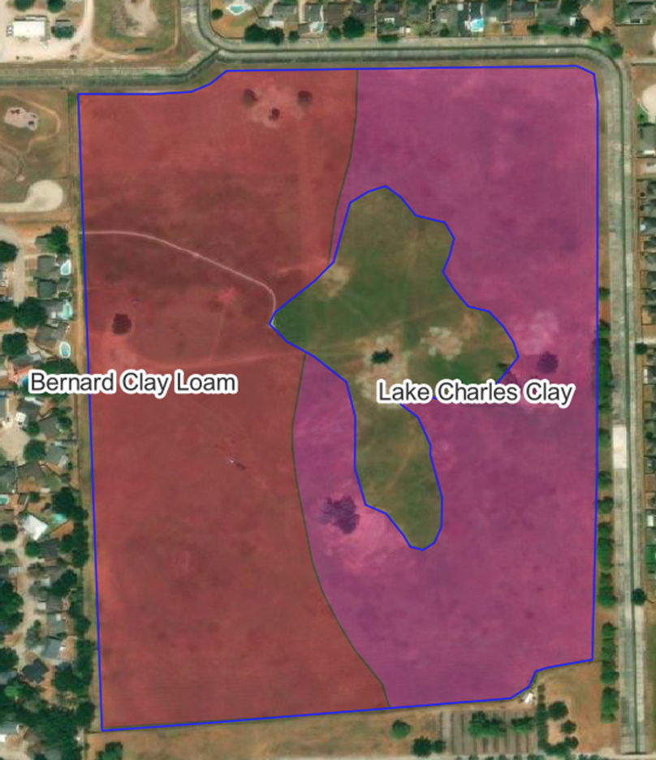
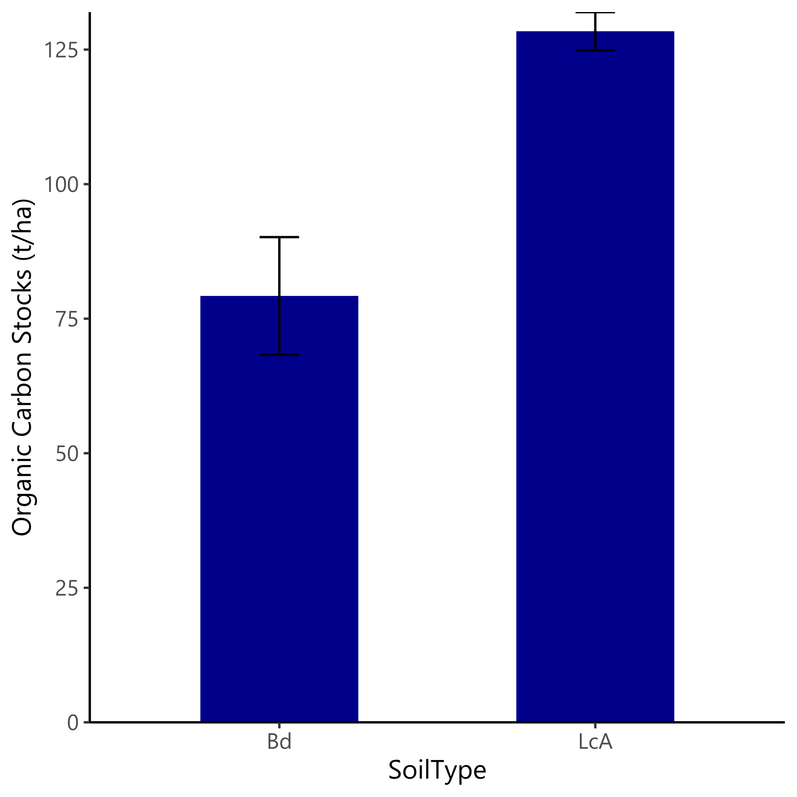
Results of SOC in different soil types
Notes:
-Map shows the different soil series seen onsite
-Soils not so starkly defined in reality
-Important to consider site characteristics when comparing remnant vs invaded systems, especially soils

Slide 25
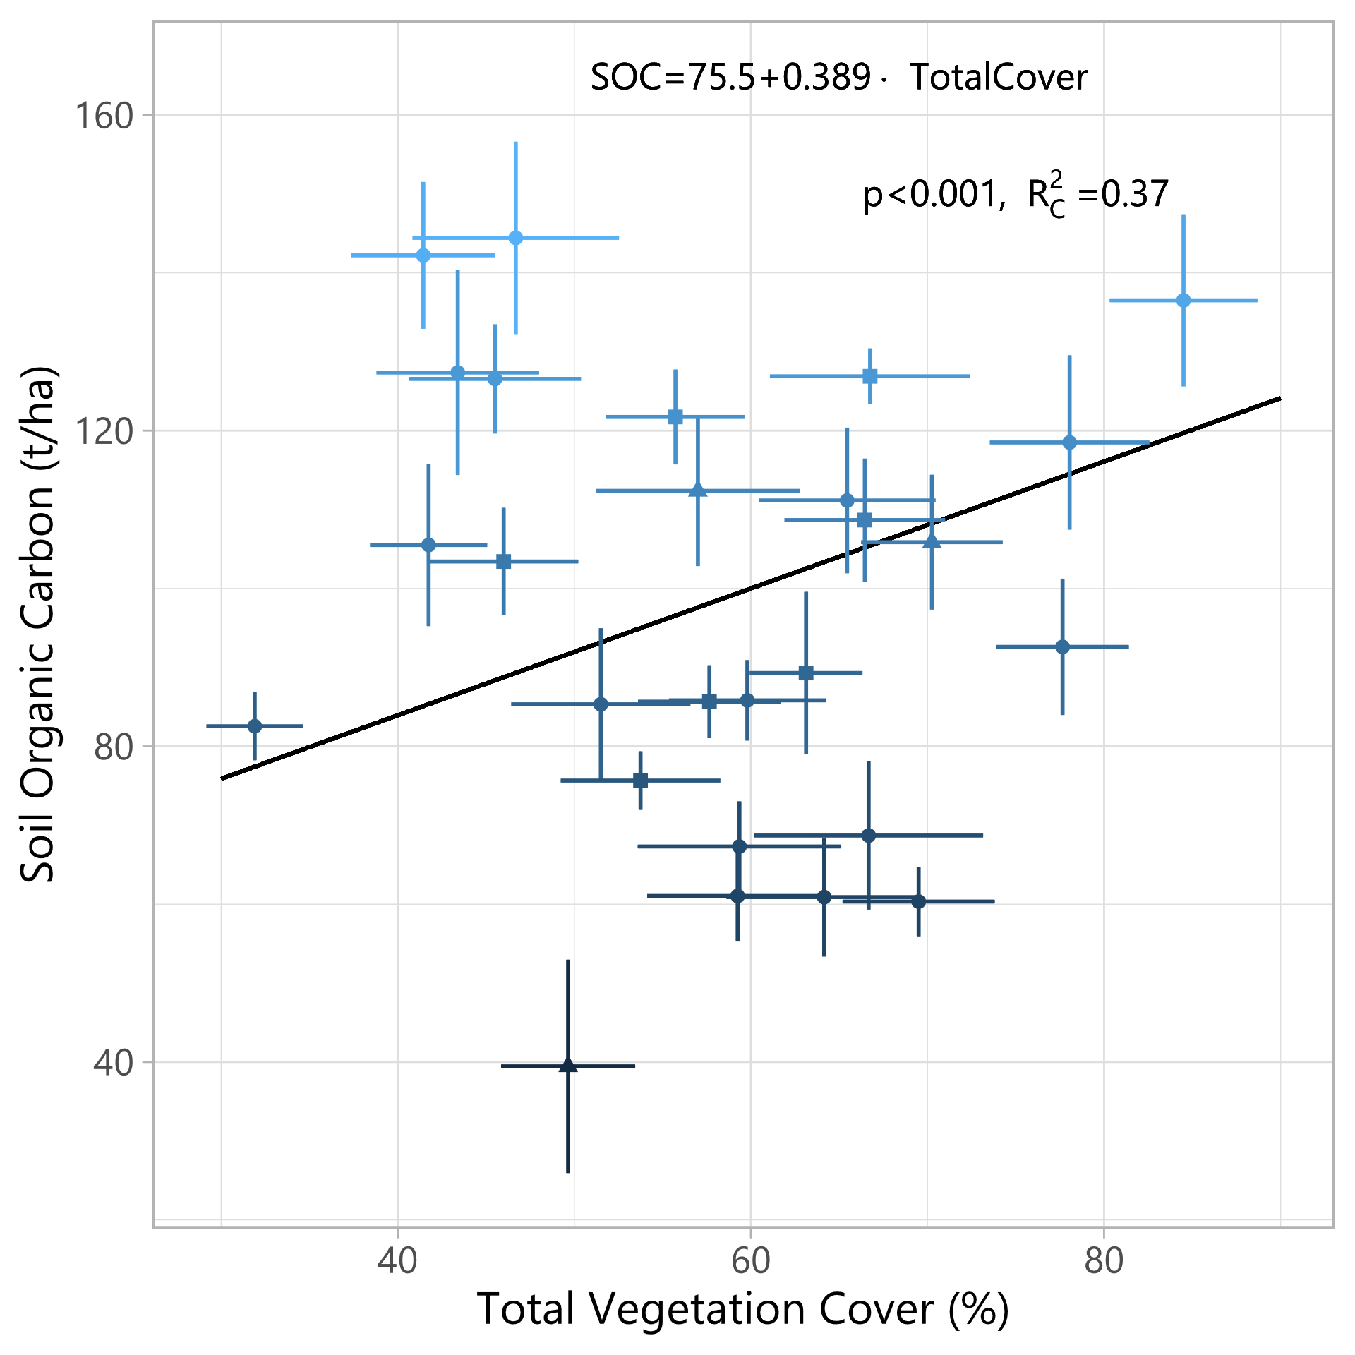
Results from the Northern Great Plains
27 Ranches covering three states in the Northern Great Plains
Diversity metric (species richness) or total native percent cover did not correlate with SOC, but total vegetation cover did
  Mixed effects model to account for site variations
Notes:
Much greater variation in site conditions made it more difficult to test for the effect of diversity
Not a planned chronosequence, so diversity and native spp values were not well controlled

Slide 26
SOC as a metric of restoration progress
Advantages
  Currently useful as a supplemental measure to traditional vegetation metrics for short term studies
  Can provide long-term (50+ years) restoration progress after vegetation communities have stabilized
  Potentially more effective when comparing tilled agricultural fields
Pitfalls and drawbacks
  Even relatively nearby and similar reference ecosystems can have very different SOC values
  Expensive relative to vegetation-based methods
  Drivers of SOC not fully understood yet
  Unclear causation

Slide 27
SOC as a metric of restoration progress
Future research
  More detailed chronosequence or longitudinal studies
  Additional studies of invaded remnant (never tilled) ecosystems

Slide 28
Questions or comments?

