Slide 1


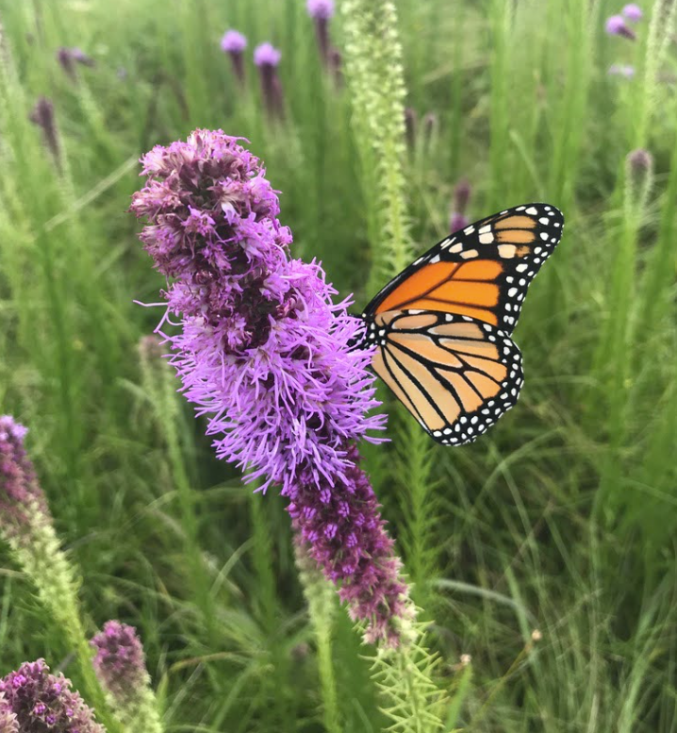

Natural resources are sources of life. It is our goal to improve our quality of life through restoring our natural resources.

Slide 2
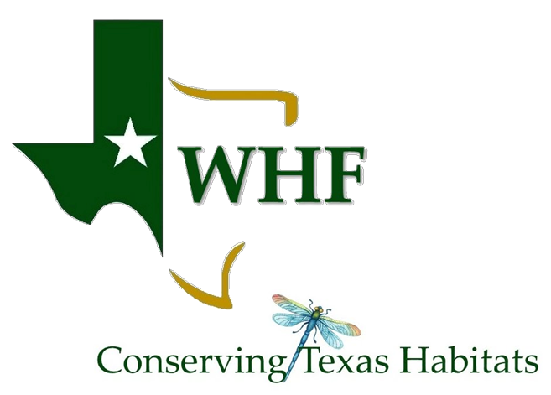
WHF is a 501(c)(3) nonprofit organization working to create resilient grasslands and healthy watersheds statewide.
Our mission is to provide on-the-ground restoration, management and generational sustainability of prairie habitat for the conservation of soil, water, air and wildlife.

Slide 3
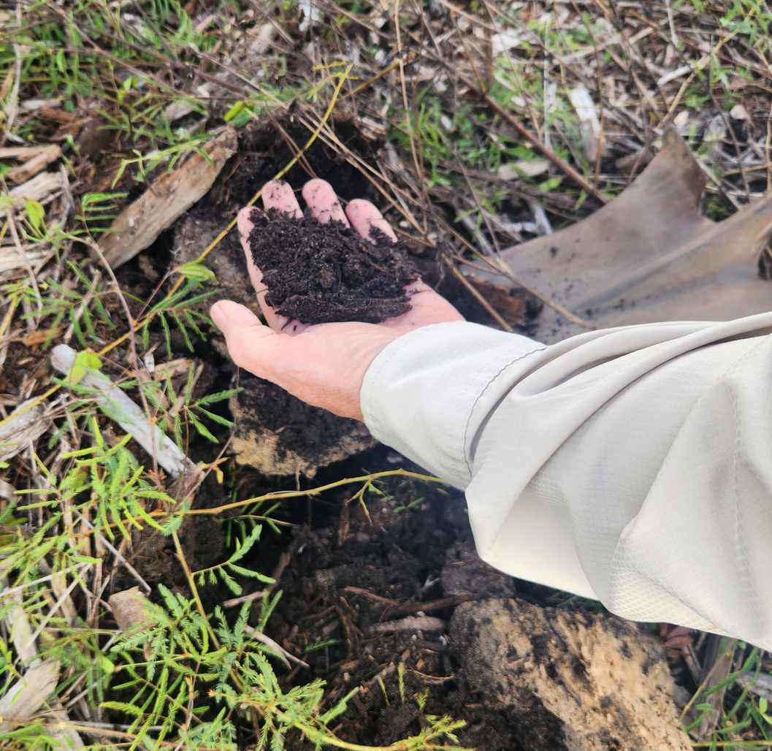
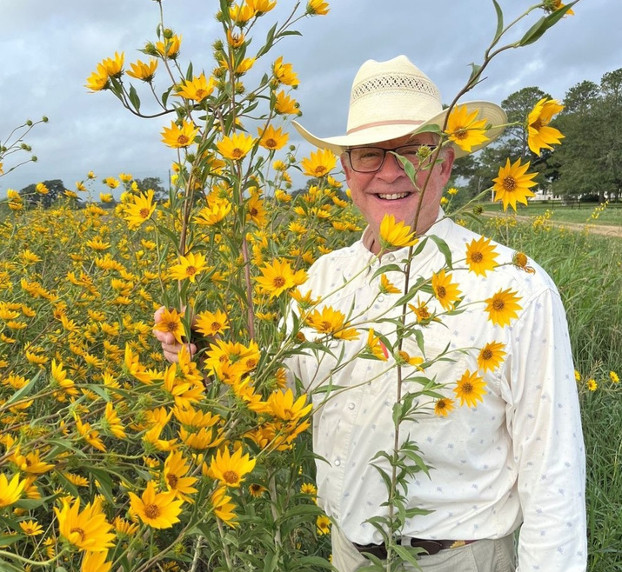
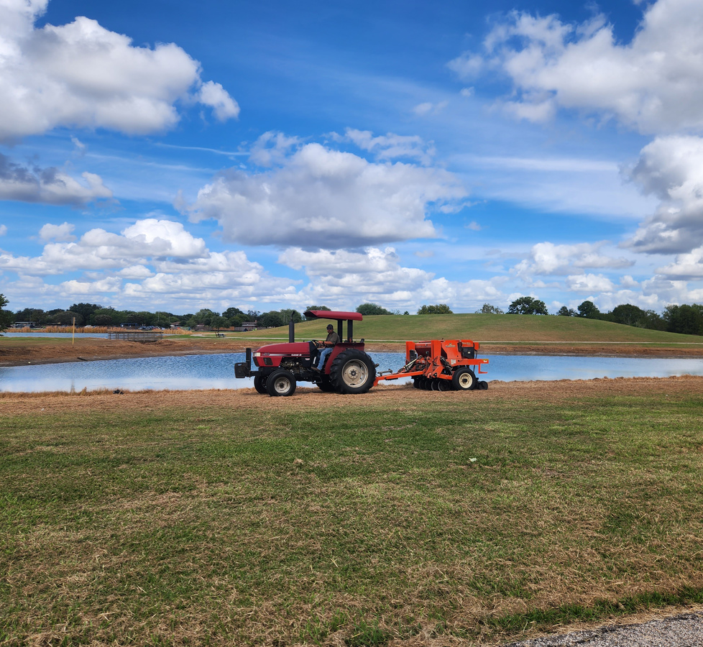
SITE ASSESSMENT
HABITAT MANAGEMENT PLAN
IMPLEMENTATION
Direct technical guidance to landowners through on-site consultations. WHF will identify their property’s possible land use issues, opportunities, and solutions.
Engaging land managers in the planning of conservation practices with the goal of providing measurable improvements of all natural resources present.
Acres under improved management as a result of planned grazing, prescribed burning, invasive species control, rangeland plantings, and more.

Slide 4
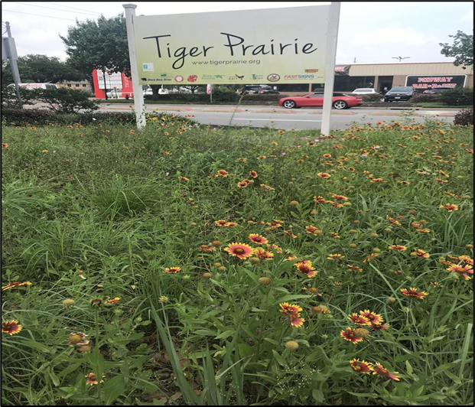
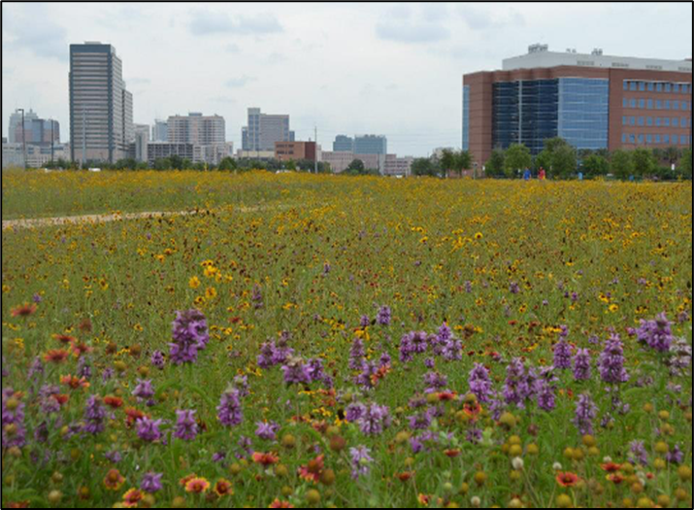
From small plots of land in the middle of Houston to large acreage ranches, we work to restore public and private lands to their highest ecological function.
URBAN
Pocket prairies and wildflower seedings in greenspaces amongst urban areas, as well as full prairie restoration sites.
Katy High School
MD Anderson Campus

Slide 5
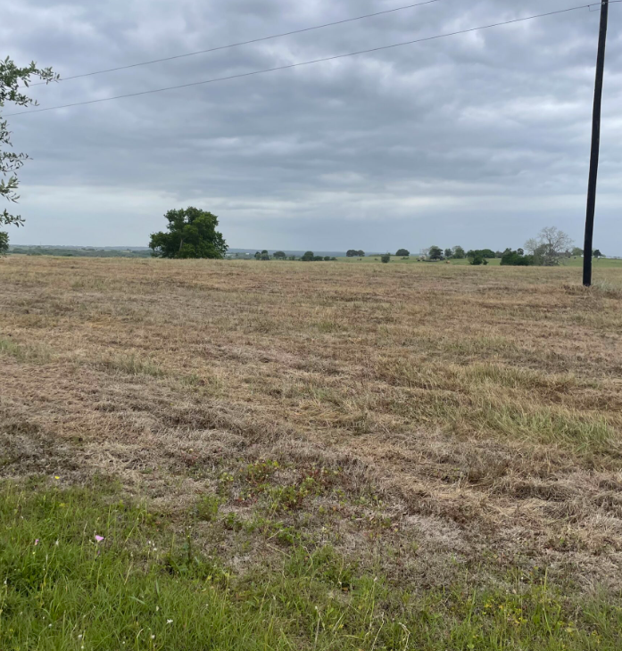
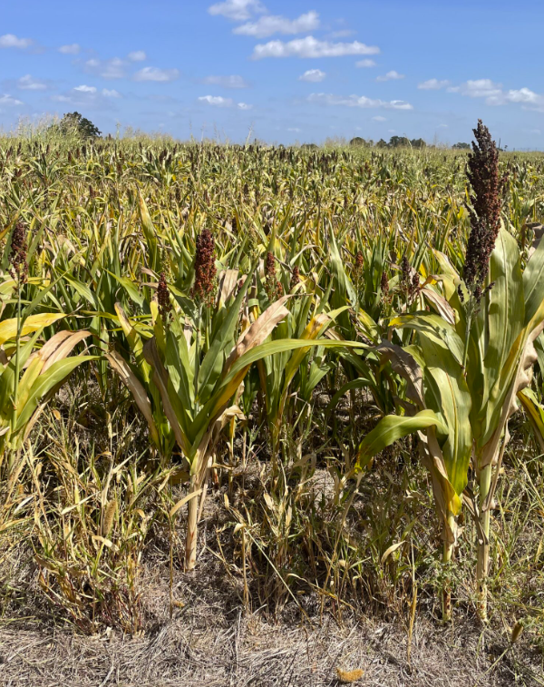
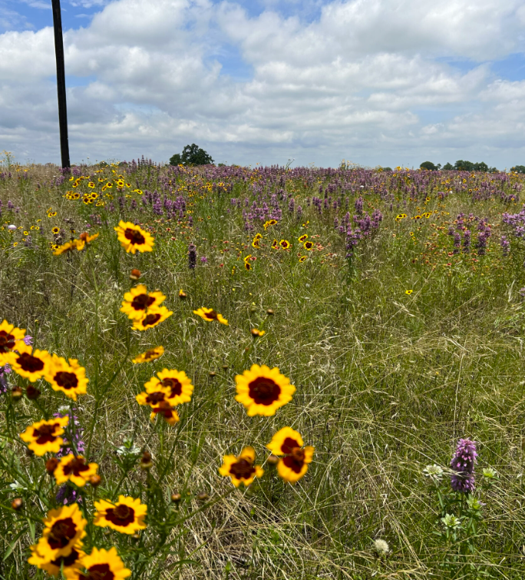
Prairie and grassland restoration of large acreage ranches, as well as regenerative agriculture management practices.
RURAL

Slide 6
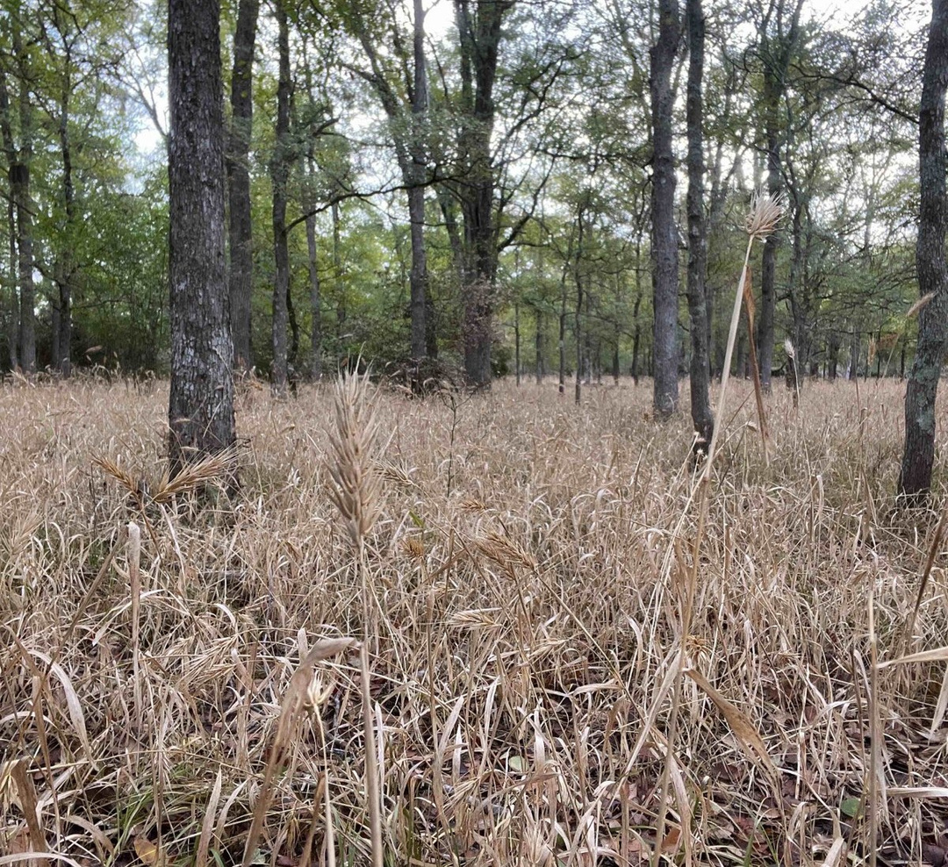
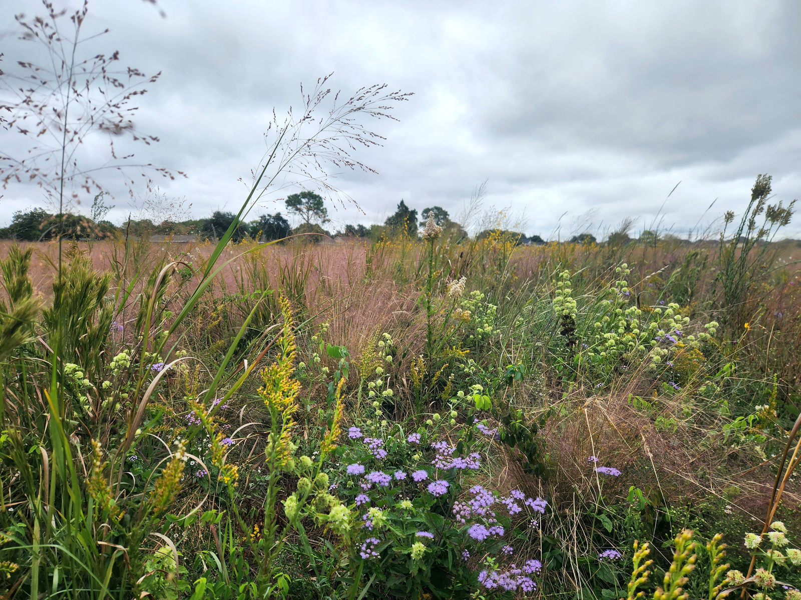
Sustaining Habitat With
Best Management Practices
Technical assistance provided at no cost to the landowner.
Using best management practices to restore public and private lands to their highest ecological function.
  Regenerative agriculture (adaptive grazing, cover crops, use of no-till drill).
  Restoring native habitat (brush management, invasive species control, prescribed burns, native seeding).

Slide 7
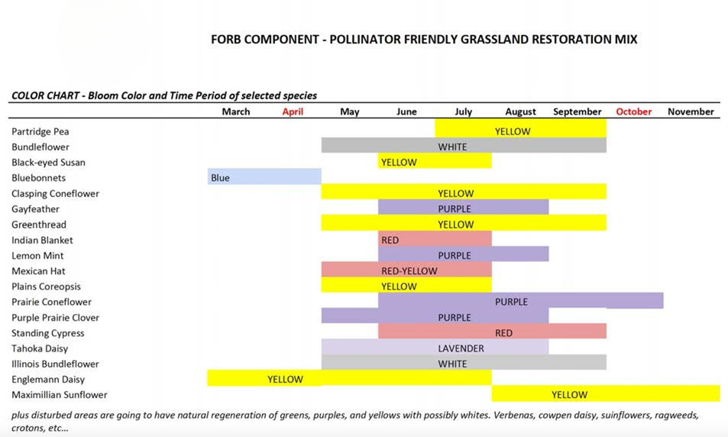
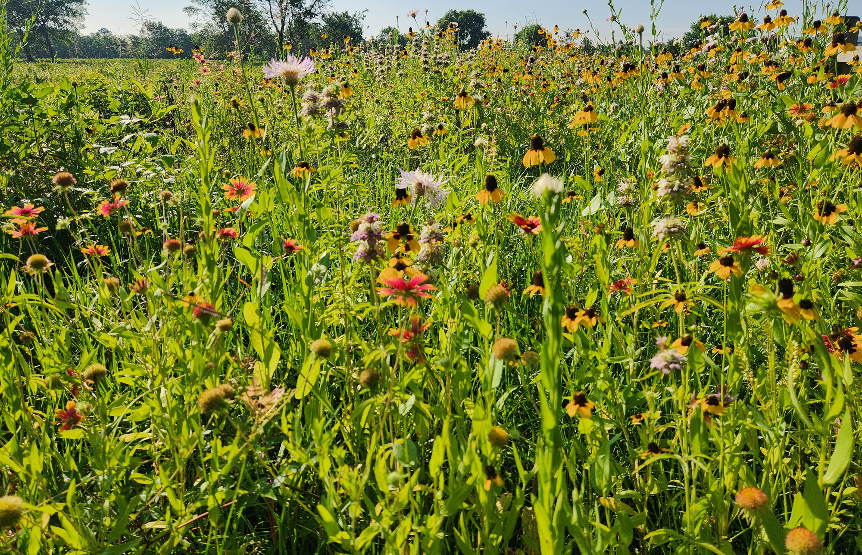
Pollinator Friendly Mixture
A percentage of commercially available native grass seed is planted along with locally harvested native grasses and forbs for wildlife benefit.
Incorporation of a diverse mixture of native annual and perennial forbs is provided to ensure a blooming period and floral resources throughout the pollinator year.

Slide 8
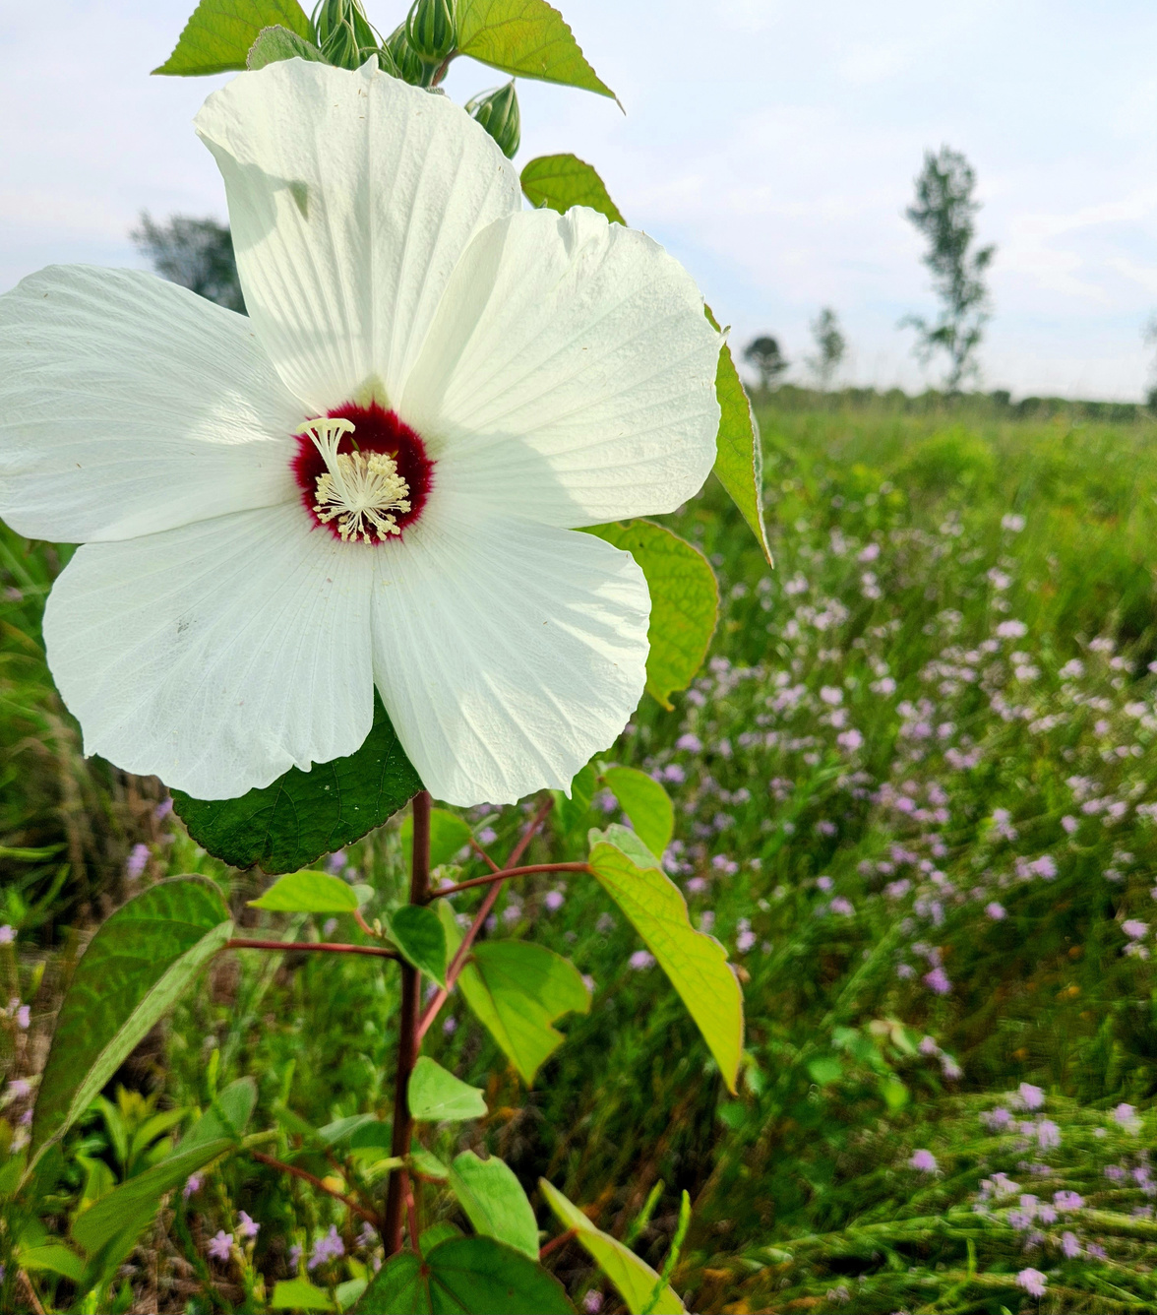



Made possible through...
Texas Coastal Prairie Initiative (TCPI)
National Fish and Wildlife Foundation (NFWF)
America the Beautiful Challenge
Natural Resources Conservation Service (NRCS)

Slide 9

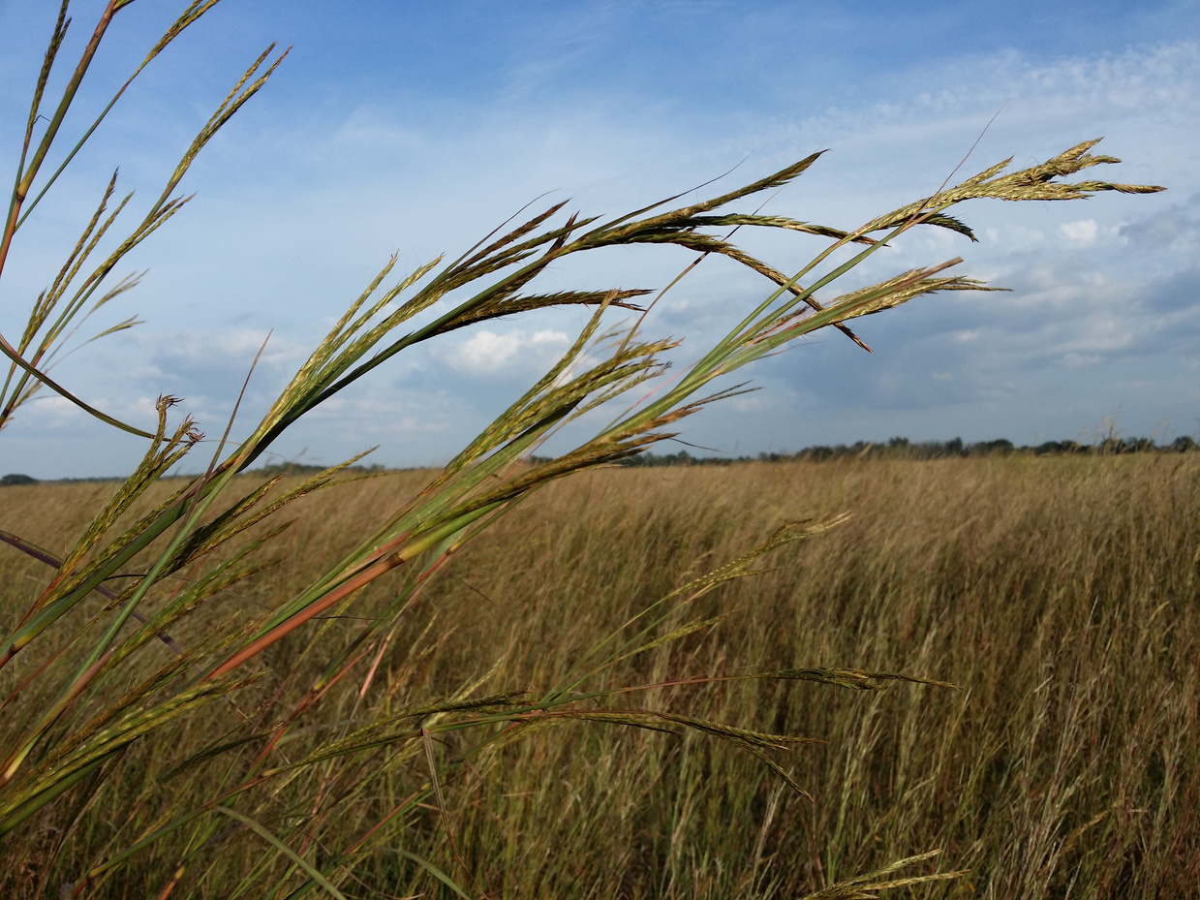
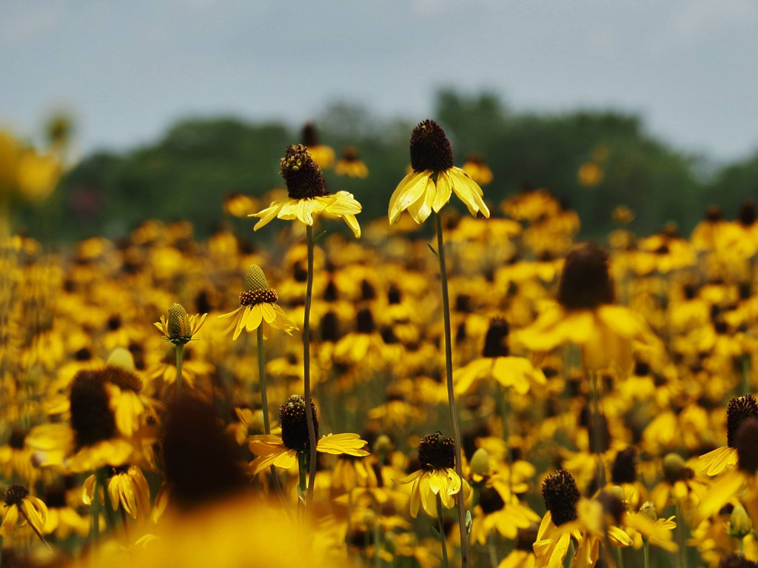


CONNECT WITH US
210-422-1600
whf-info@whf-texas.org
www.whf-texas.org
Follow us on social media! @whftexas

