Slide 1
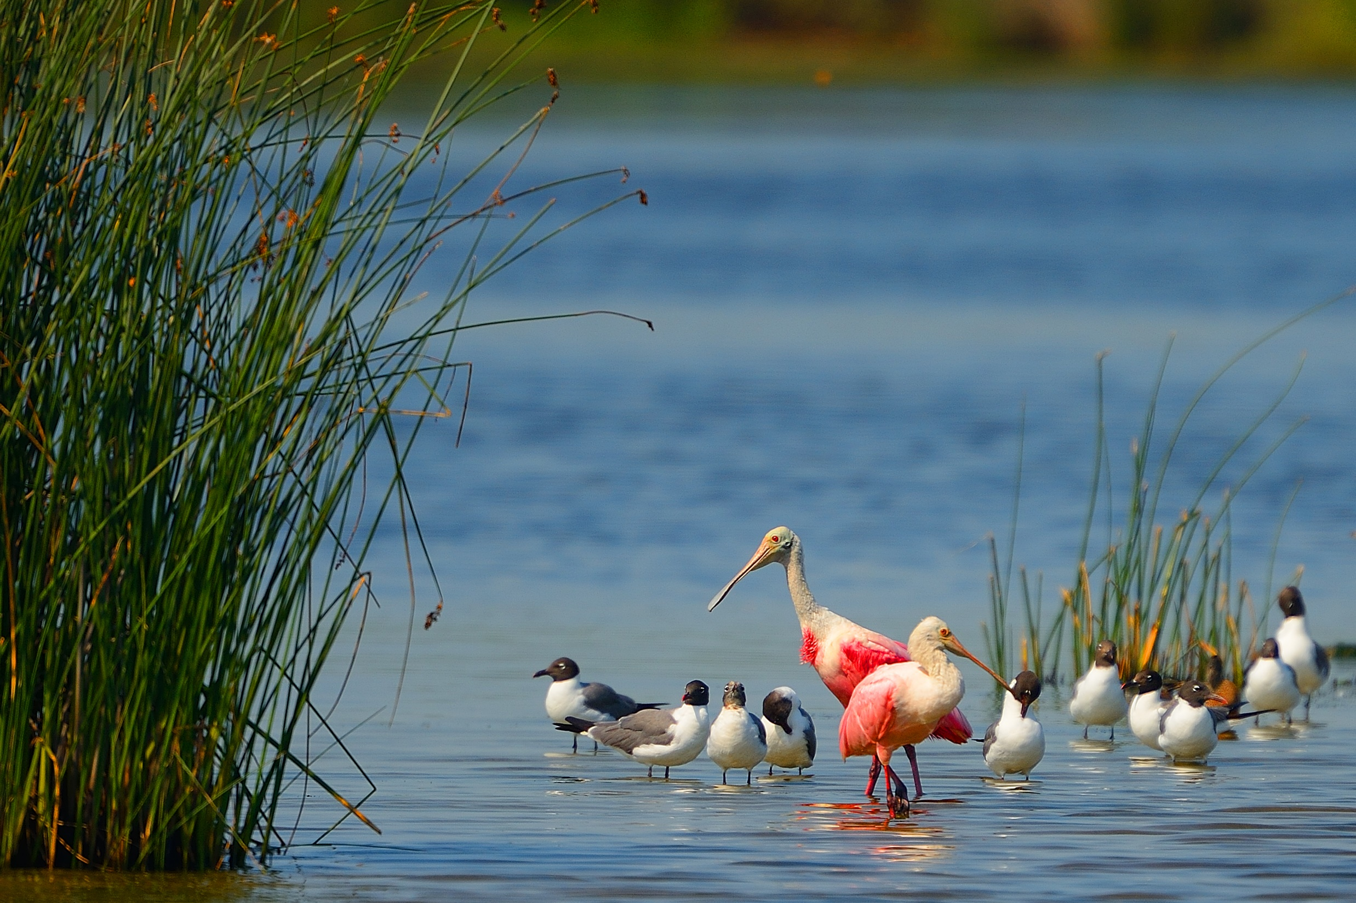

Chocolate Bay Preserve
Ricci Simmons, Conservation Stewardship Manager

Slide 2
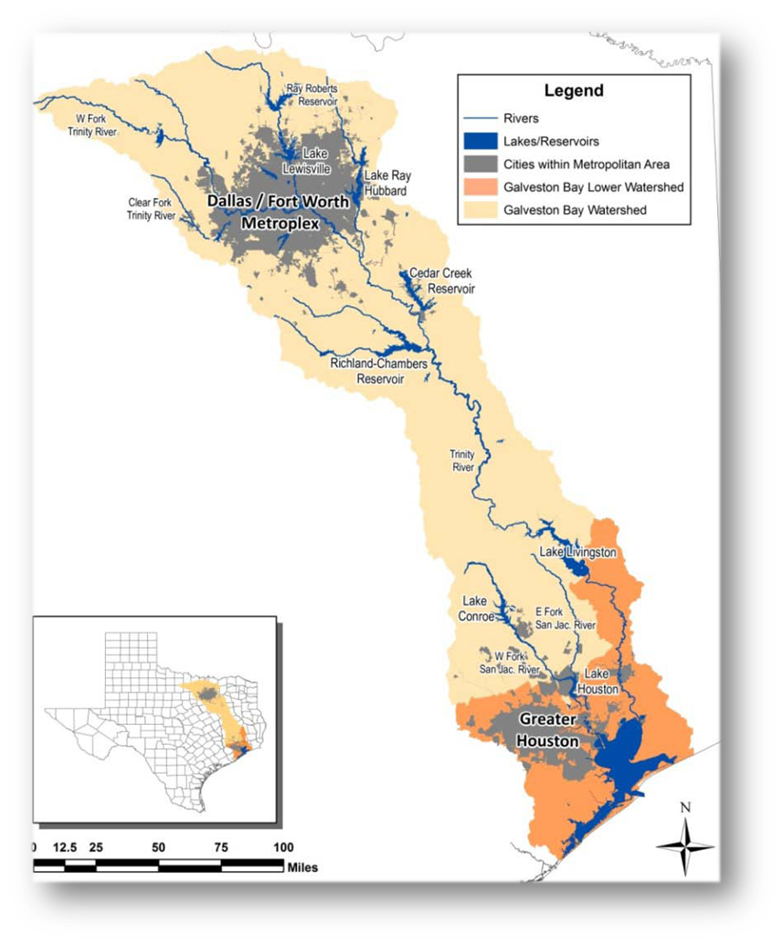
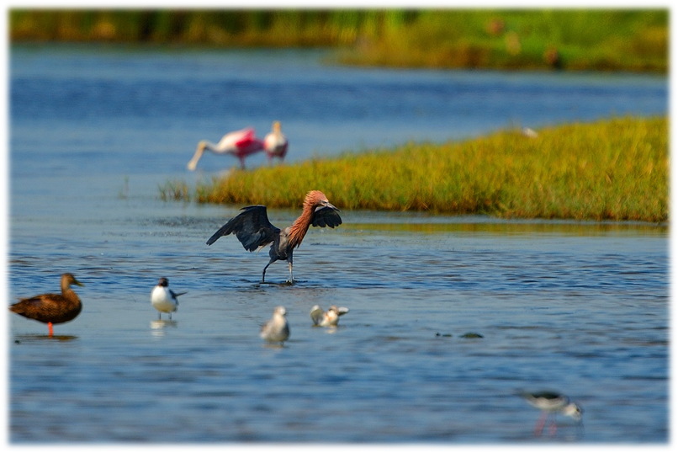

Where we work
The mission of the Galveston Bay Foundation is to preserve and enhance Galveston Bay as a healthy and productive place for generations to come.
Notes:
We accomplish our mission through 4 Program Areas – Research, Education, Advocacy, and Conservation (Land Protection)

Slide 3
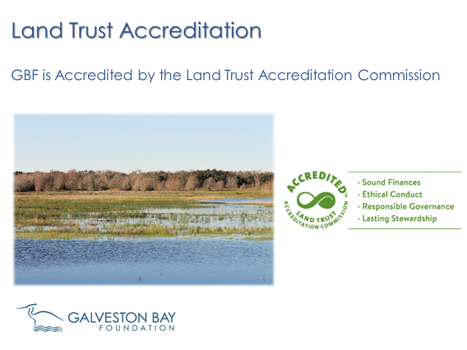
Notes:
Provides organizational stability and consistency with national standards and practices.
Has built structure as our land trust continues to grow

Slide 4
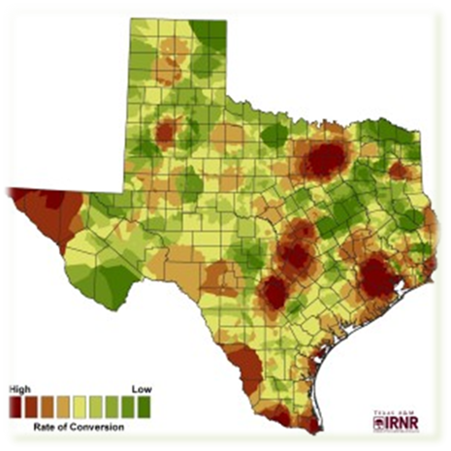
Land Conservation Program Objectives
Conserve land within the Galveston Bay watershed to:
  Preserve ecologically sensitive areas and rare plant communities
  Provide habitat for local and migratory wildlife and fishery species
  Maintain or Improve Water Quality
  Coastal Resiliency, Carbon Storage and Sequestration, Ecosystem Services for Coastal Communities

Slide 5
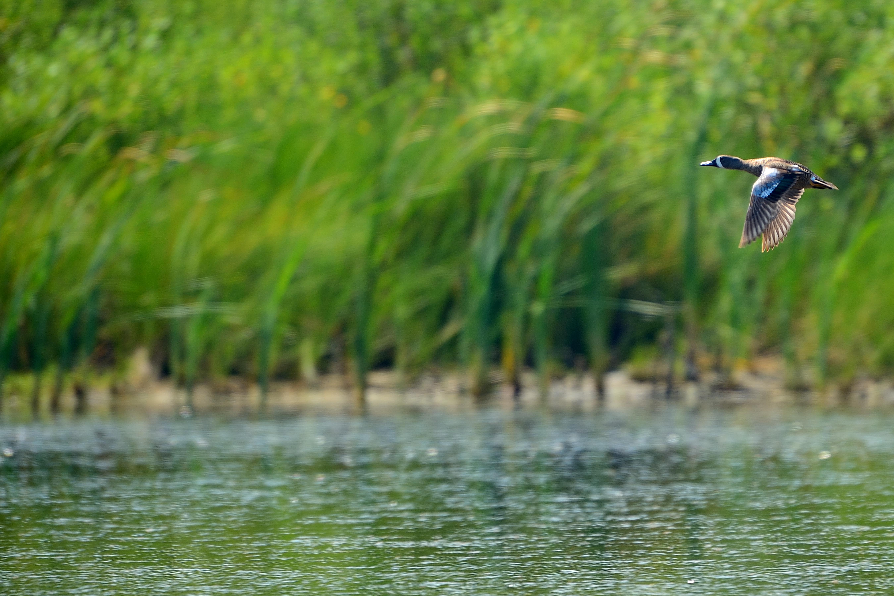
Conservation Initiative Areas
Notes:
Change from reactive to proactive approach to land conservation
Developed strategic conservation areas based on habitat quality, parcel size, and connectivity with other conserved lands

Slide 6
Chocolate Bay Preserve
Notes:
1. Property was originally thought to be too dry and disconnected from the Gulf to satisfy the GEBF (Gulf Environmental Benefit Fund
) priorities and Plea Agreement from BP Settlement
2. Developed a site-specific floral inventory and habitat description with friends at TPWD

Slide 7
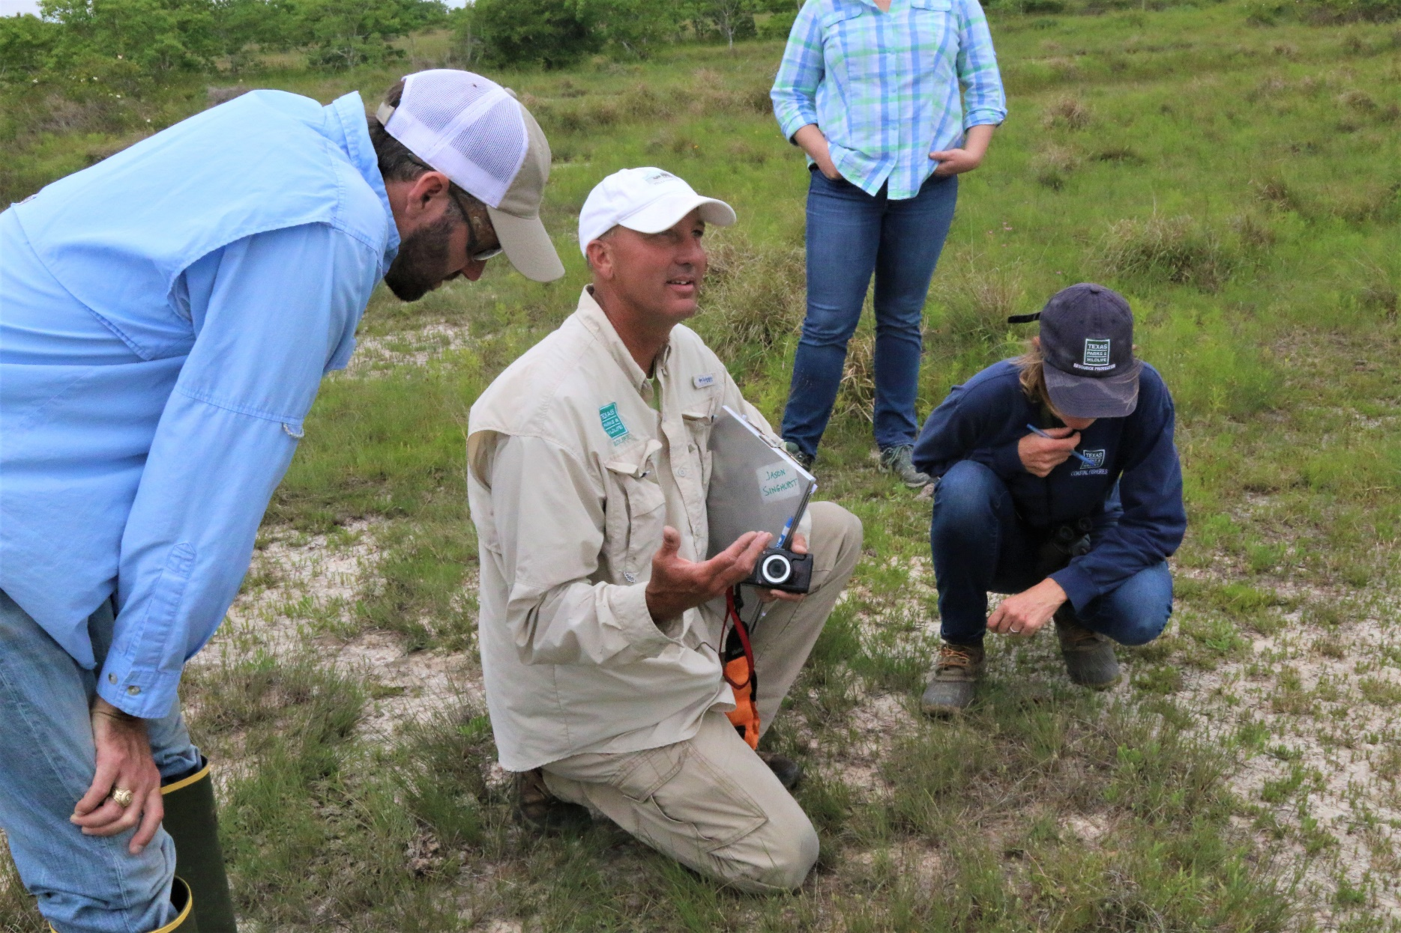
Chocolate Bay Preserve
Notes:
Enlisted TPWD staff botanist to describe the prairie habitats, wetland habitats, and ecological importance of the property

Slide 8
Chocolate Bay Preserve
Notes:
Awarded 10.6 million for the acquisition.

Slide 9
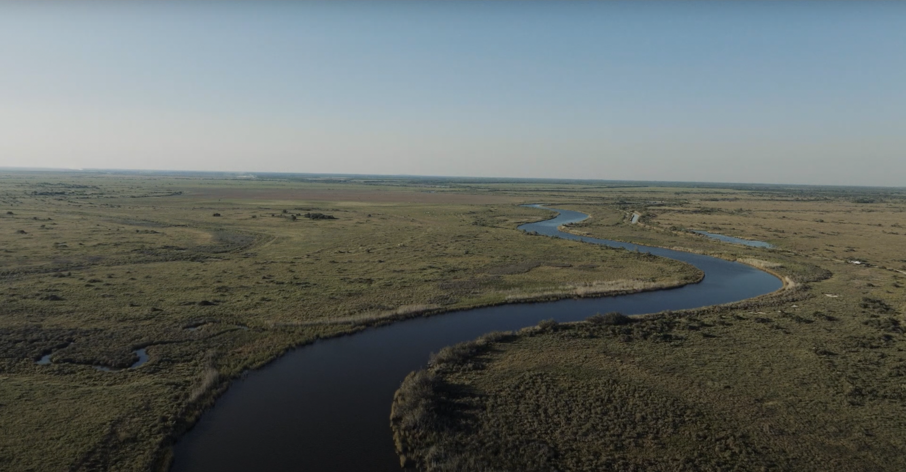
Chocolate Bay Preserve
Notes:
Once TPWD was satisfied, GBF began developing application materials for NFWF.
120 page application and lots of coordination with NFWF staff to ensure the proper natural resource concerns being addressed were documented.
Due Diligence with NFWF - PITA

Slide 10
Chocolate Bay Preserve
Closed in 2021 – 4,714 acres
Added 555 acres in 2022
Preserve contains more than 14 miles of interface with Galveston Bay and tributaries

Slide 11
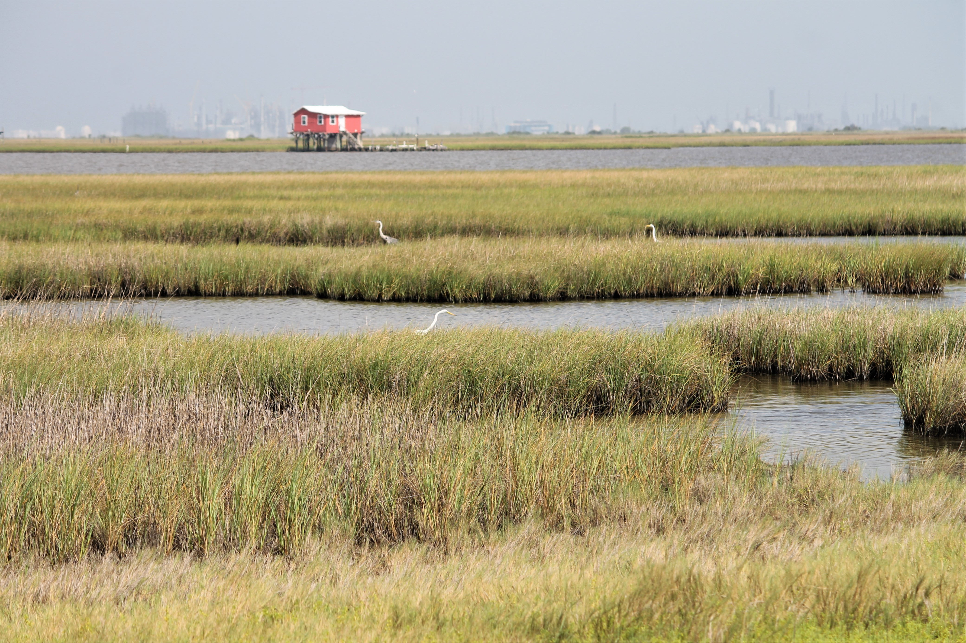
Chocolate Bay Preserve
Notes:
Discuss project identification
LYME Timber
Funding sources – GEBF
TPWD Sales Pitch

Slide 12
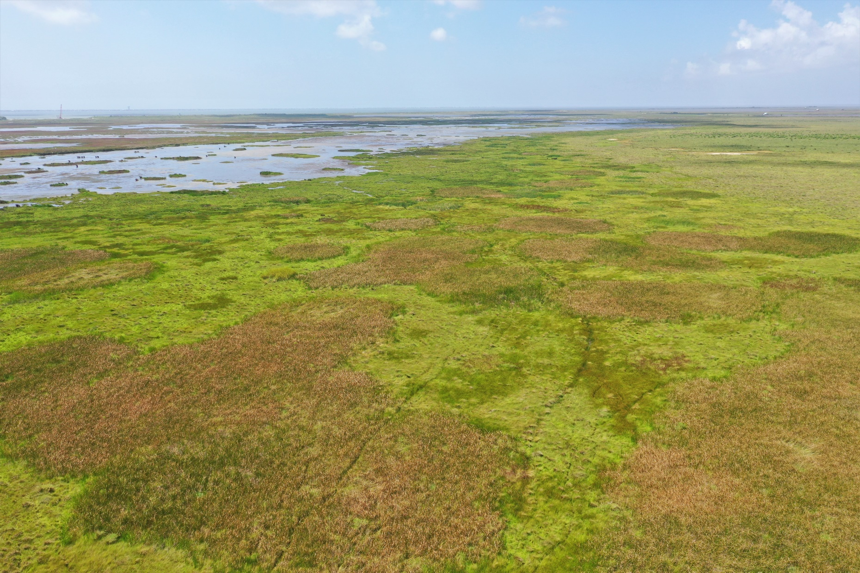
Chocolate Bay Preserve
Notes:
Coastal Tidal Marsh

Slide 13
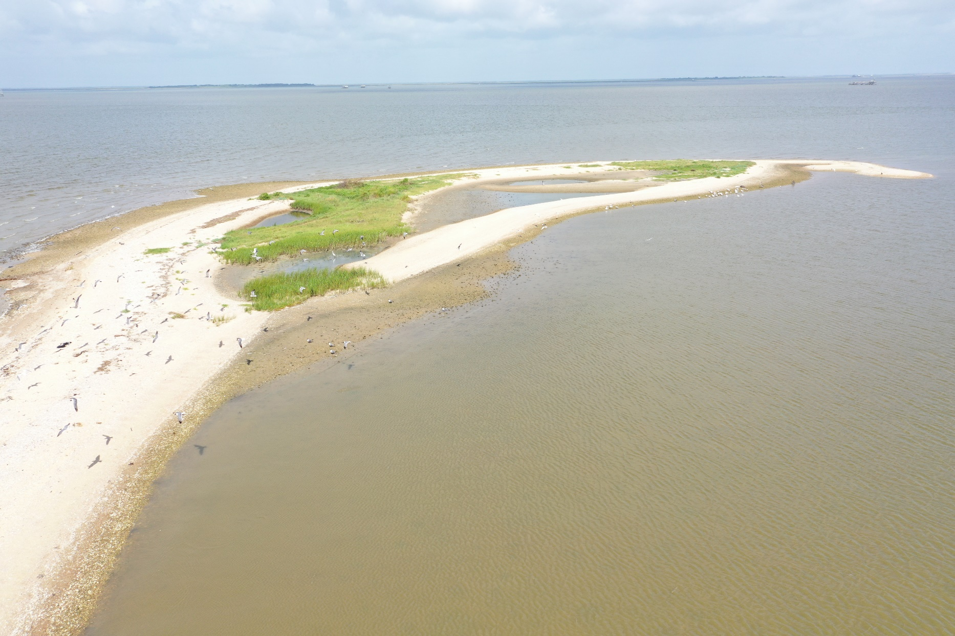
Chocolate Bay Preserve

Slide 14
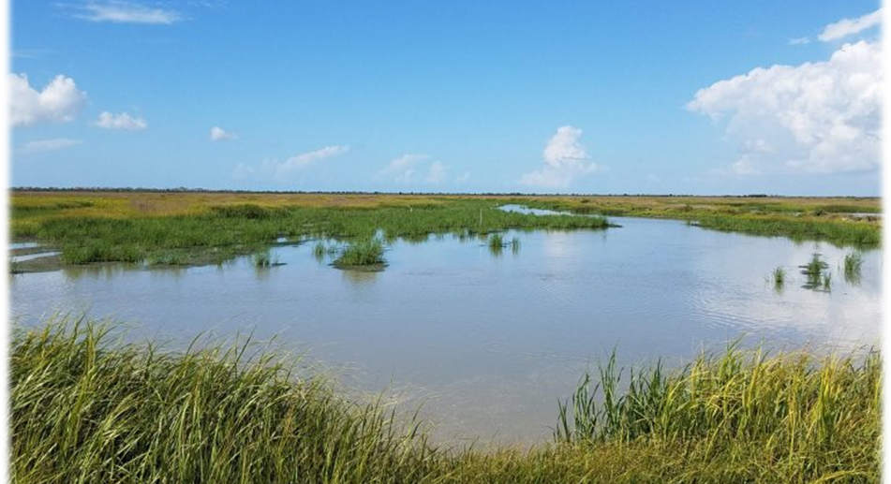
Chocolate Bay Preserve
Notes:
Uplands have a matrix of wetlands and coastal depressions

Slide 15
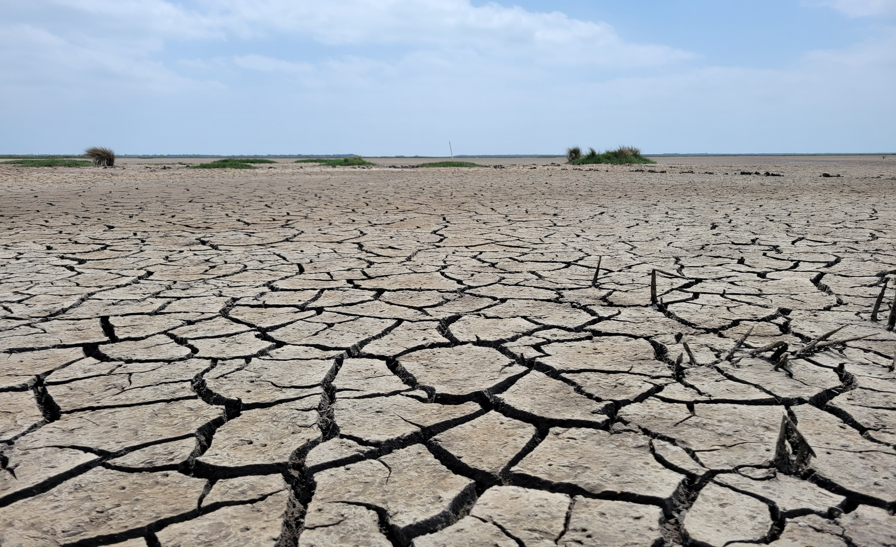
Chocolate Bay Preserve
Notes:
Uplands have a matrix of wetlands

Slide 16
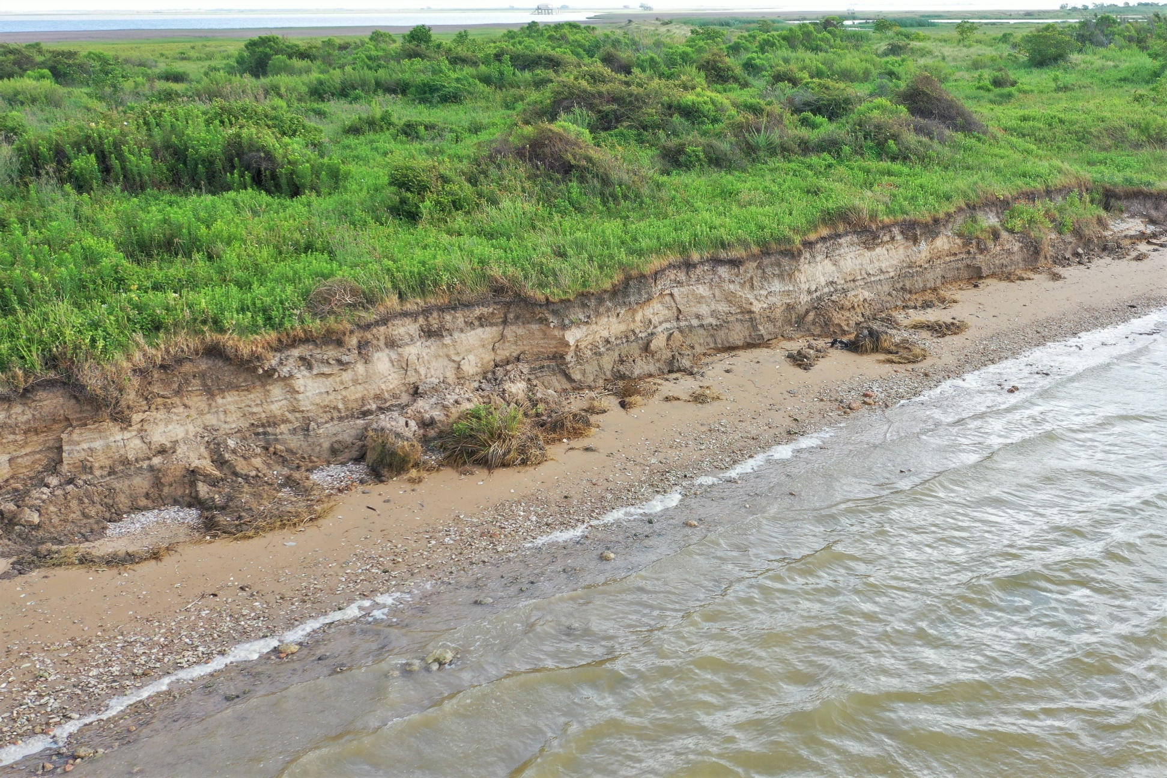
Chocolate Bay Preserve
Notes:
Gulf Coast Chenier Forest- shoreline erosion

Slide 17
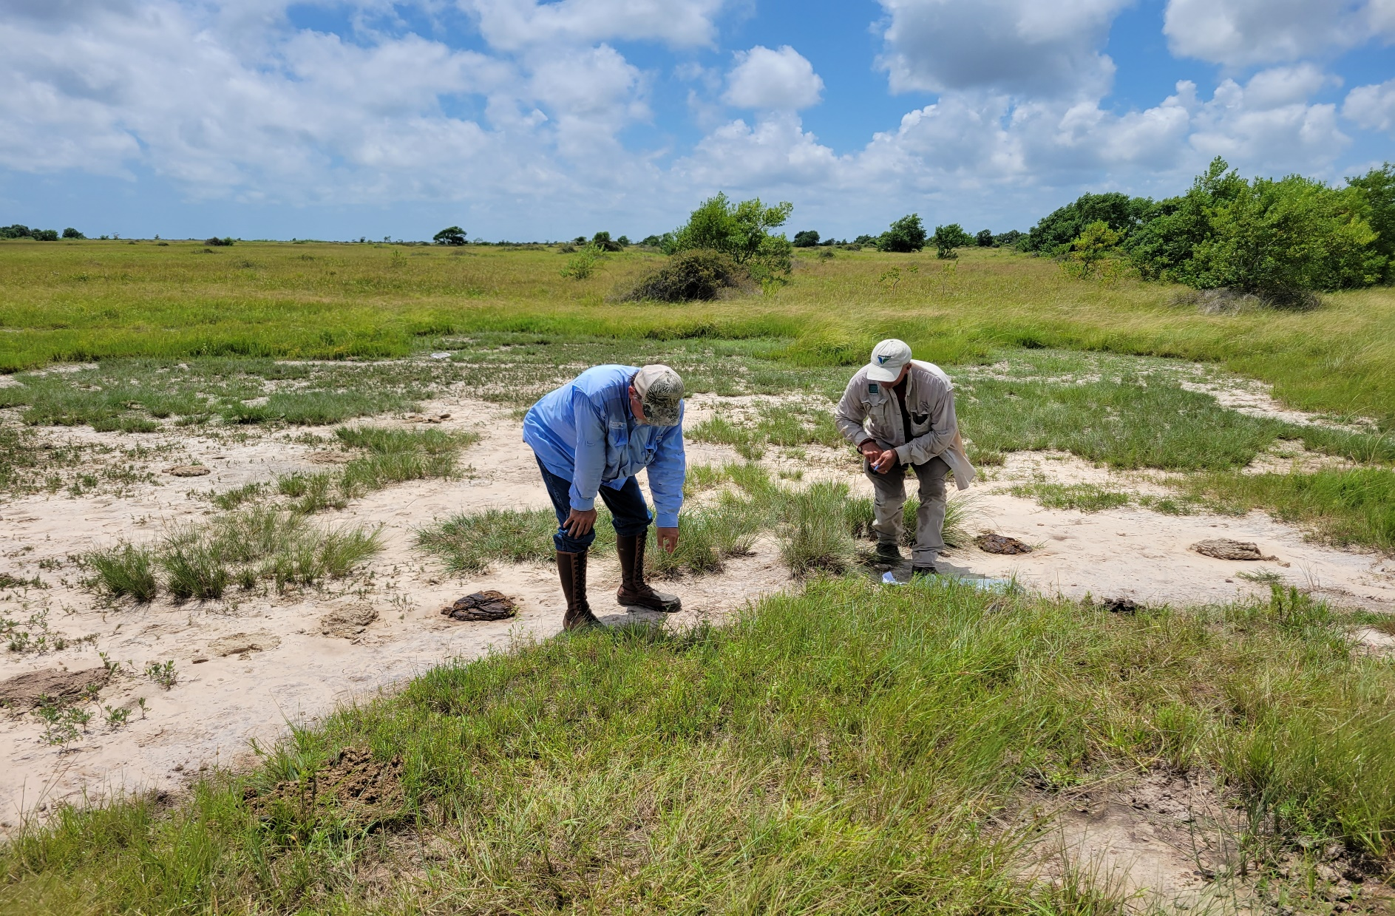
Chocolate Bay Preserve
Notes:
Saline blowouts or salty prairie with unique endemic veg community. Texas windmill grass a rare and endemic species

Slide 18
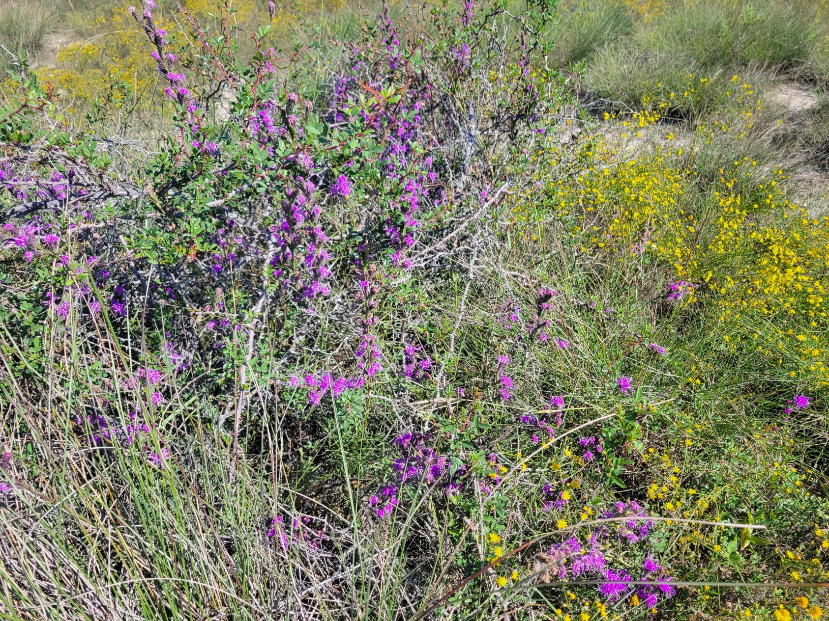
Chocolate Bay Preserve
Notes:
Notable rare species are Liatris braceata,

Slide 19
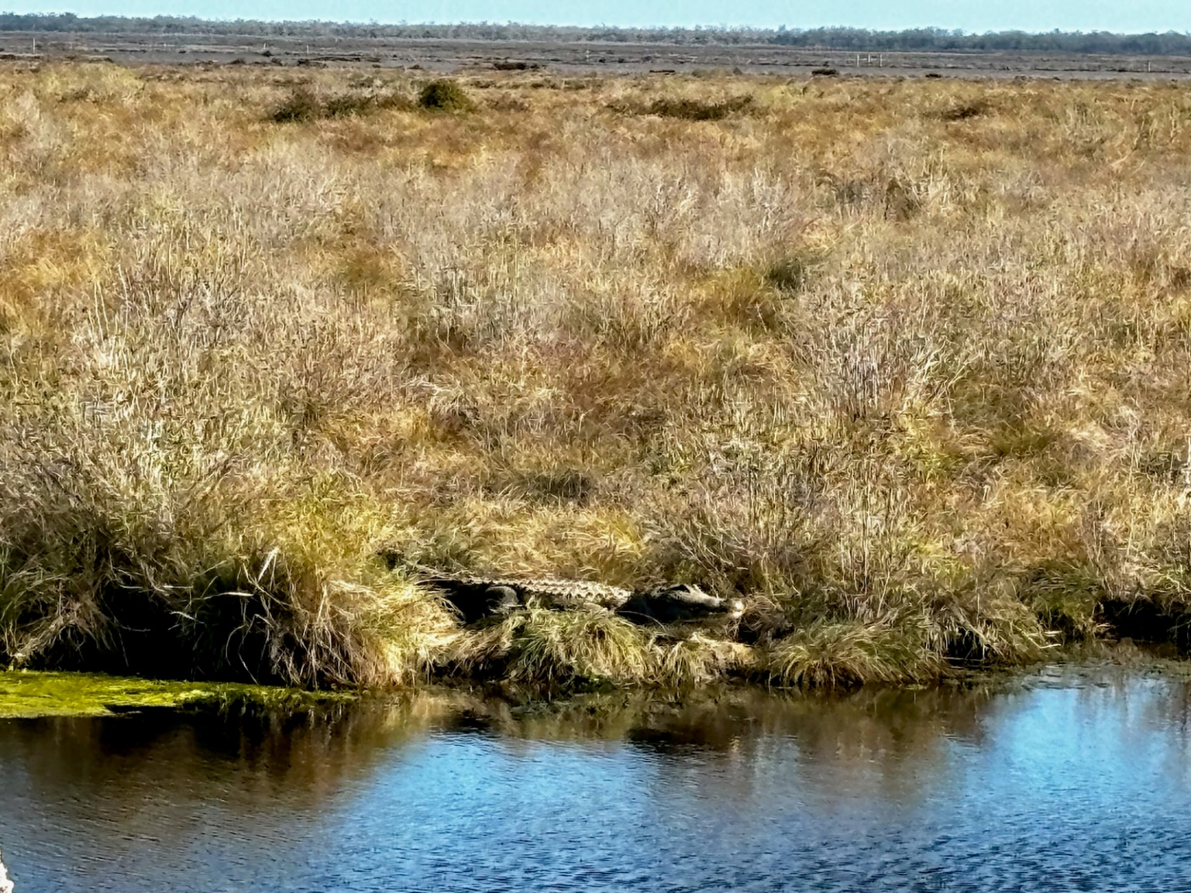
Chocolate Bay Preserve
Notes:
Big Bertha

Slide 20
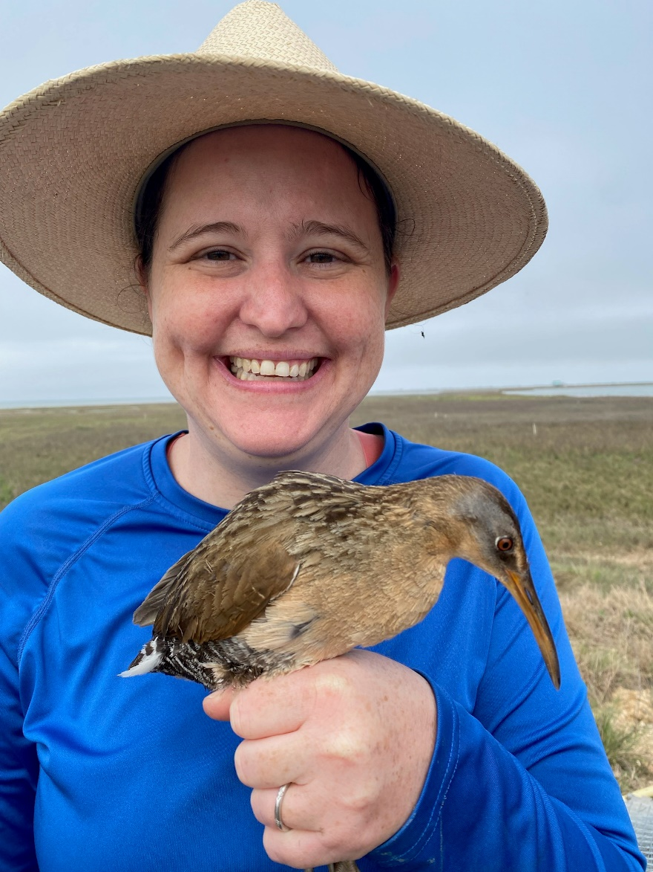
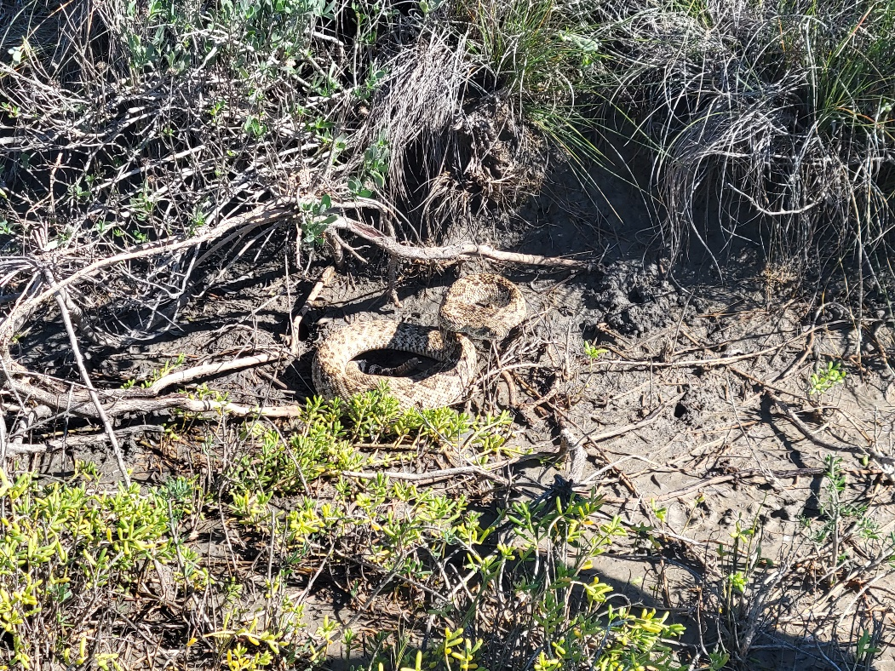
Chocolate Bay Preserve
Notes:
Black rail and rattlesnake

Slide 21
Chocolate Bay Preserve

Slide 22
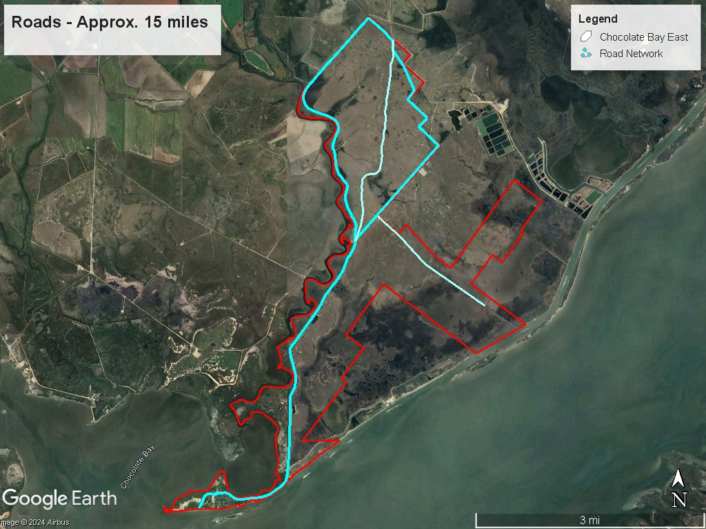
Chocolate Bay Preserve
Notes:
Road enhancements, firebreaks, and water impoundment

Slide 23
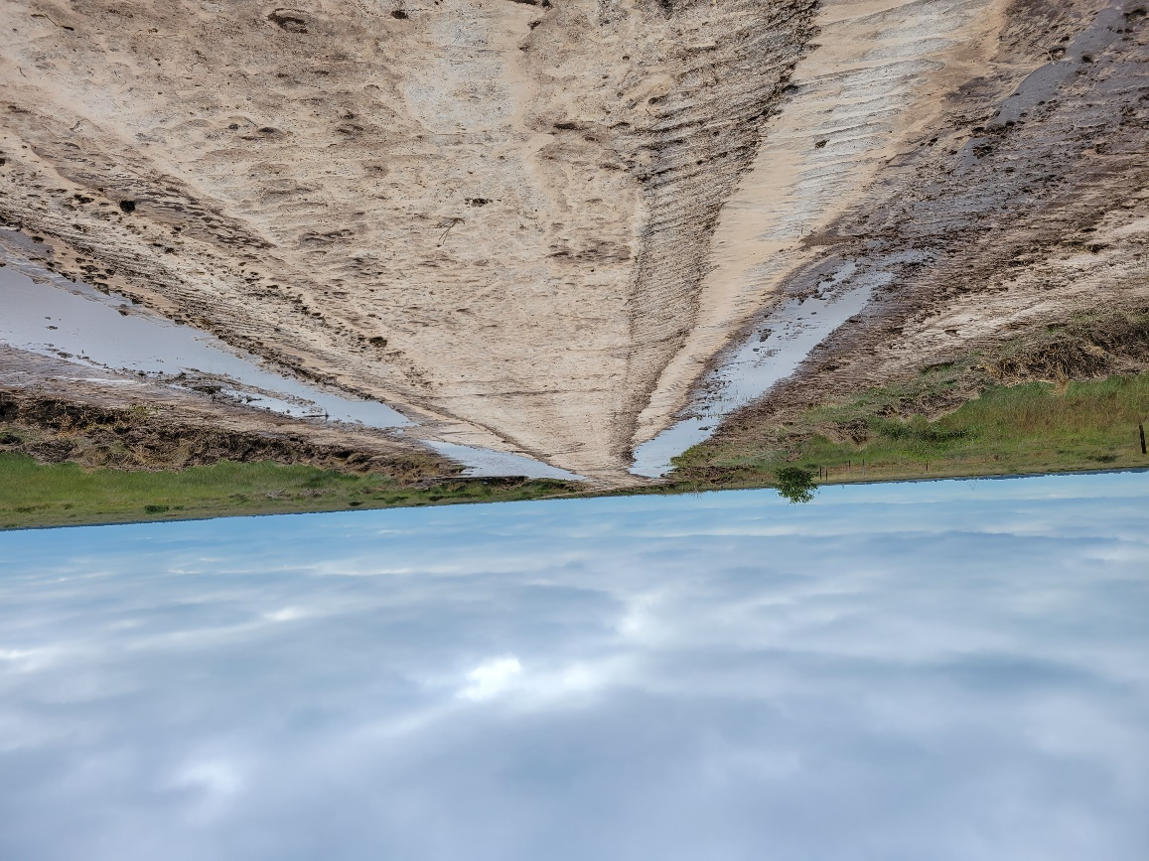
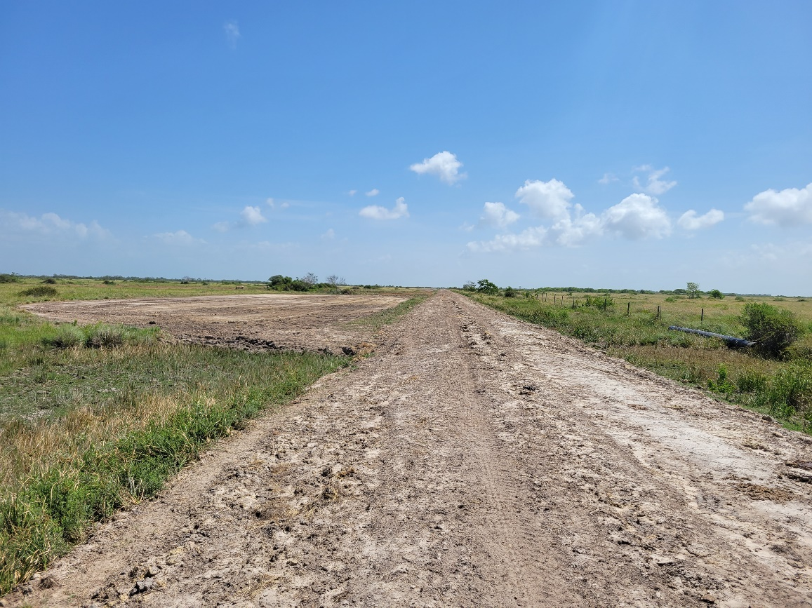
Chocolate Bay Preserve
Notes:
Road enhancements, firebreaks, and water impoundment

Slide 24
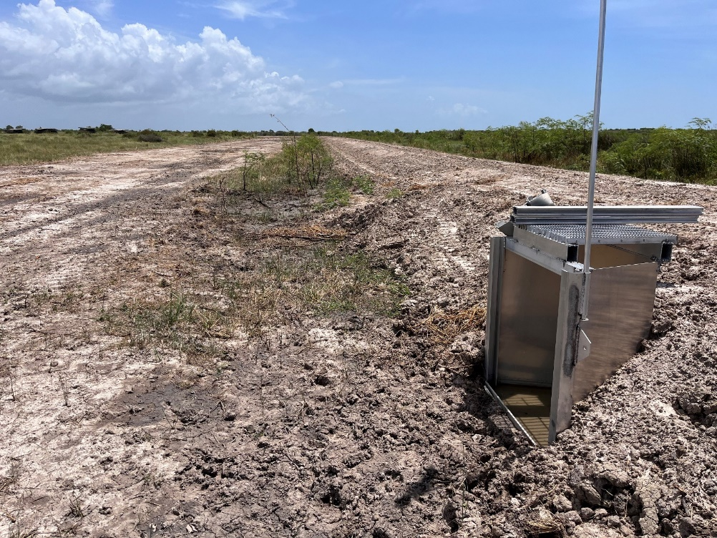
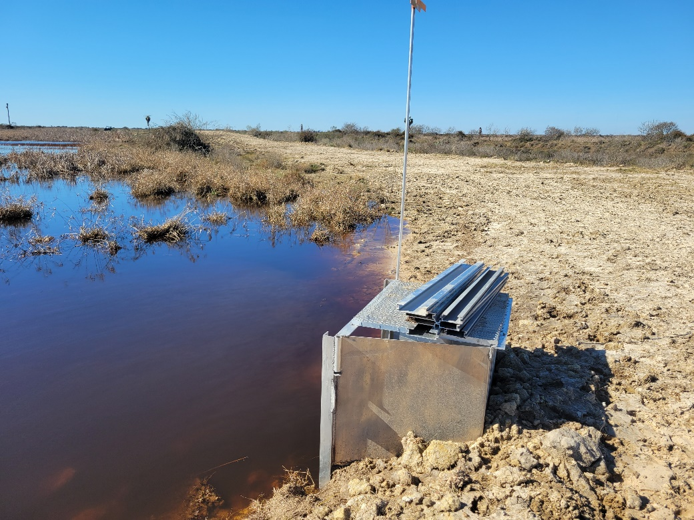
Chocolate Bay Preserve
Notes:
Water control structures, culverts

Slide 25
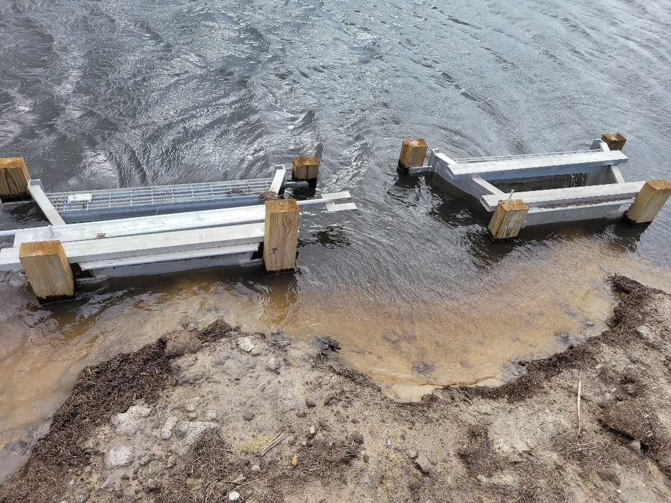
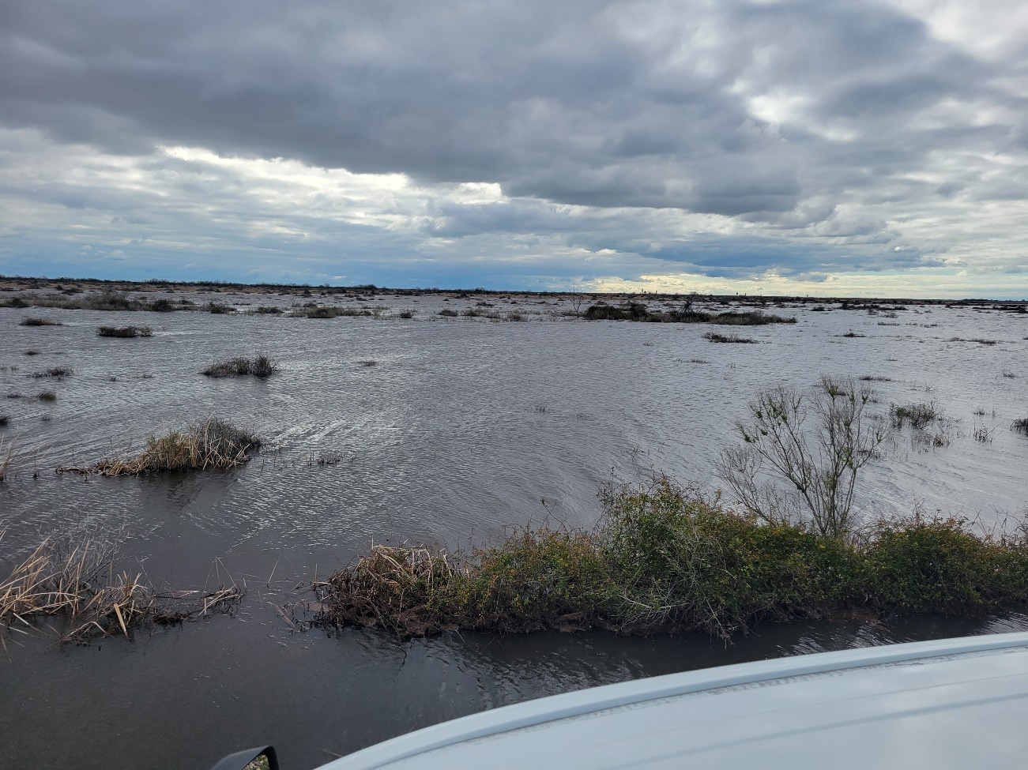
Chocolate Bay Preserve

Slide 26
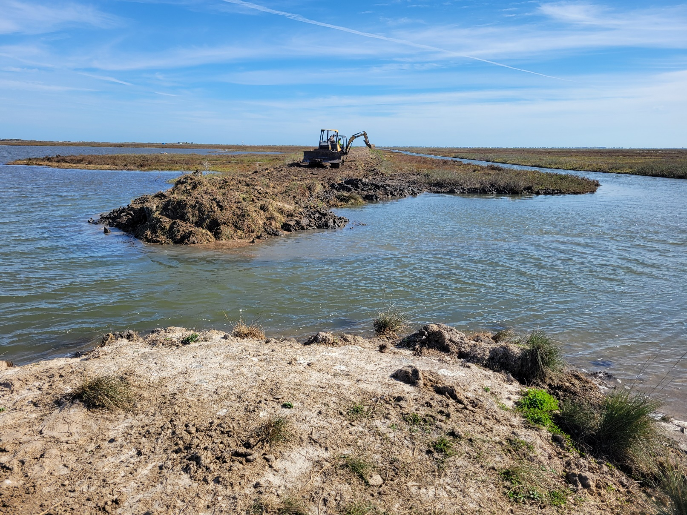
Chocolate Bay Preserve

Slide 27
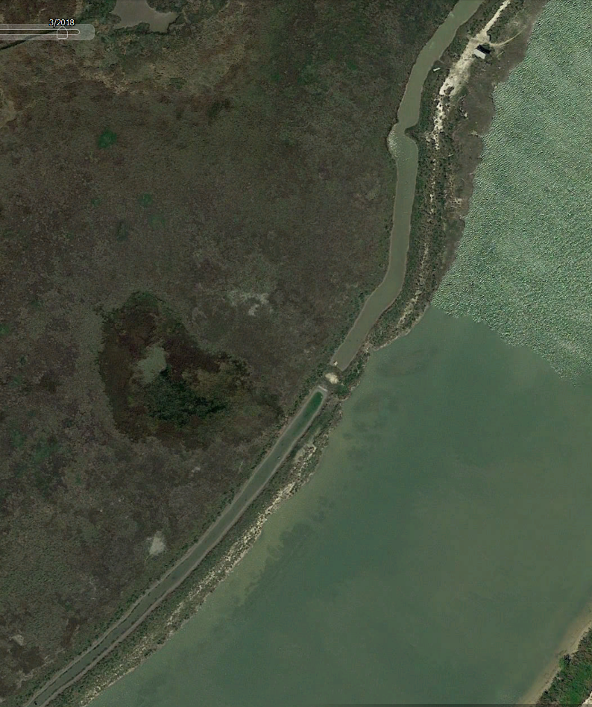
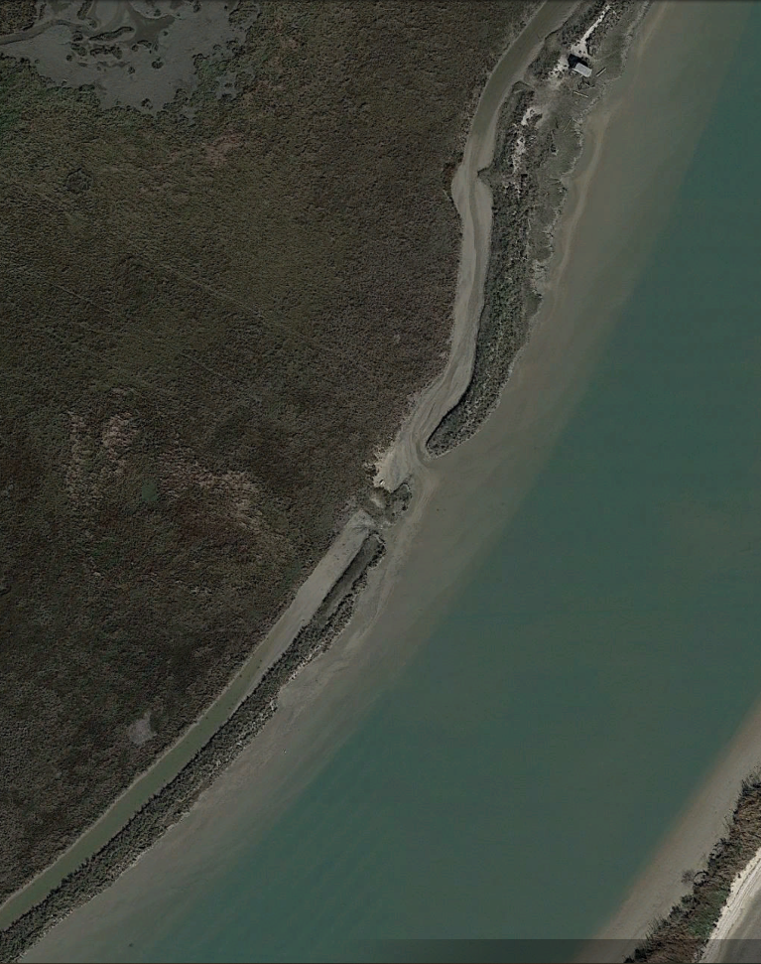
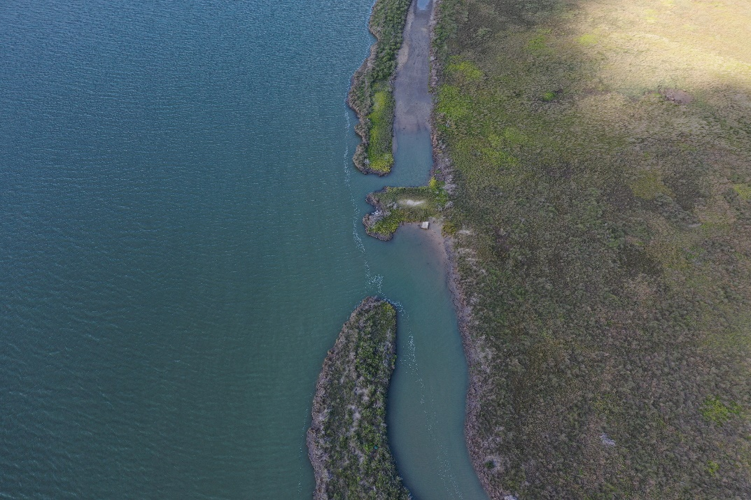
Threat: Saltwater Intrusion
Chocolate Bay Preserve
Chocolate
Bay Preserve
Chocolate
Bay Preserve
Saltwater
intrusion
ICW
ICW
2018
2022

Slide 28
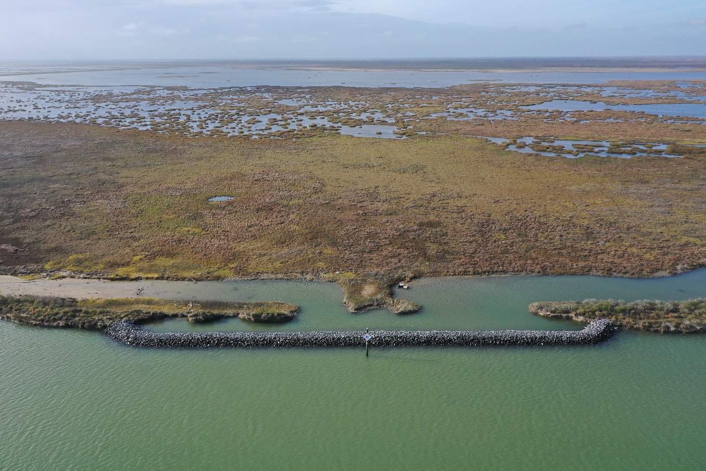
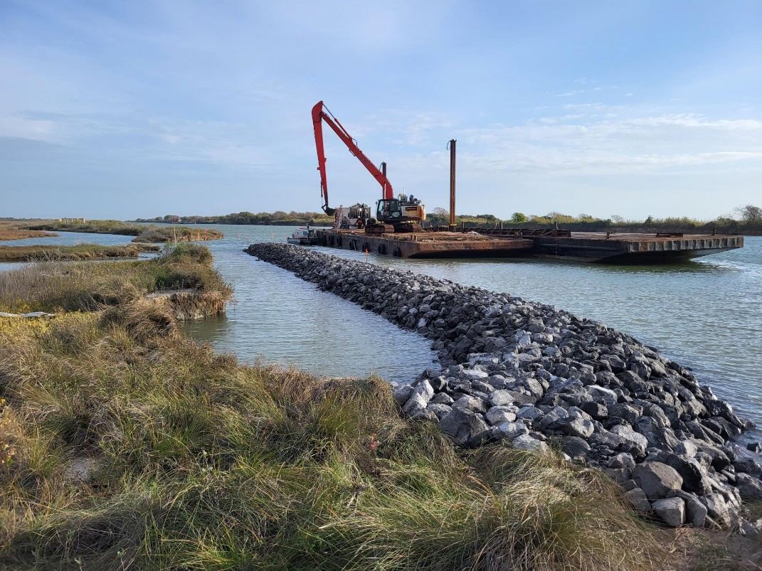
Chocolate Bay Preserve

Slide 29
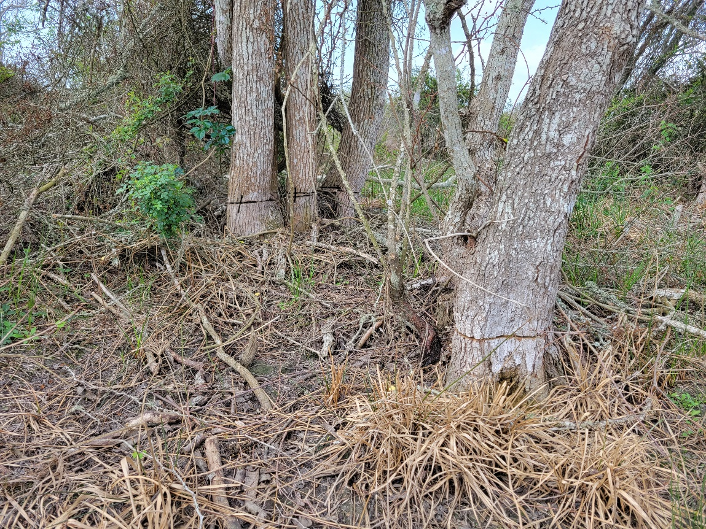
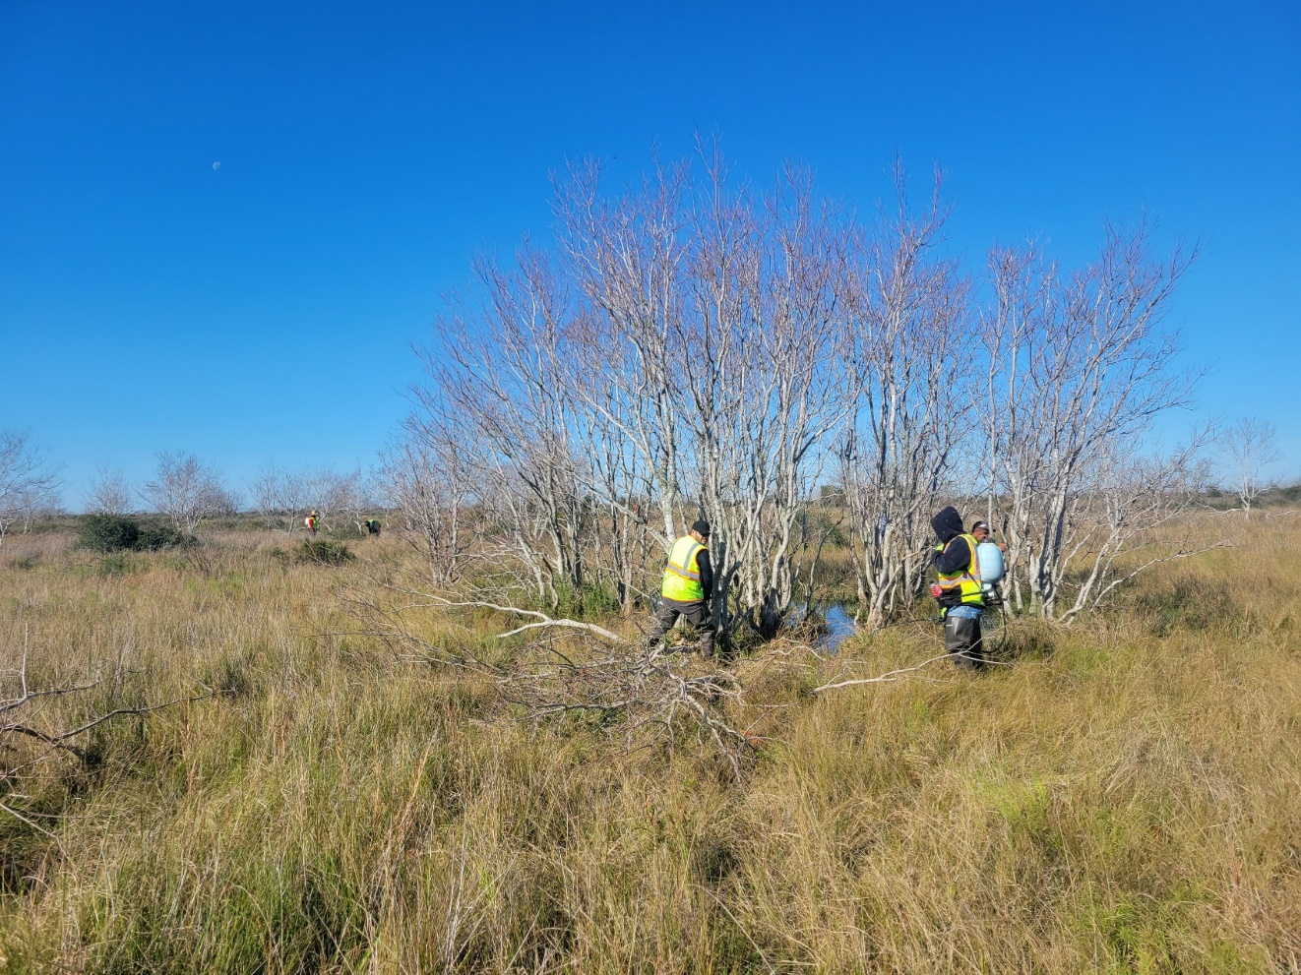
Chocolate Bay Preserve
Notes:
Chinese tallow -1750 acres

Slide 30
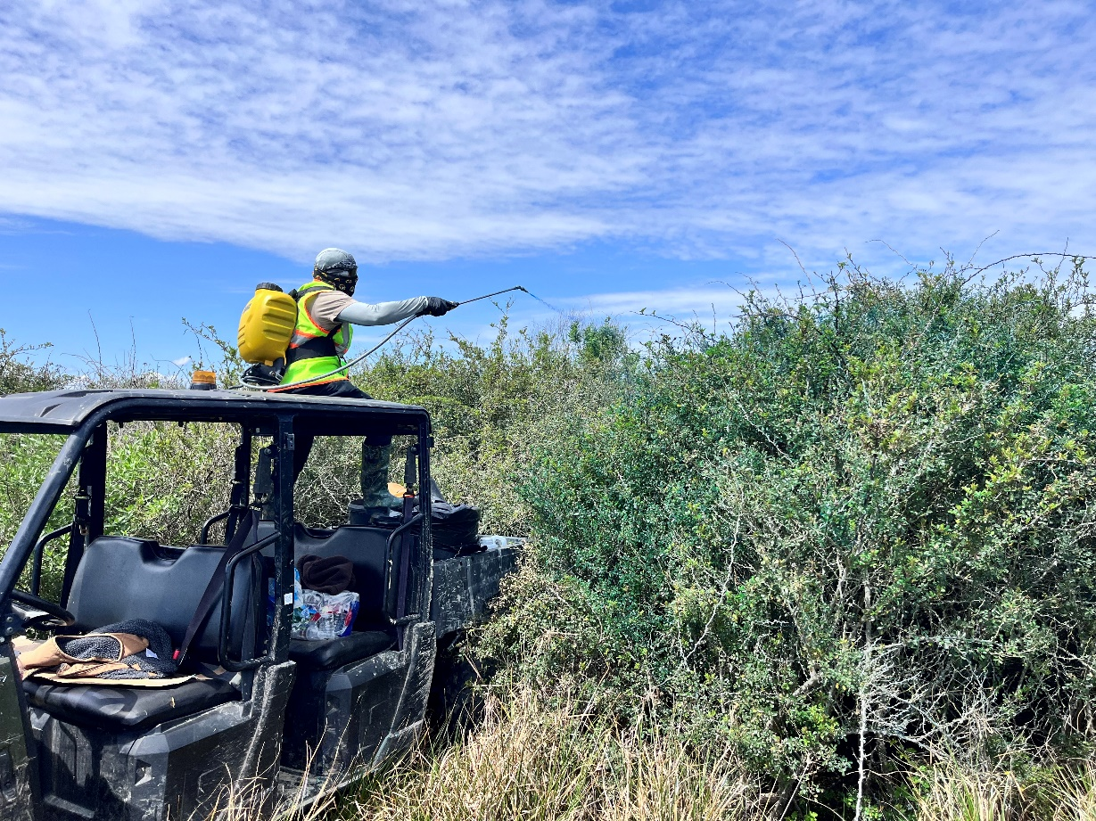
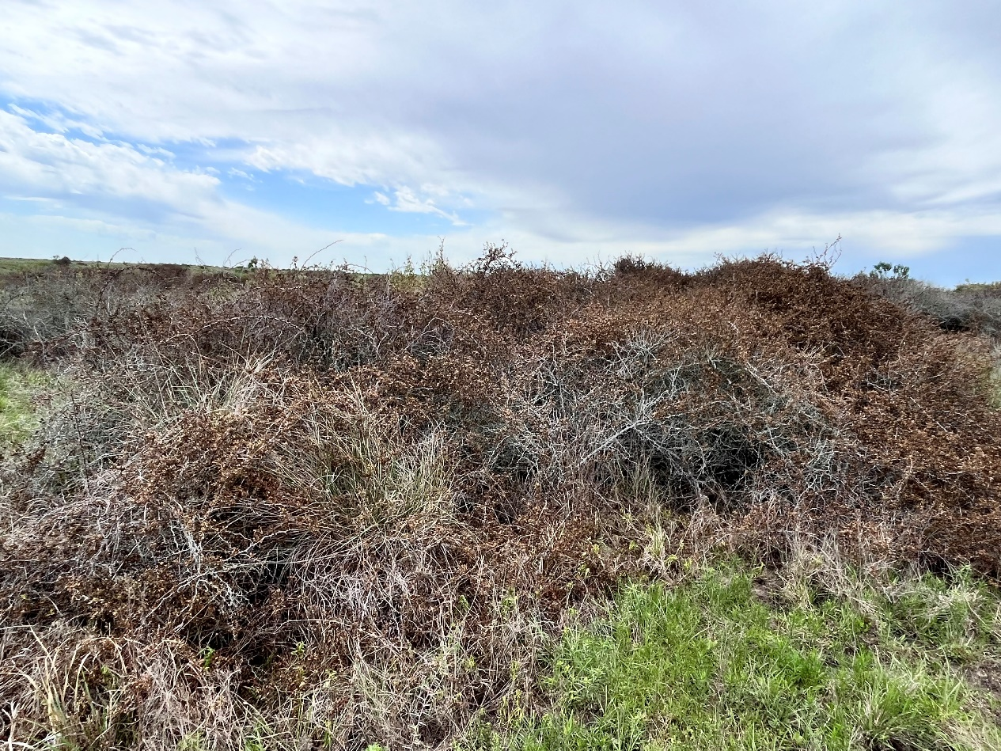
Chocolate Bay Preserve
Notes:
Macartney Rose – 515 acres

Slide 31
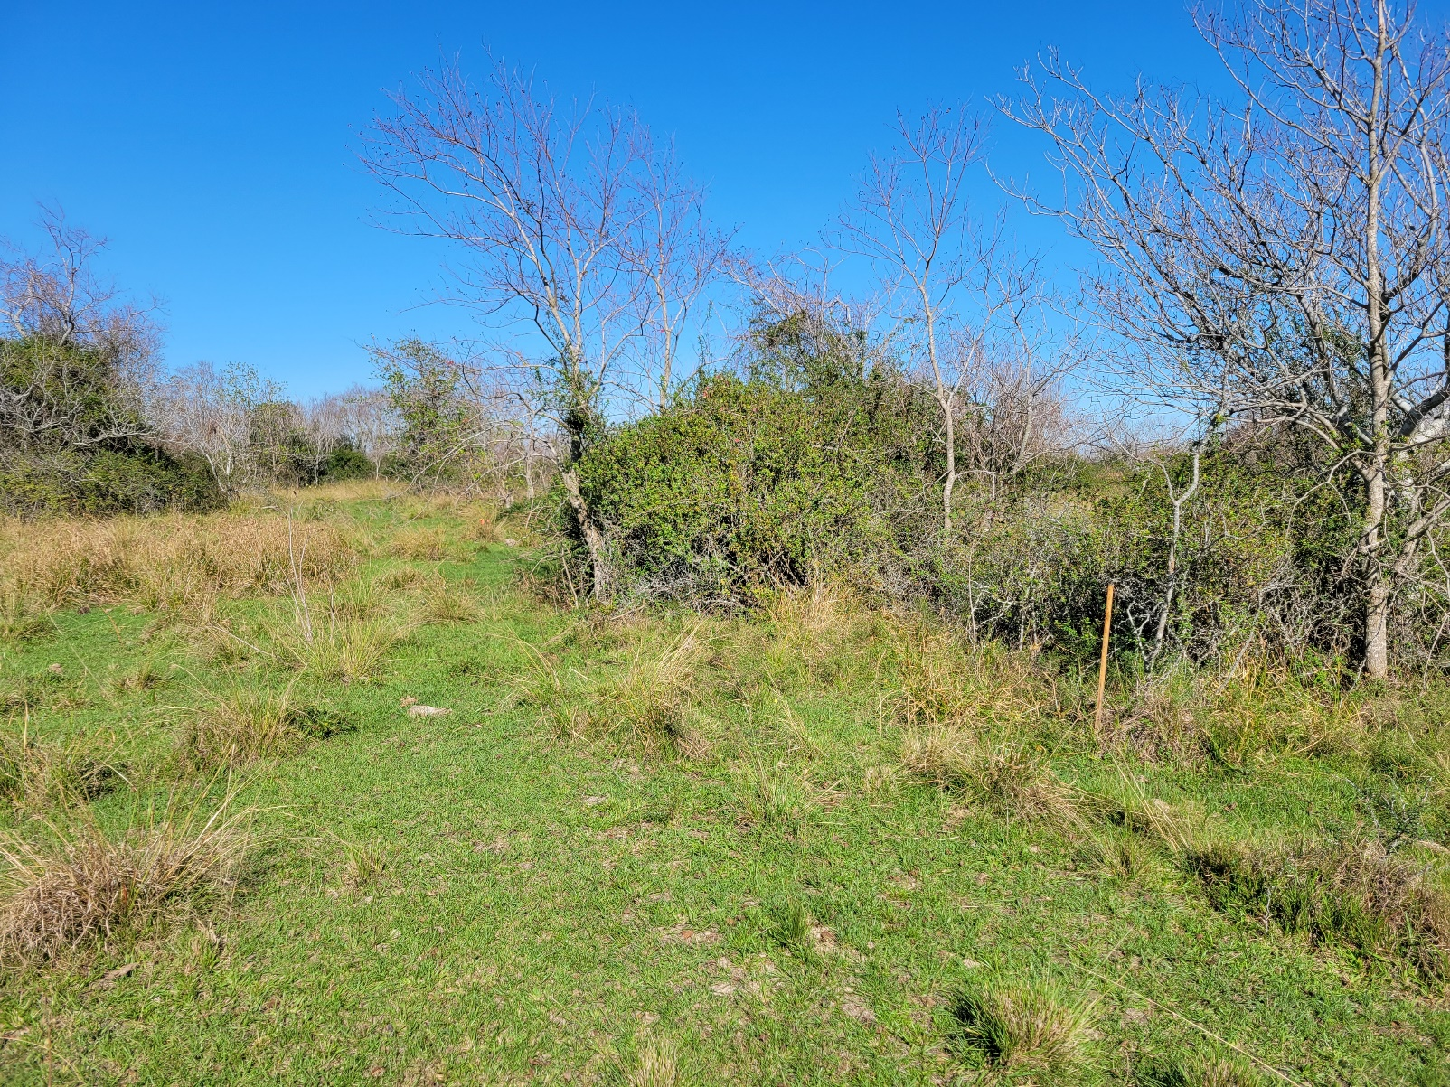
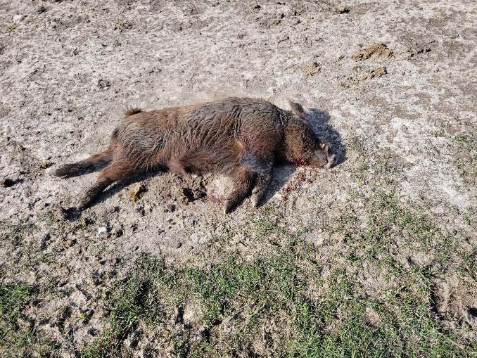
Chocolate Bay Preserve
Notes:
Hog, deep-rooted sedge, old world bluestems, tallow

Slide 32
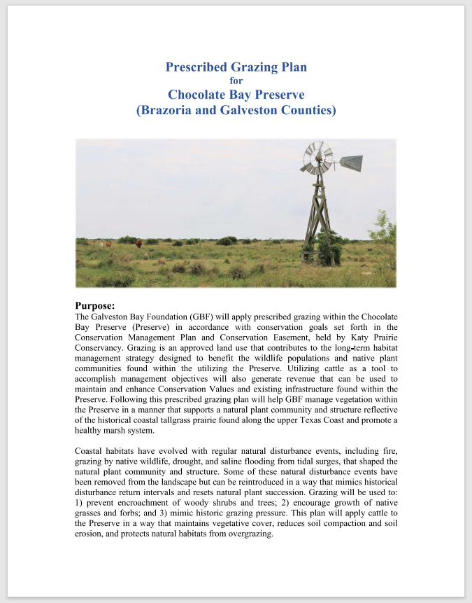
Chocolate Bay Preserve
Notes:
Grassroots carbon agreement earn income from high-quality soil carbon drawdown credits by commitment to implement and maintain regenerative grazing practices.

Slide 33
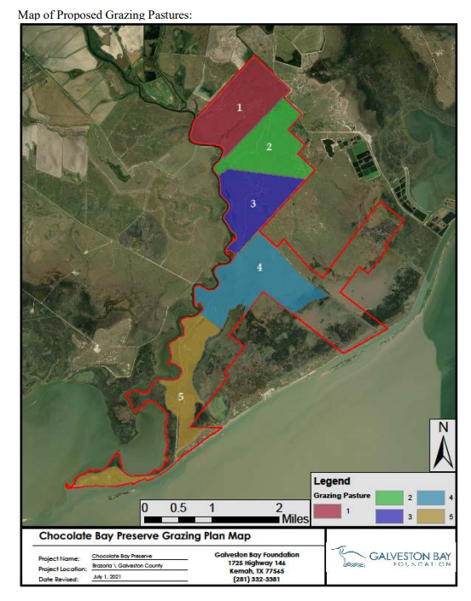
Notes:
Macartney Rose – 515 acres

Slide 34
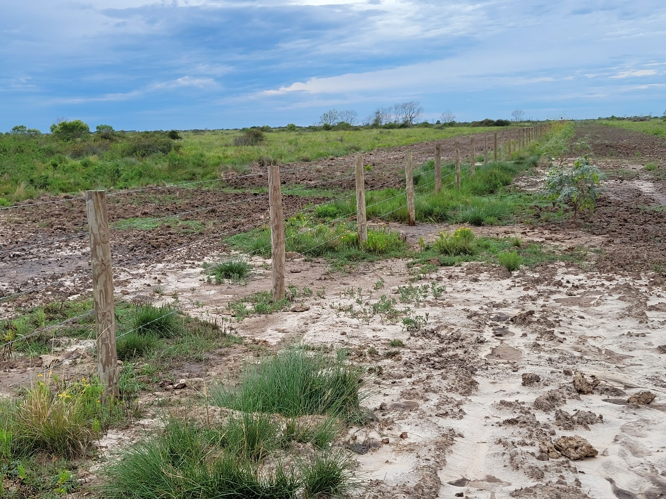
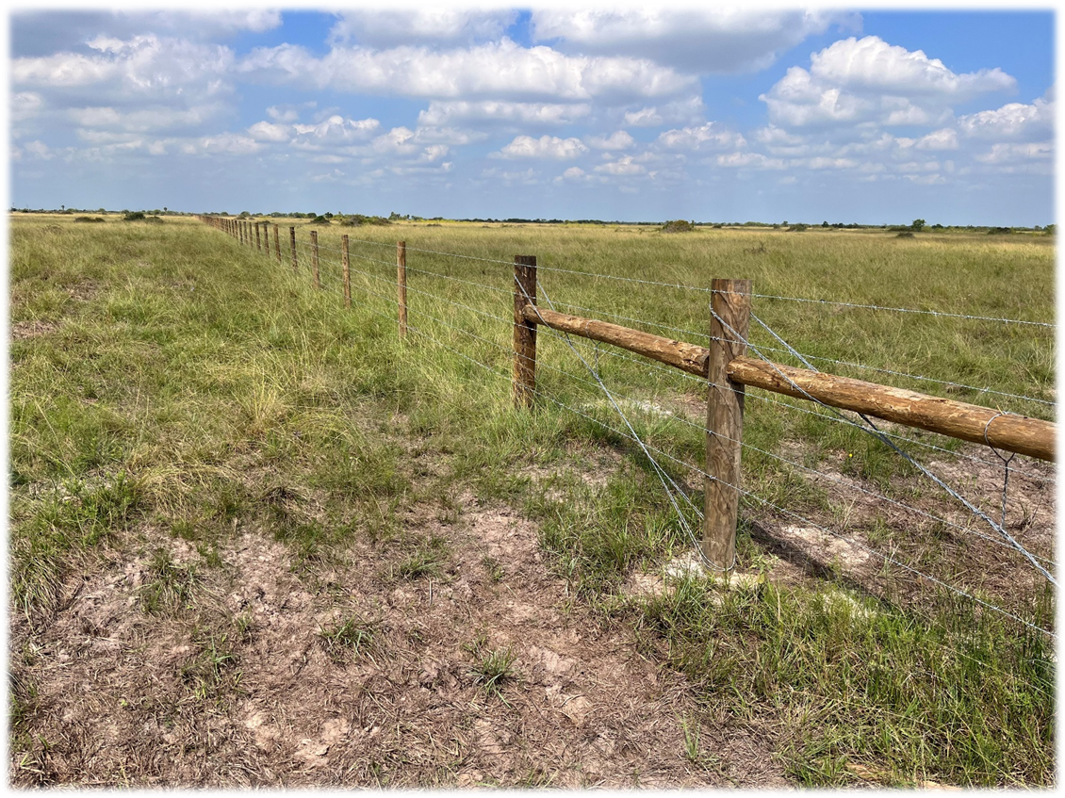
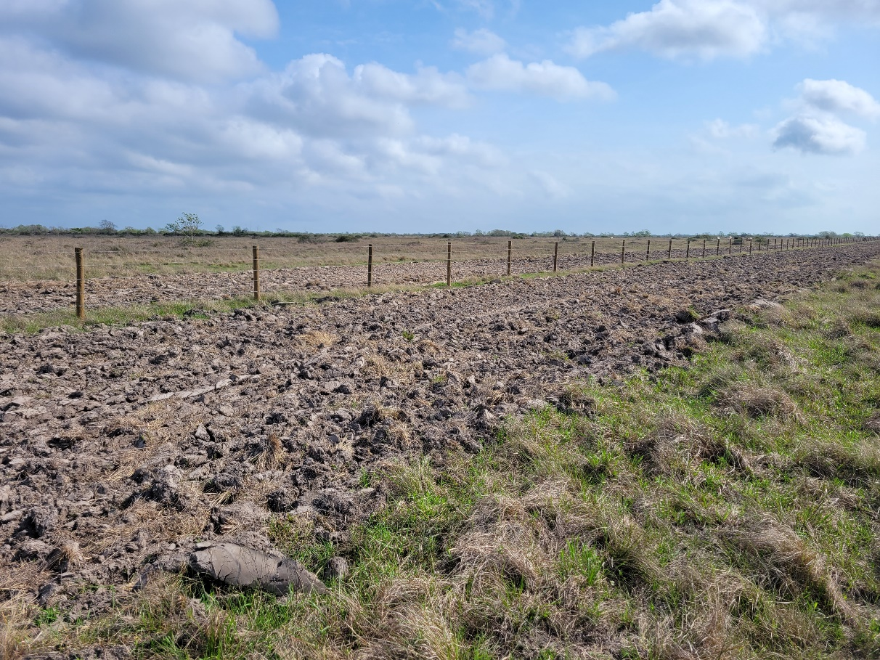
Chocolate Bay Preserve
Notes:
17,000 ft of cross fencing with gates intended for cattle rotation. Firebreaks are disced on both sides

Slide 35
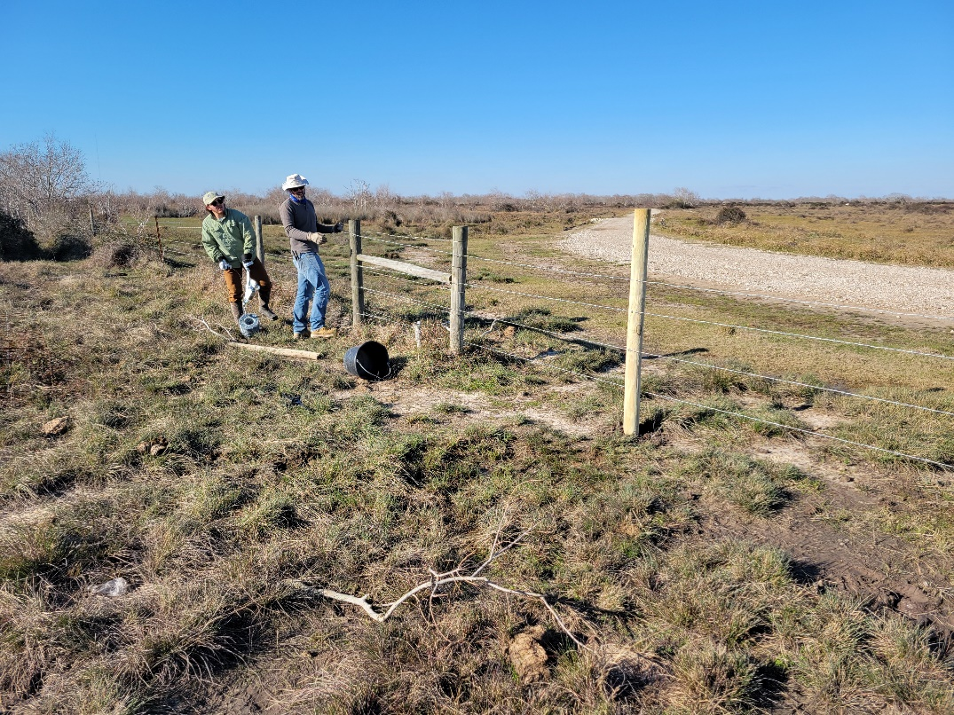
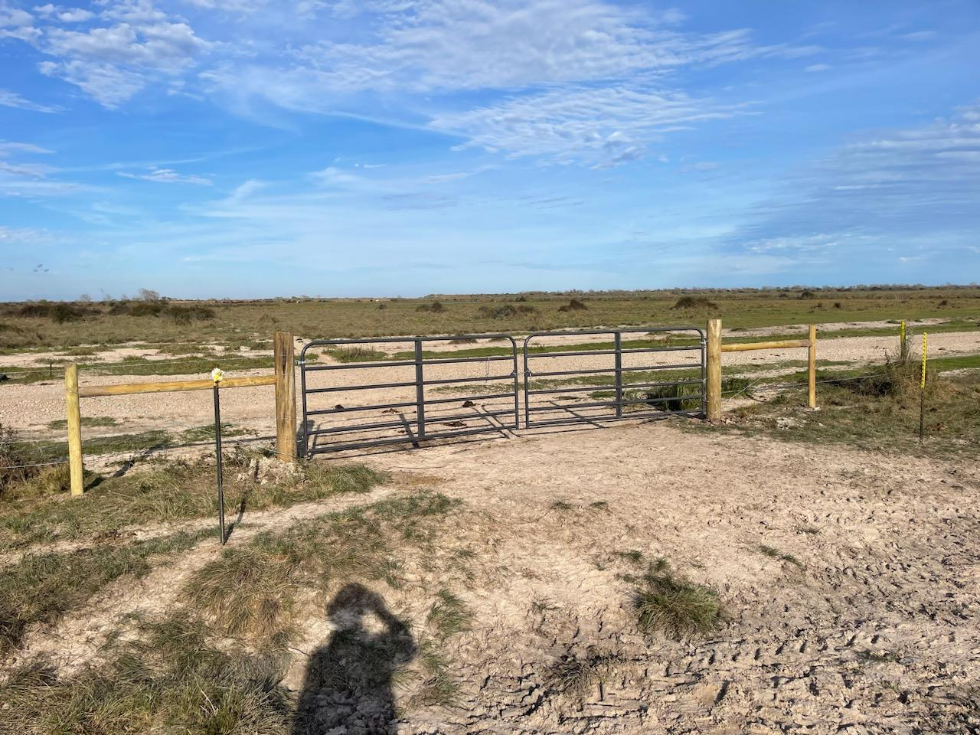
Chocolate Bay Preserve
Notes:
Repaired perimeter fencing and gates for heavy equipment transportation

Slide 36
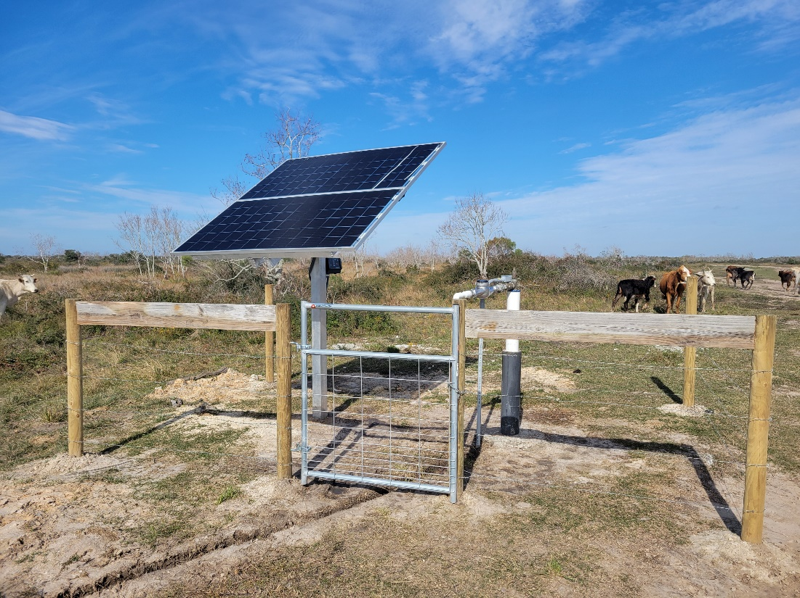
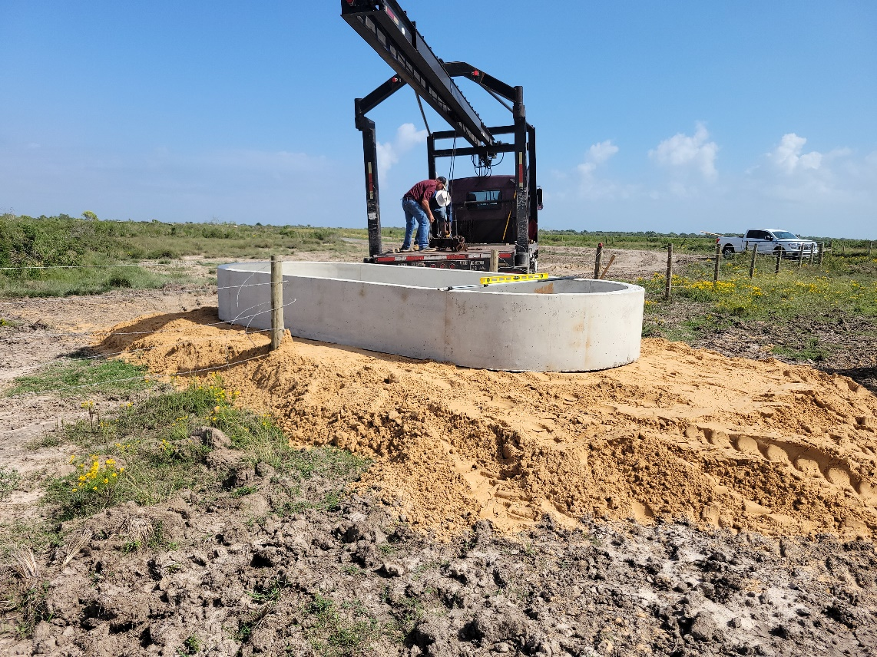
Chocolate Bay Preserve
Notes:
3 solar pumps, 2 1600 gallon water troughs, and 2 750 gallon water troughs

Slide 37
Proposed Grazing Rotation Schedule
(250 head)
Chocolate Bay Preserve
Pasture 1 (630 acres) – 60 days
  January 1 - February 29
  July 1 – August 31
Pasture 2 (550 acres) – 60 days
  March 1 – April 30
  September 1 – April 30
Pasture 3 (525 acres) – 60 days
  May 1 – June 30
  November 1 – December 31
Pasture 4 (800 acres)
  Needs fencing in the marsh to be included in rotation.
  Hopeful to construct summer of 2024 if conditions are dry enough

Slide 38
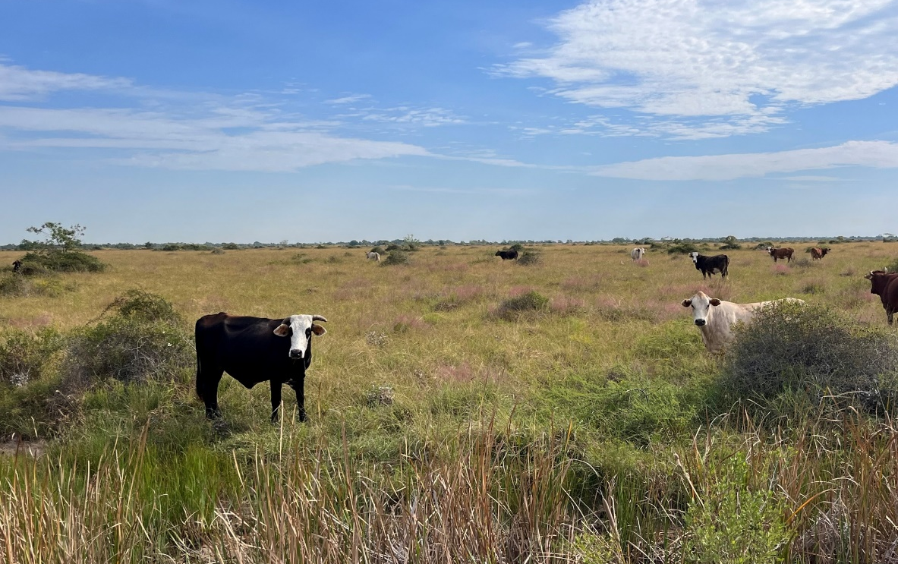
Chocolate Bay Preserve
Notes:
Current lease overstocked cows without our permission.
Rest the property until August 1.
Year 1 stocked at %50
Year 2 stocked at %75
Year 3 stocked at %100

Slide 39
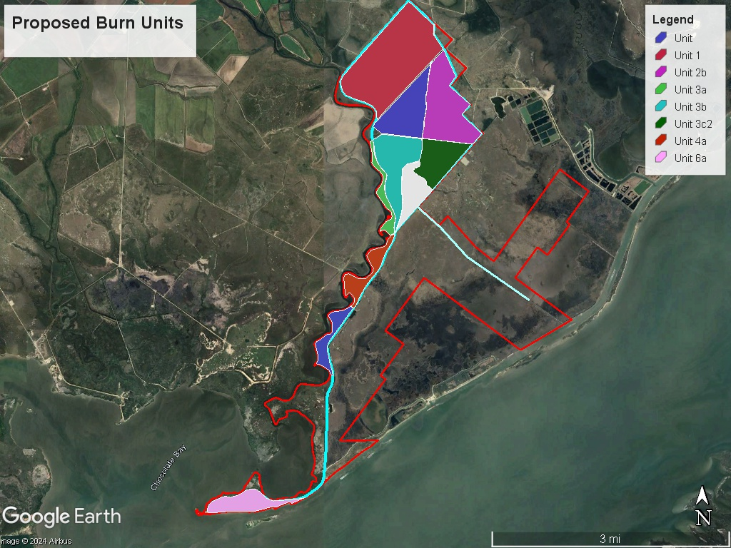
Prescribed burn plan in the works…
Chocolate Bay Preserve

Slide 40
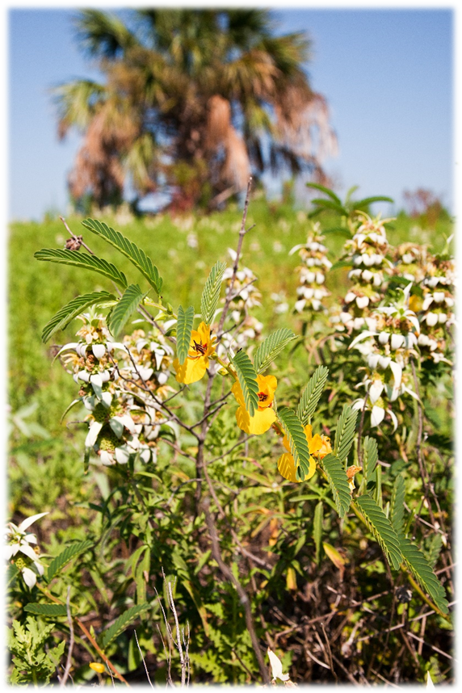


Questions?

