Slide 1
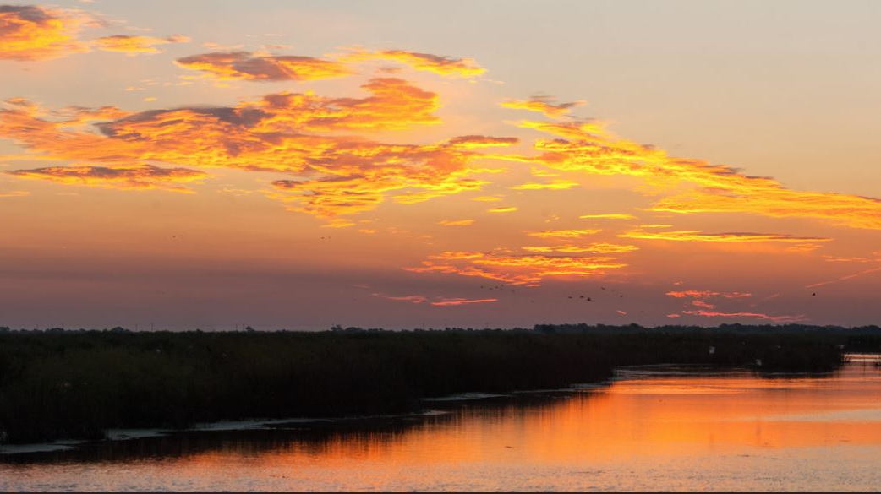
Road Map to Restoration
Anahuac National Wildlife Refuge
Kristin Fritz-Grammond
Anahuac National Wildlife Refuge Manager
Deputy Project Leader Texas Chenier Plain Refuge Complex

Slide 2
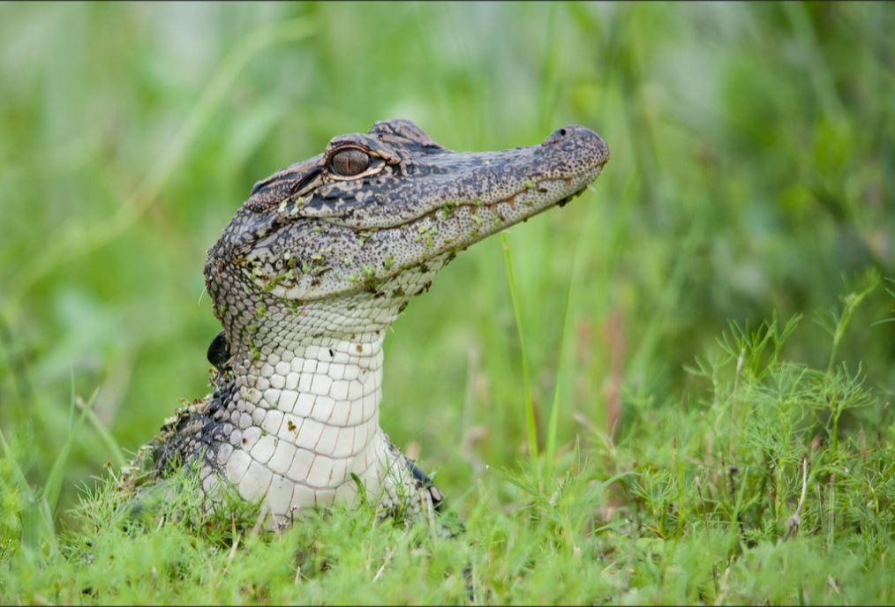
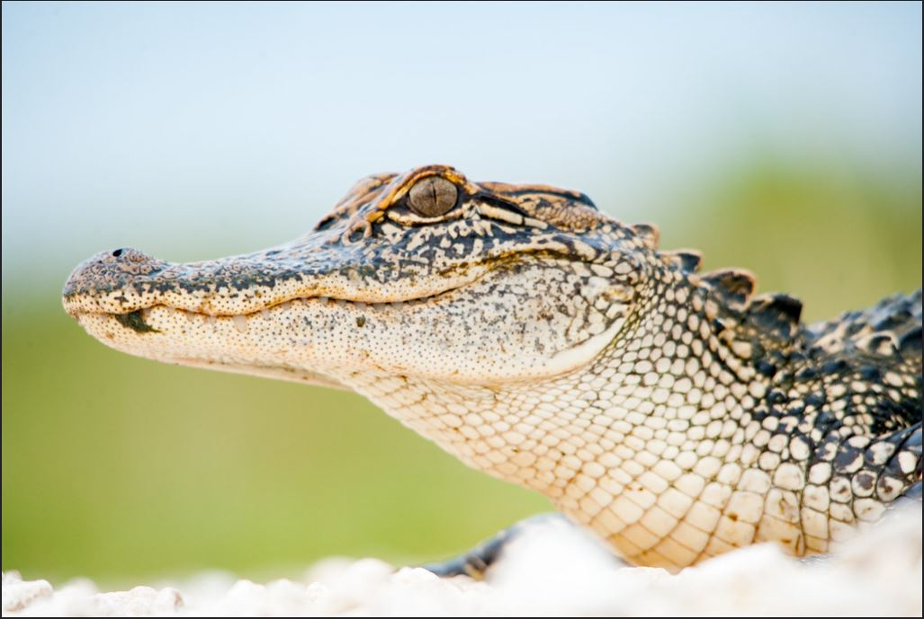
Welcome to Anahuac – Alligator Capital
Notes:
Who am I and my background – grew up on a farm in southern MN growing corn and soy beans (family is still there). Every field is tiled and drained… way of life. Started restoring prairies and wetlands in the prairie pothole region in the tall grass area… techniques …. Ups and downs … learning process. Not an expert!

Slide 3
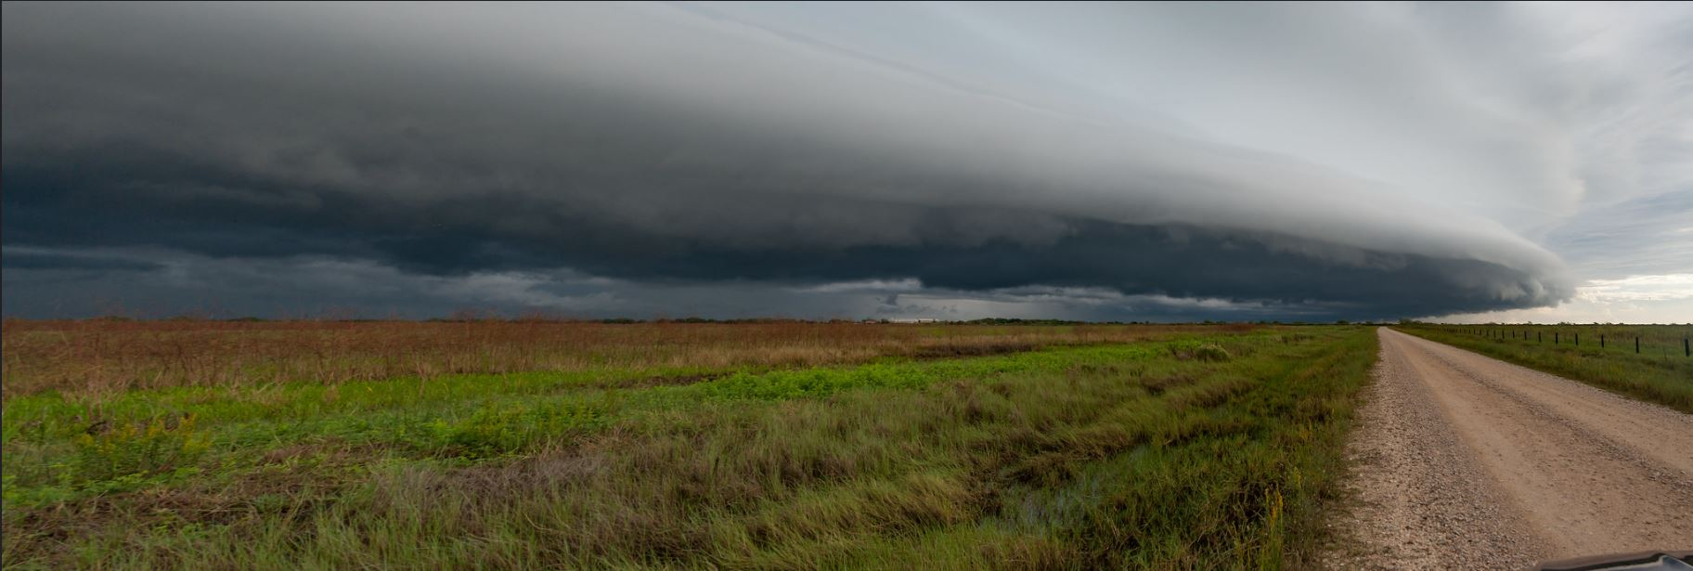
The Good, the Bad and the Ugly

Slide 4
The Good, the Bad and the Ugly
Partners (without partners we could not do this work!)
Highly altered landscape
Mother Nature (hurricanes/storms/extreme conditions)
Sea Level Rise
Fierce Growing Season
Invasive Species
  Vegetation
  Hogs
Listed and Endangered Species
  Permitting
  Timing of breeding season
Source of seed
  Vendor / Local Origin
FUNDING
Managing Expectations

Slide 5
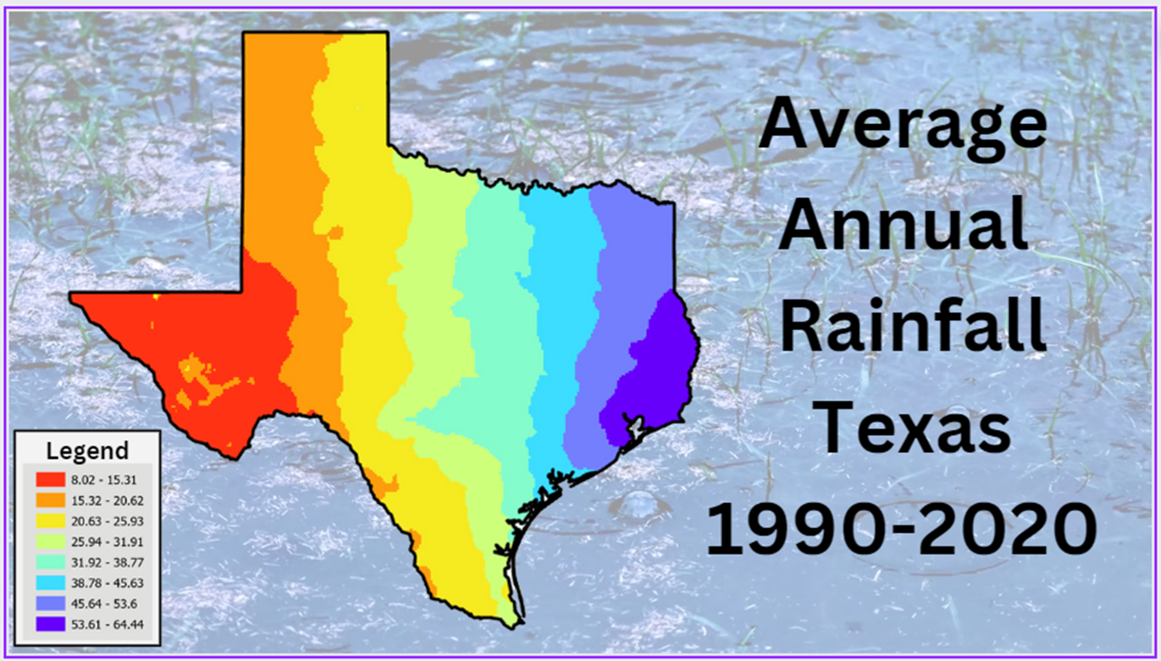
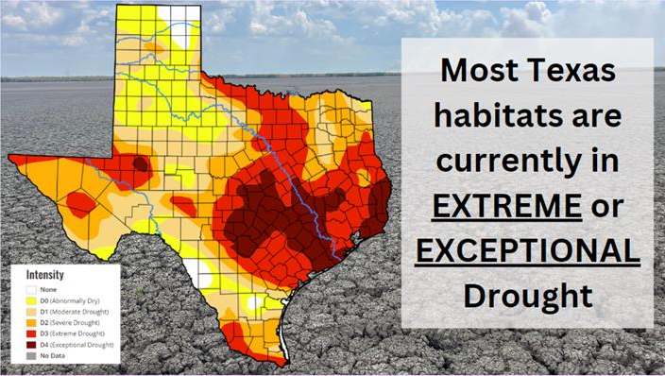
2023

Slide 6
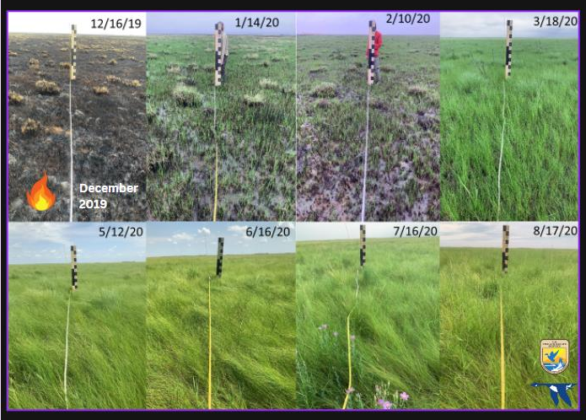
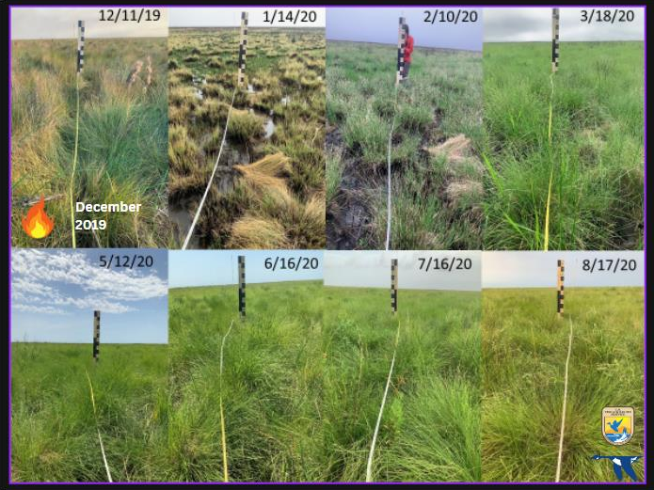

Slide 7
Land Management Techniques on Anahuac NWR
Fire
Grazing
Organic Rice Farming
Spraying
  Individual Plant Treatment
  Aerial Spraying (Fixed wing/ helicopter/ drone)
  Boom/Wand Spraying (Airboat/Marsh Master/ ATV/UTV)
Mechanical
  Aerator
  Mowing – Marsh Master/Tractor
  Mulching

Slide 8
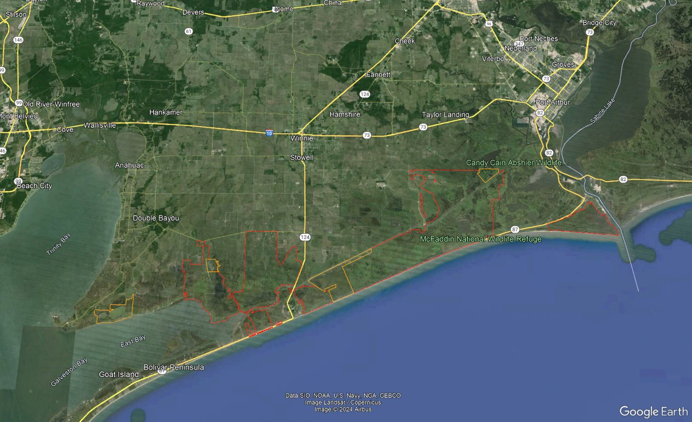

Slide 9
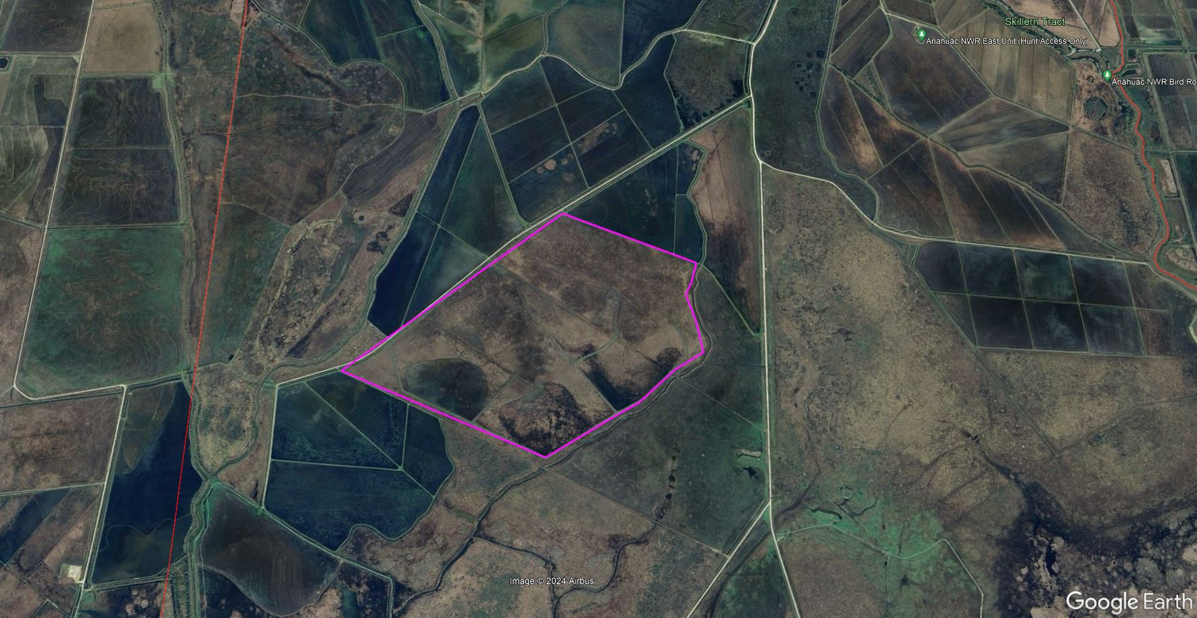

Slide 10
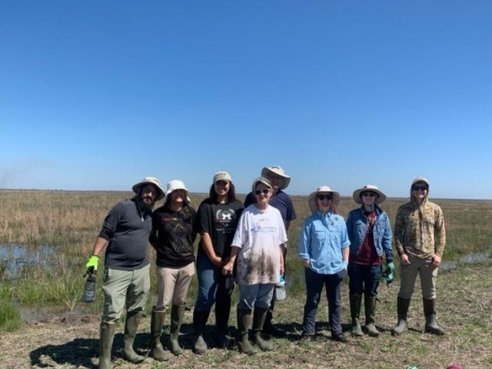
Pintail Partnerships
Texas A&M AgriLife Extension Service (AgriLife)
Ducks Unlimited
Texas Rice Industry Coalition for the Environment (Tx RICE)
North American Wetlands Conservation Act, DU, Texas Commission on Environmental Quality (secured by AgriLife and passed through to DU), and USFWS Coastal Program.

Slide 11
The thought behind Pintail Restoration…
The technique used for this project restored historic wetlands and uplands within the Unit with the objective to provide habitat functions and benefits resembling what was once on the landscape before human alteration

Slide 12
Pintail Unit Design and method….
The project design was based off historical imagery and soil cores to determine presence of upland and wetland habitats existing prior to human manipulation of the land.
The soil data determined depth of excavation to restore wetlands filled in by land leveling for agriculture.
Local prairie seed and wetland plant propagules were also acquired through partnerships with AgriLife and TX RICE to replant upland and wetland sites in the project area.

Slide 13
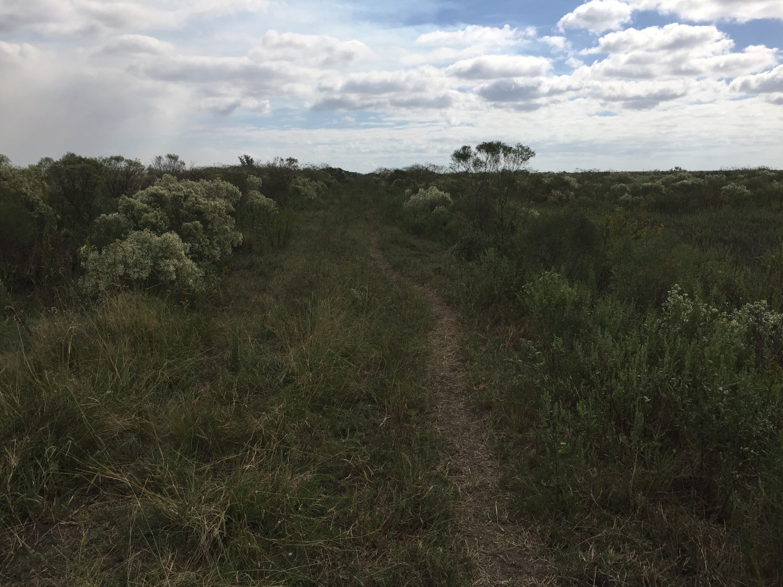
Steps
Site Preparation / Brush removal
Surveying
Soil Coring
Design and Construction
Planting (aerial, mechanical, no snow)
  Mechanical followed by aeration (seed to soil contact)
  By hand (wetland areas) grow out ponds (on & off site) based off Sheldon Lake

Slide 14
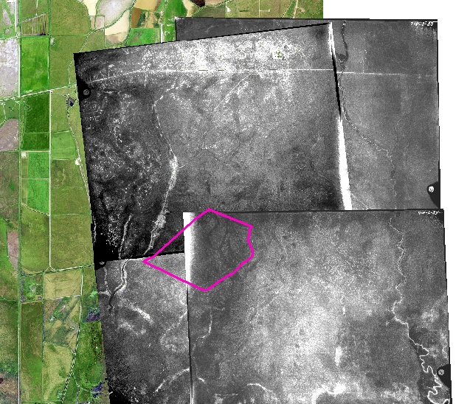

Slide 15
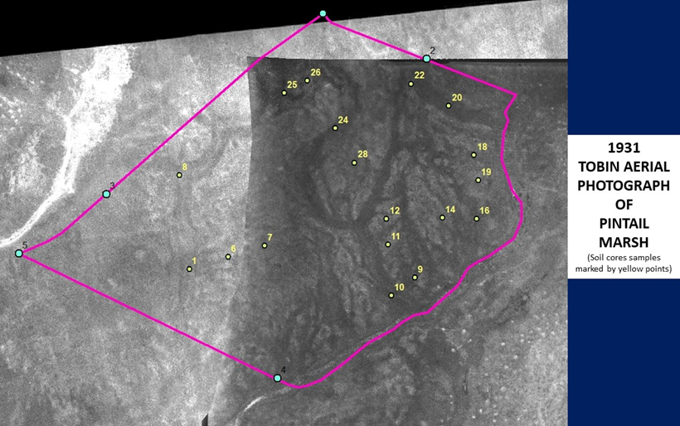
Soil Cores – 17 samples
Sample collection was completed in September and October 2018 by field staff: Marissa Llosa, Andy Rydzak and Rosemary Kline. All samples were collected by hand, and half of the collected samples were assessed in the field by Marissa Llosa. Several samples were returned to the office and assessed by Dr. John Jacob.

Slide 16
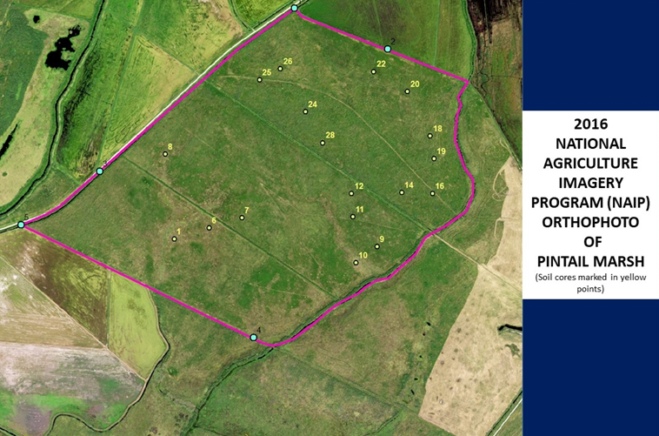
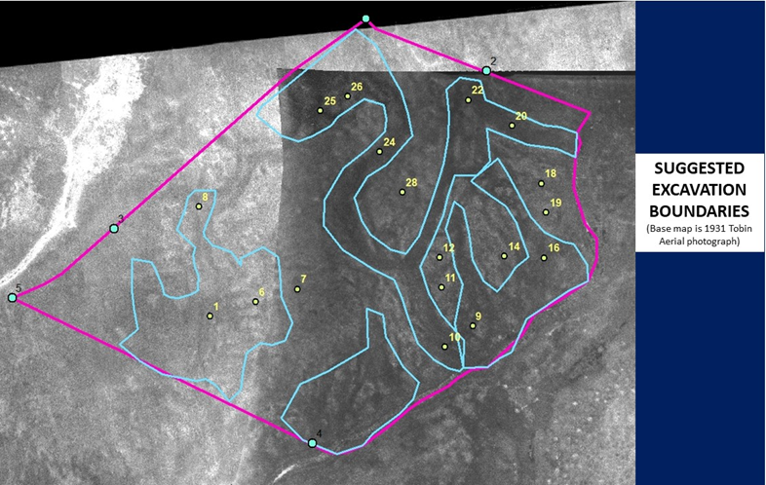

Slide 17
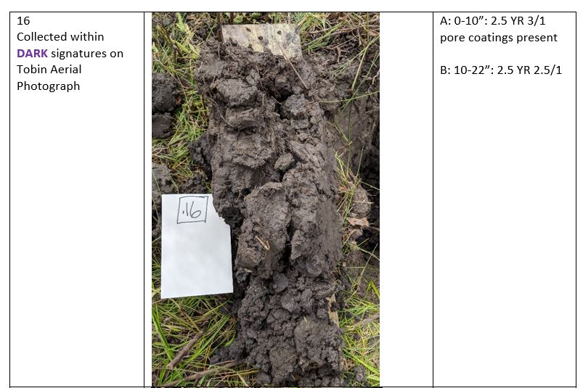
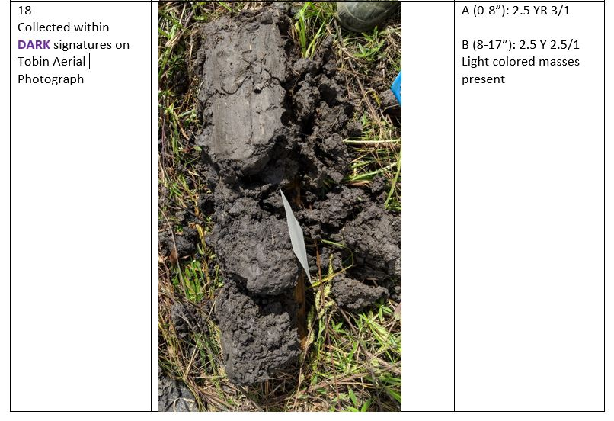
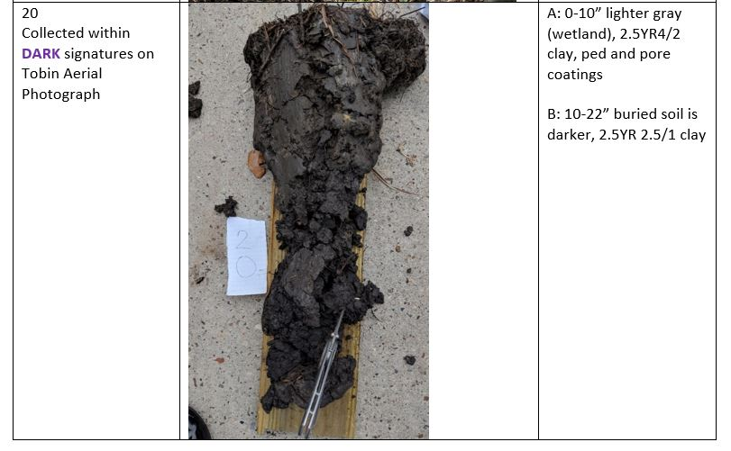
Soil Core Samples

Slide 18





























































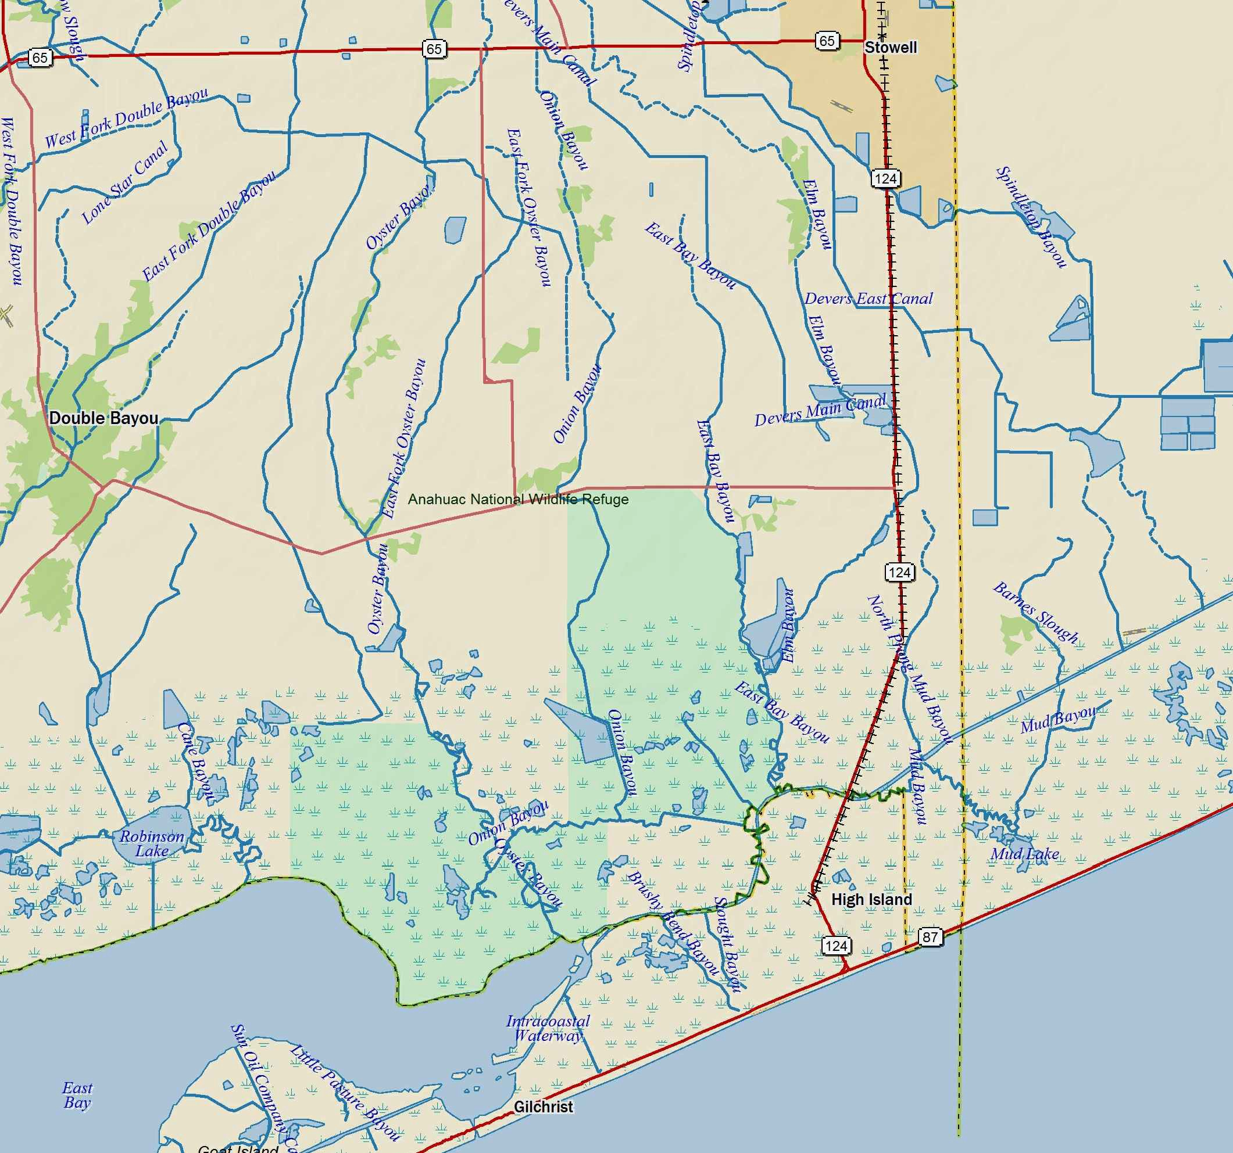
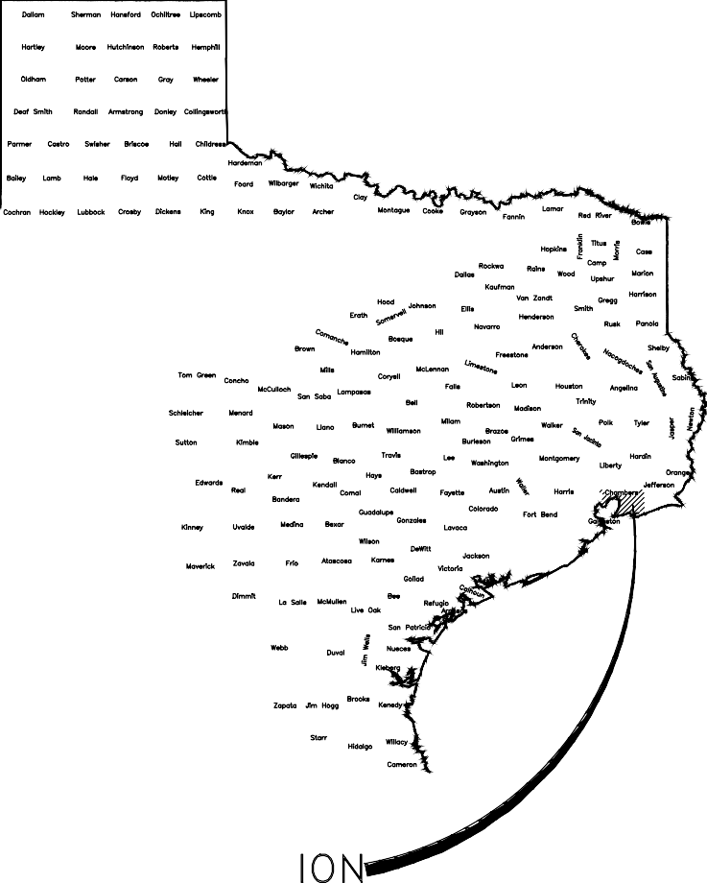
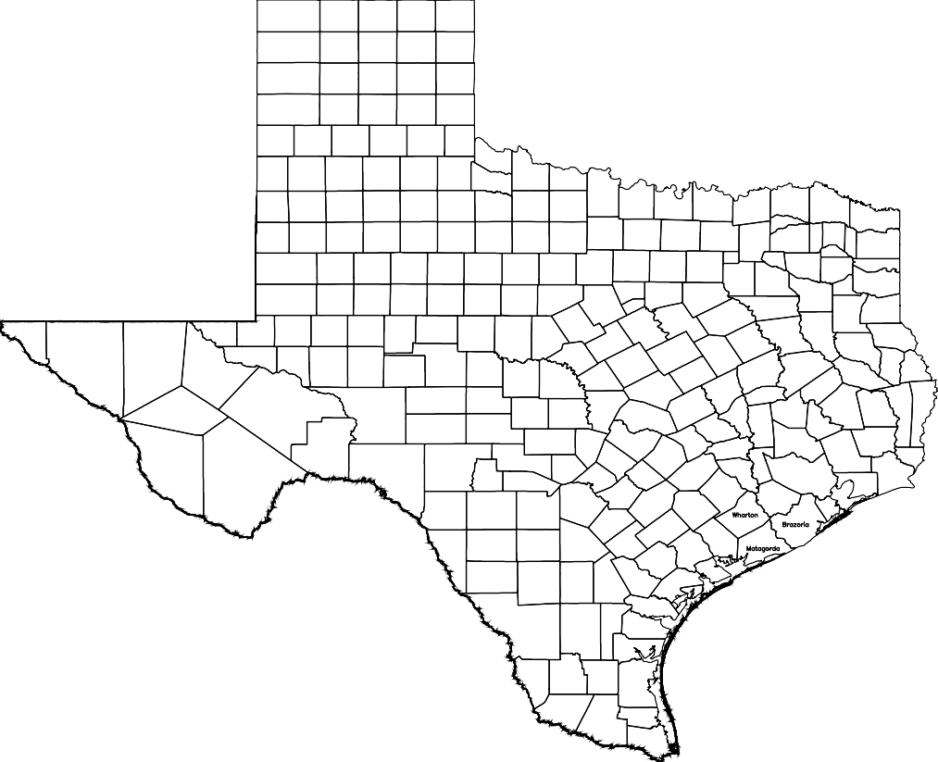


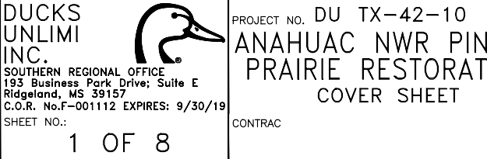
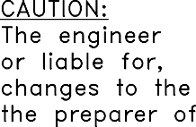
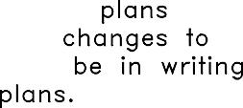


Slide 19
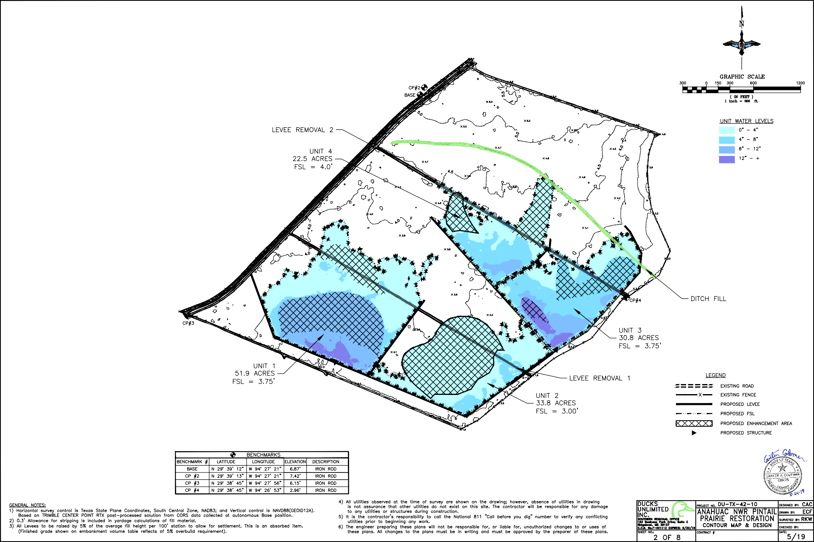

Slide 20
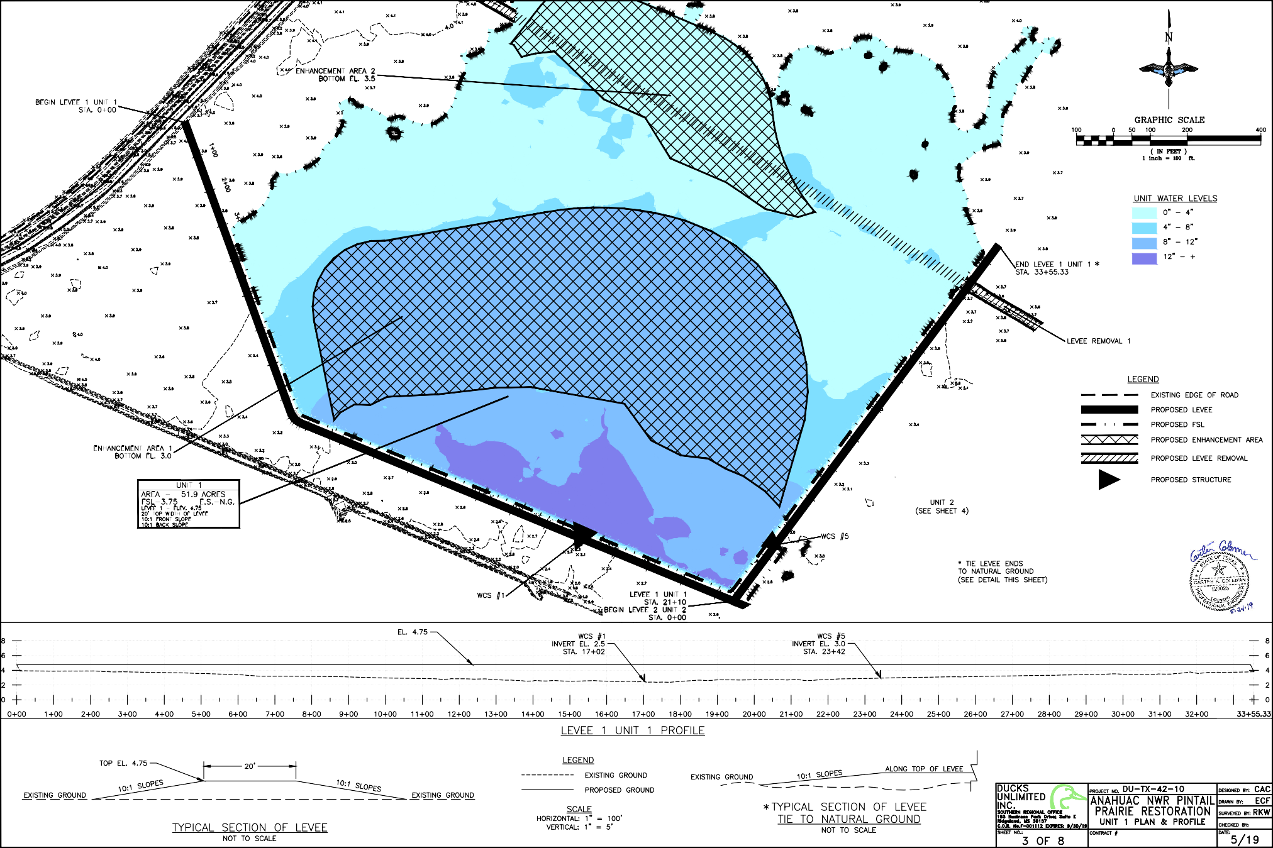

Slide 21
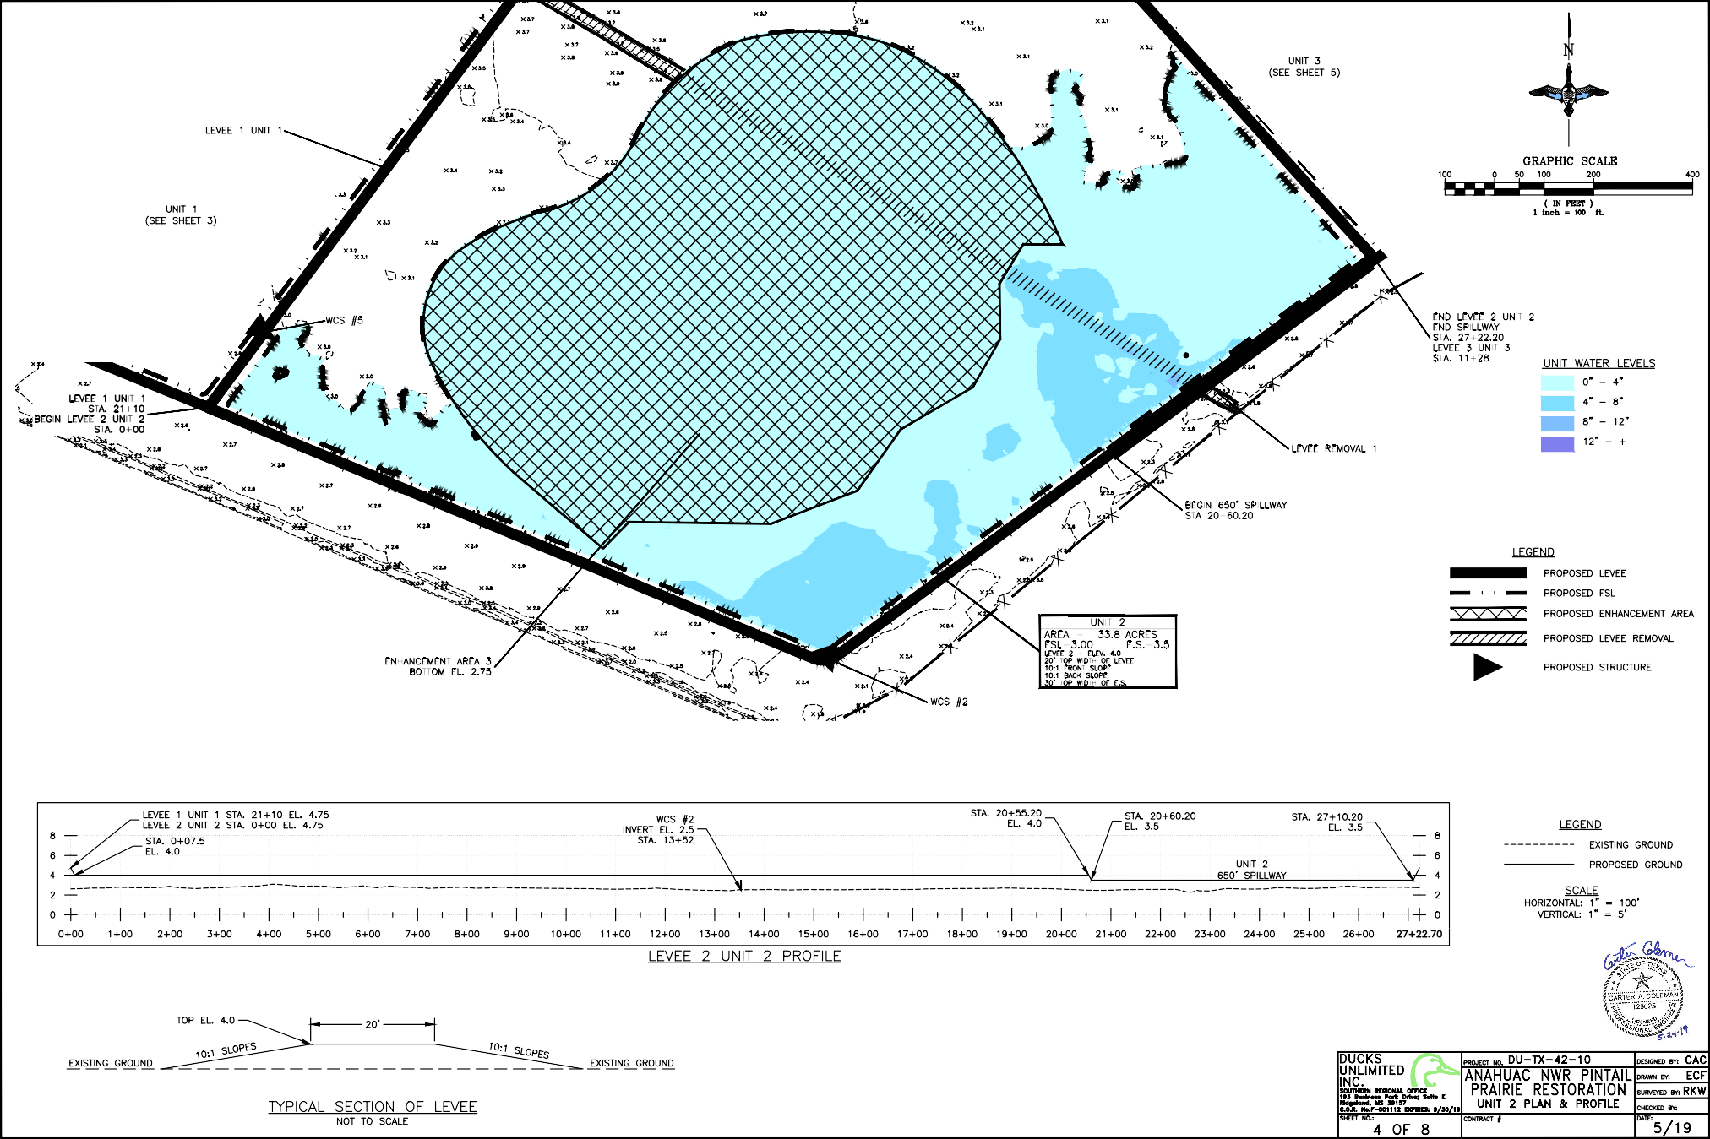

Slide 22
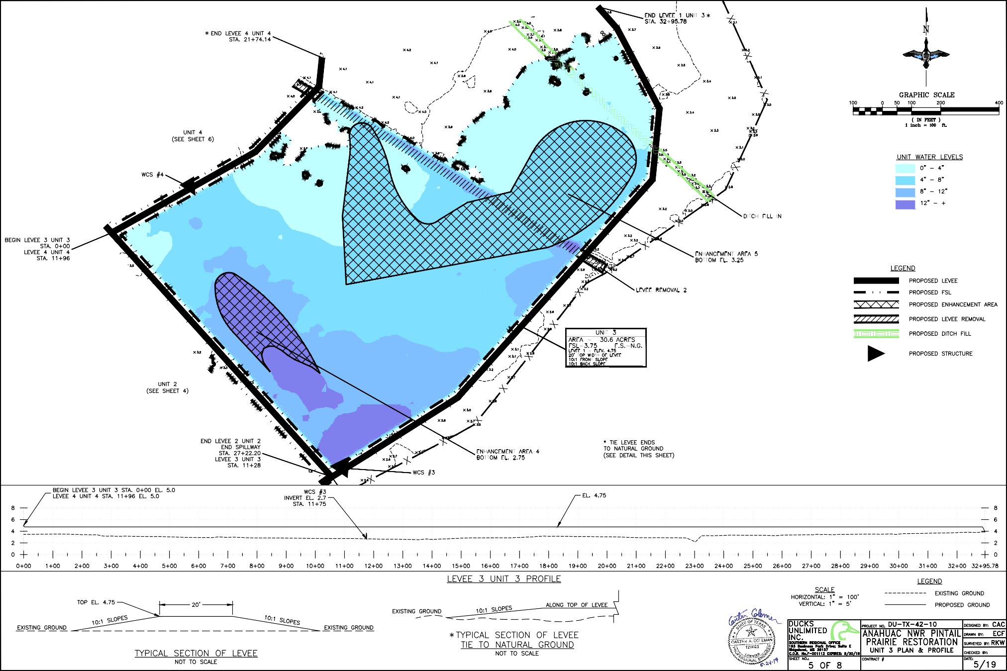

Slide 23
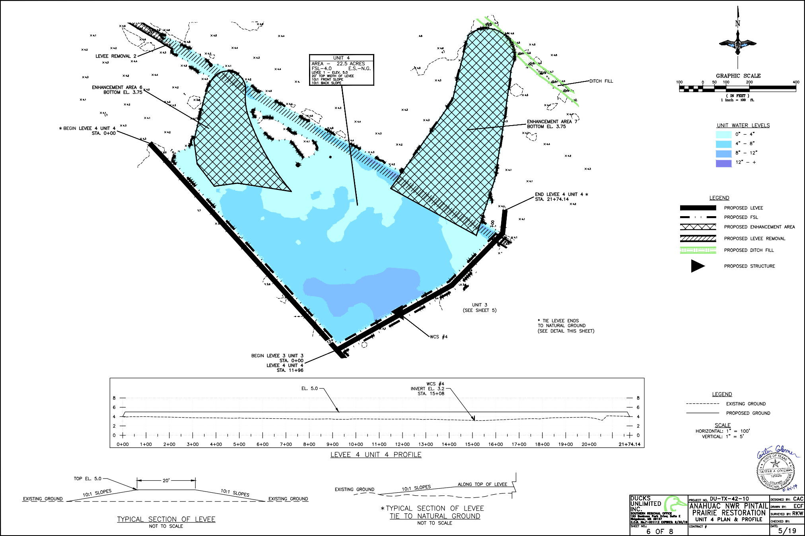

Slide 24
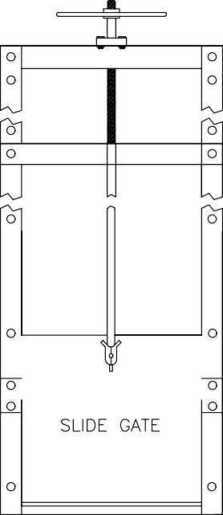
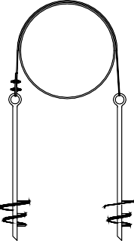




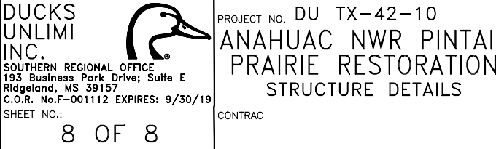

Slide 25
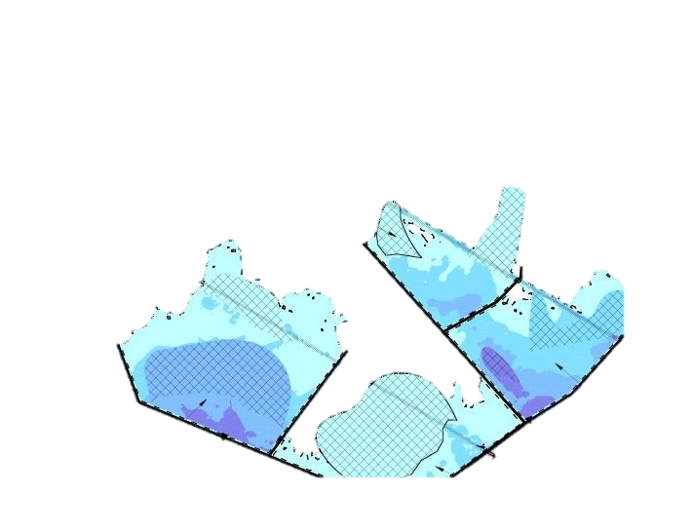
Pintail Unit Design Overlay

Slide 26
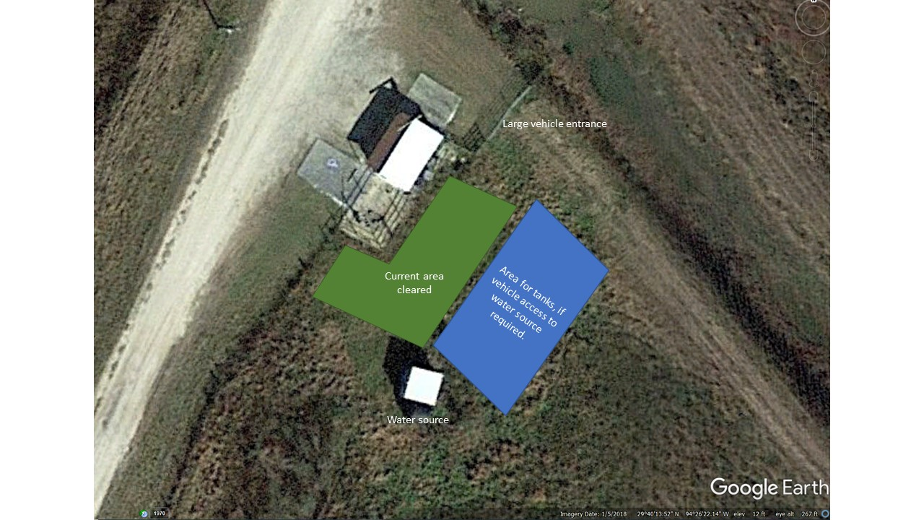
Species Mix
Upland Forbs / Grass
Wetland
Little Blue Stem
Indian Grass
Silver Blue Stem
Tall Drop Seed
Brownseed Paspalum
Long Spiked Tridens
Eastern Gama Grass
Big Blue Stem
Switchgrass
Various Sedges
Jungle Rice
Millet
Bushy Blue Stem
Basketflower
Windflower
Prairie Nymph
Blue Eye Grass.
Stiff Stem Flax
Indian Paint Brush
Prairie Plantain
Green Milkweed
Prairie Parsley
Green Wild Indigo
Mexican Hat
Indian Blanket
Clasping Leaf Coneflower
Black Eyed Susan
Illinois Bundle Flower
Gayfeather
Yellow Thistle
Spiderwort
Rosinweed
Maximilian Sunflower
Swamp Sunflower
Blue Eye Grass
Horse Mint
Fall Aster
Narrow Leaf Mountain Mint
Wand Goldenrod
Tall Goldenrod
Rattlesnake Master
Baldwin’s Ironweed
Obedient Plant
In total we planted 1000 plants and distributed roughly 2000 seedballs

Slide 27
Cost ….
$513,050
Expenses associated with project planning and coordination
Engineering and design
Construction, contract management
Vegetation planting

Slide 28
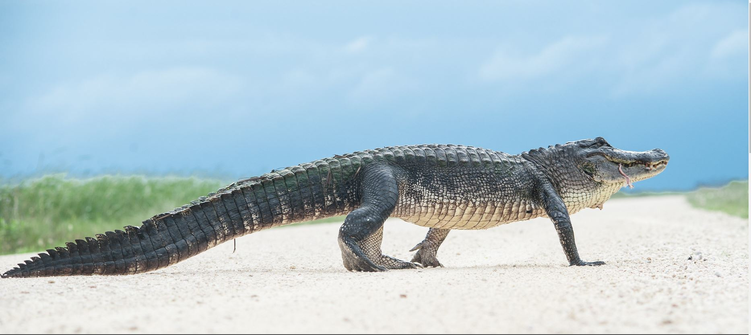
See you later….

Slide 29
Comments/Questions/Discussion

Slide 31
