Slide 1
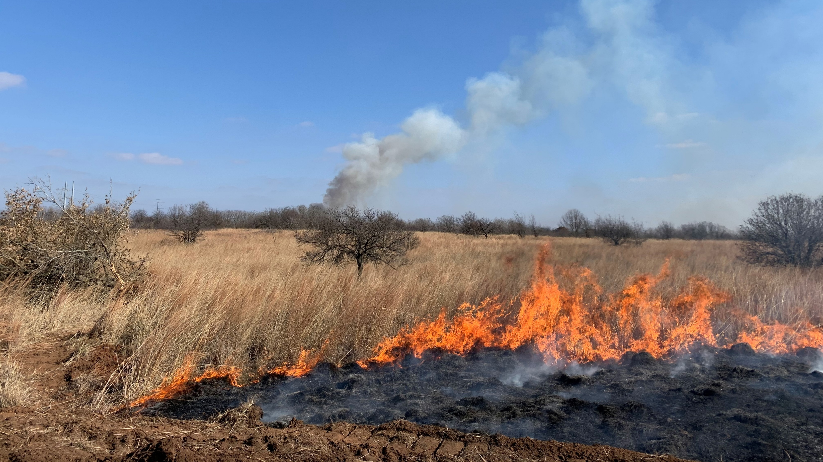
Beyond The First Step
Derek Wiley: Conservation Delivery Specialist OPJV/TPWD
Notes:
Introduce yourself, background, and why this topic of importance
Considerable money spent on installing practices every year, not as much money spent on maintaining work
All conservation efforts need conviction and willingness to constantly be working on something

Slide 2
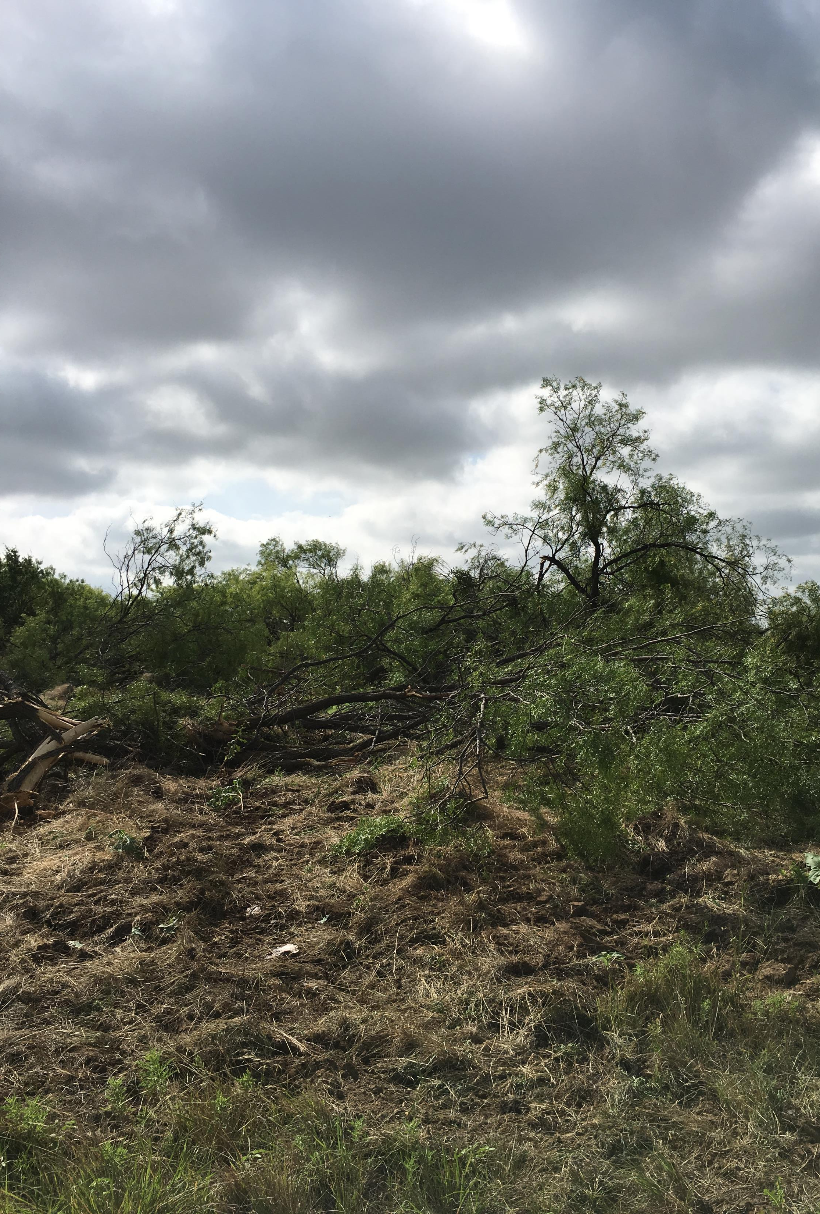
Initial Practice Installed, Now What?
  Practice maintenance is key to sustaining the INVESTMENT in conservation
  Rarely is installing a conservation practice the end of the road for land management
  Plant succession never stops, particularly in areas with high amounts of rainfall and long growing seasons
Notes:
Besides the monetary investment of purchasing a property working on restoration is an investment, in time, money, sweat, blood and tears. As with any investment most people want to focus on growing and improving their investments, making them better over time. Land management is no different. Initial investments are made but then consistent attention must be paid to that investment to allow it to grow and develop into the end goal. In this case we’re talking about excellent coastal prairie habitat.

Slide 3
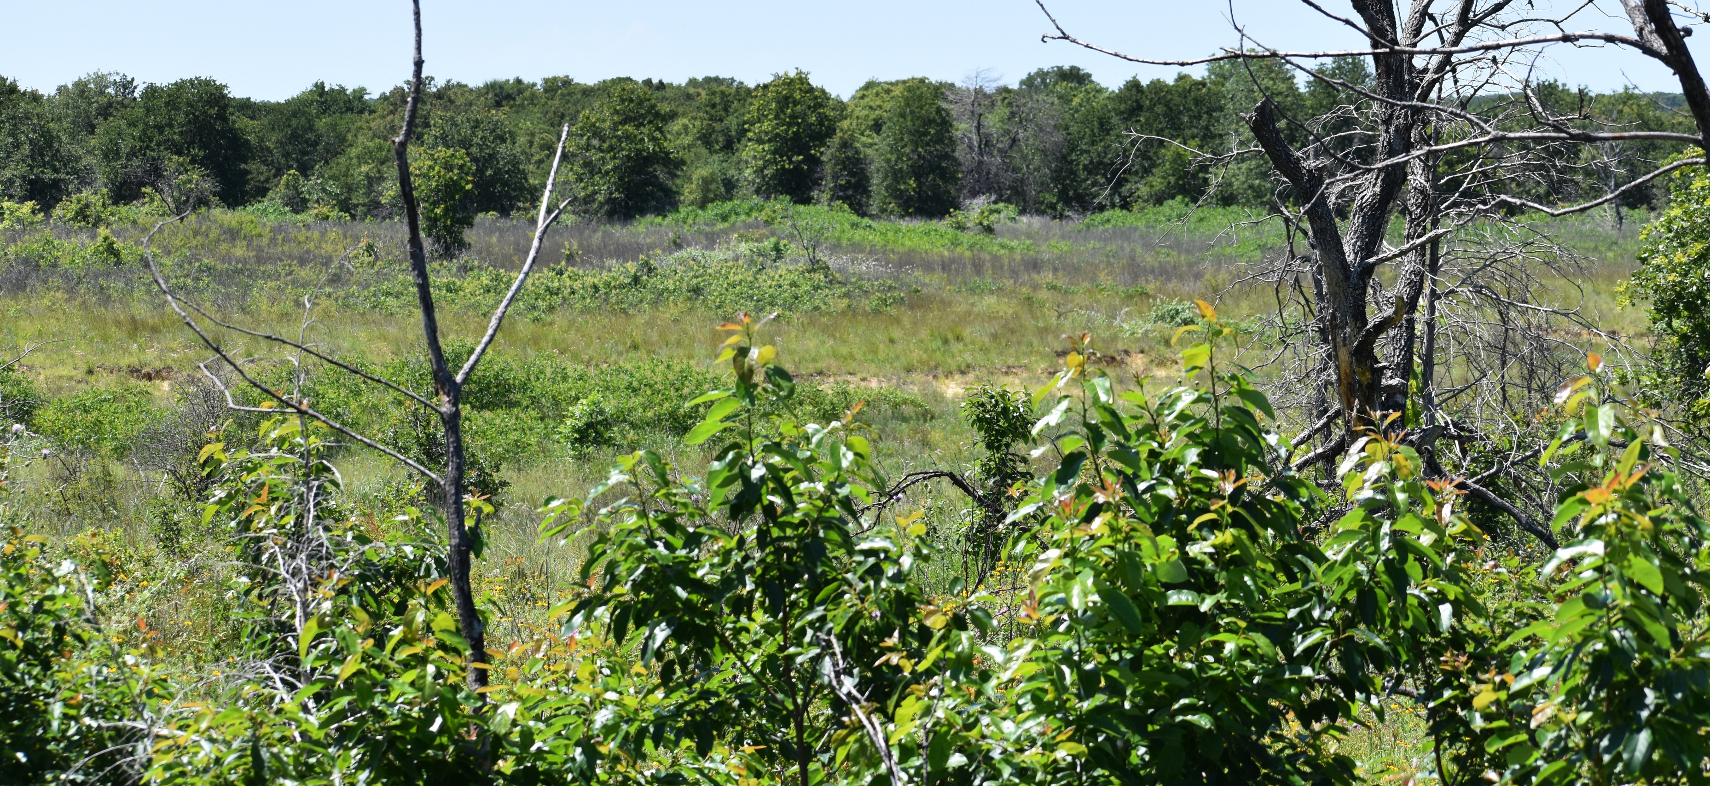
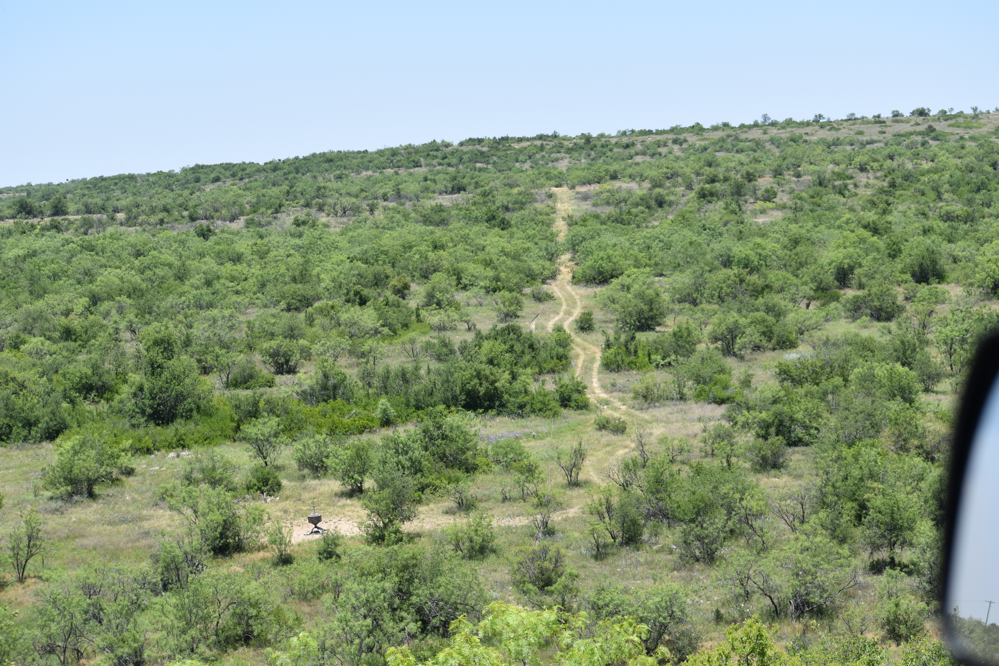
Where is the ideal place to stall succession?
This varies by geography and landowner objectives, however starting with what a property was historically and what ecological processes likely limited the system is a great place to start.
Not all properties can or should be fit into the same mold
Web Soil Survey is a fantastic resource for evaluating soils, climax plant succession stages and what the property is most likely capable of producing.
Notes:
Particularly for grassland systems most of the ecosystem processes will be the same, fire, grazing, and rest are the most important aspects of grassland management. We will considerably about those today. Based on individual objectives for a property different management activities can take place but starting with what a property could be is the best way to avoid heartache in forcing a square peg into a round hole for desired habitat conditions.

Slide 4
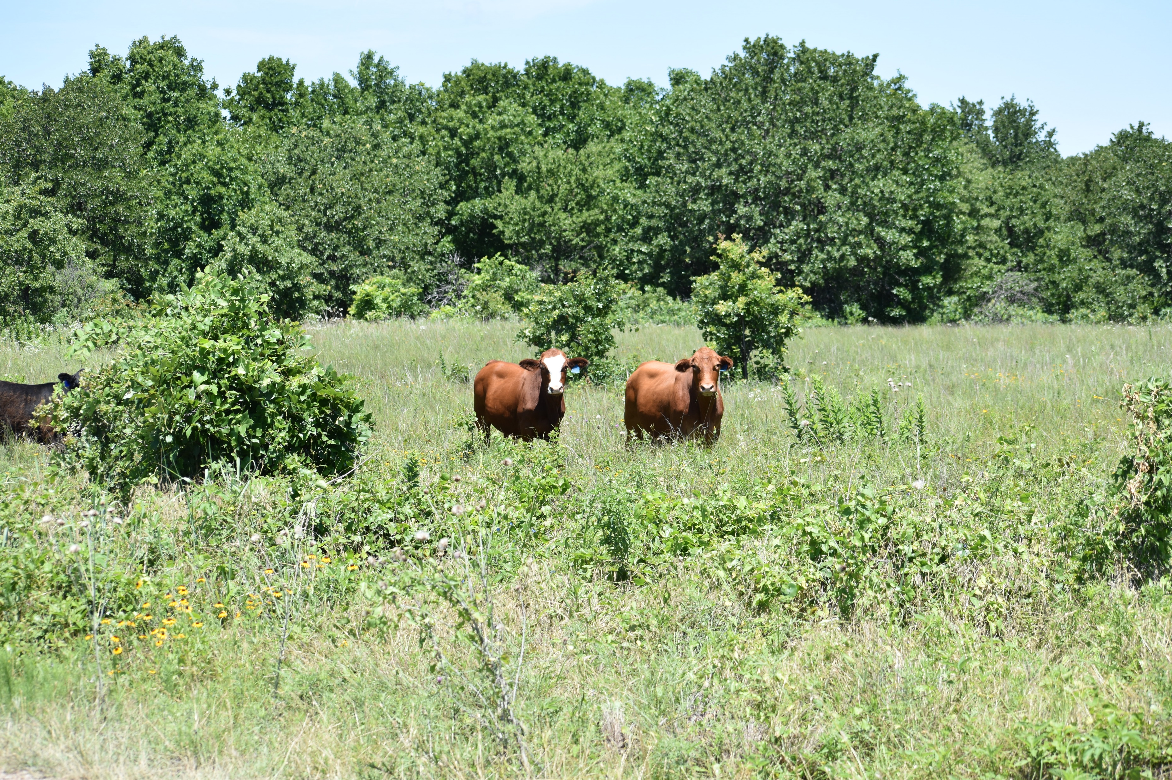
Landscape of Disturbance
In Texas, the majority of our ecosites evolved with frequent disturbance, exceptions for far west Texas. Historically these disturbances revolved around two primary disturbance factors:
  Fire
  Grazing
Notes:
Coastal Prairies certainly included this disturbance. Fire return intervals in here are generally 3 years or less. Season of burn is not quite as important as burn frequency and that is especially important in areas that need to burn this frequently to maintain reduced woody cover amounts. In the absence of these large disturbance factors, other methods of disturbance can be used but not necessarily replacing the major ecosystem drivers listed above. Quite a bit can be done with herbicides to reduce woody vegetation, but we don’t get the increased nutrient cycling and reinvigoration of herbaceous plants with this treatment. Same thing with mowing and haying, while still better than doing nothing replacing completely fire, grazing and the interaction amongst the two is not quite possible.

Slide 5
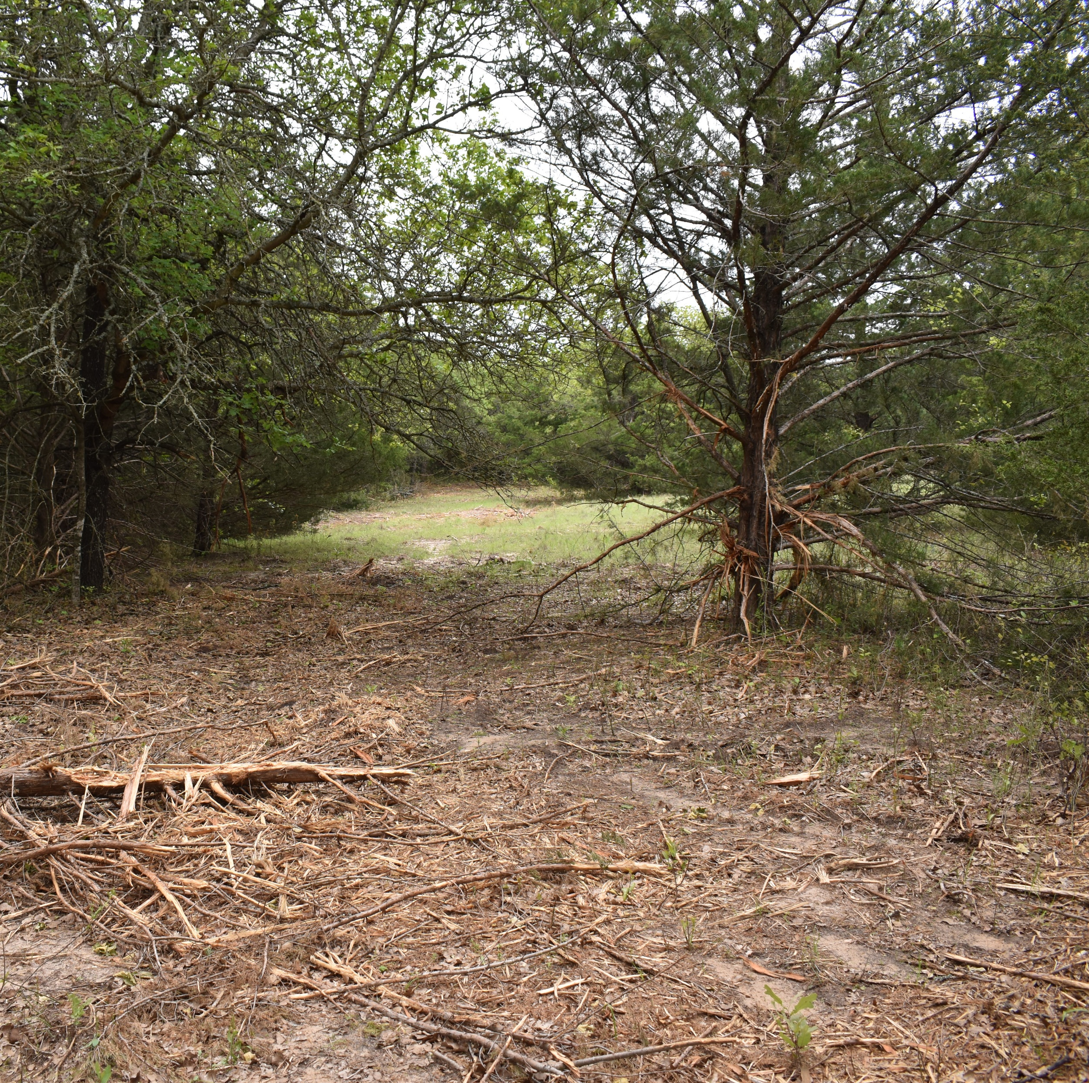
Absence of Disturbance
With suppression of fire followed by intense continuous grazing, and cropland conversion much of our landscape changed
The disturbances that created much of the productive pre-European ecosystems were altered
Many of these altered systems are quite expensive to restore

Slide 6
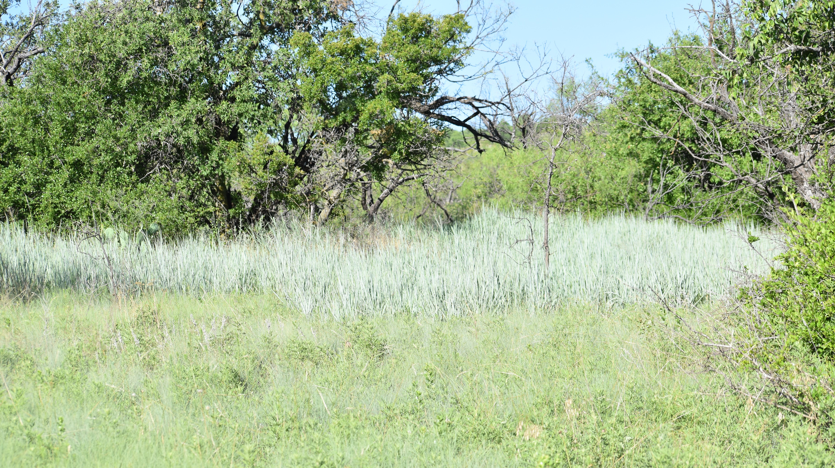
Habitat Restoration is Expensive
Heavy Mechanical Brush Management – Estimated to cost roughly $475/ac. (NRCS Scenarios FY22).
On large scales this is not work easily accomplished or afforded for most landowners
Managing this investment to extend the life of a practice is almost essential
Notes:
This is where beyond the first step really hits home. Particularly with landowners that are managing their property as working lands; consistently spending this kind of money on a property to produce more vegetation is cost prohibitive. Without extending the life of a practice and including extensive management spending the money to restore a property to good coastal prairie or any prairie habitat may not make sense. However, with using maintenance practices such as fire and grazing that are relatively inexpensive to use ~$10/ac. for prescribed fire application restoration makes much more sense. Fire application also improves vegetation quality for livestock, and properly grazed, can increase gains.

Slide 7
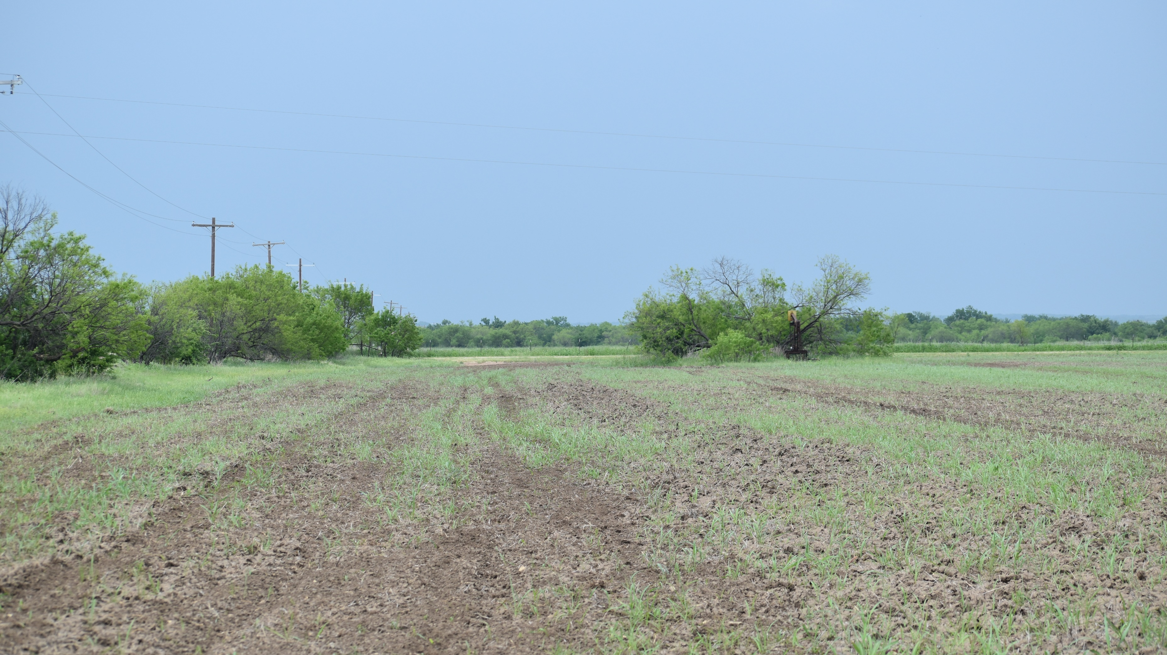
Habitat Restoration is Expensive
Cropland conversion to native vegetation is estimated at $175.73/acre (NRCS scenarios FY22).
Again, this is cost prohibitive to do consistently and without management that investment will be lost
Notes:
The lifespans of these practices can vary drastically, brush management is typically 10 years. Range planting is listed at 40 years. However, without consistent maintenance of these practices they will not last that long before needing treatment again. Consistently doing the same practices on the same acres is not going to move the conservation needle in the direction we need it to go. Climate issues are front page news almost daily it seems. Without changing the status quo for land management that is going to continue to be the case. Restoring healthy diverse ecosystems and importantly the ecosystem services they provide will play a huge role in climate and conservation issues moving forward.

Slide 8
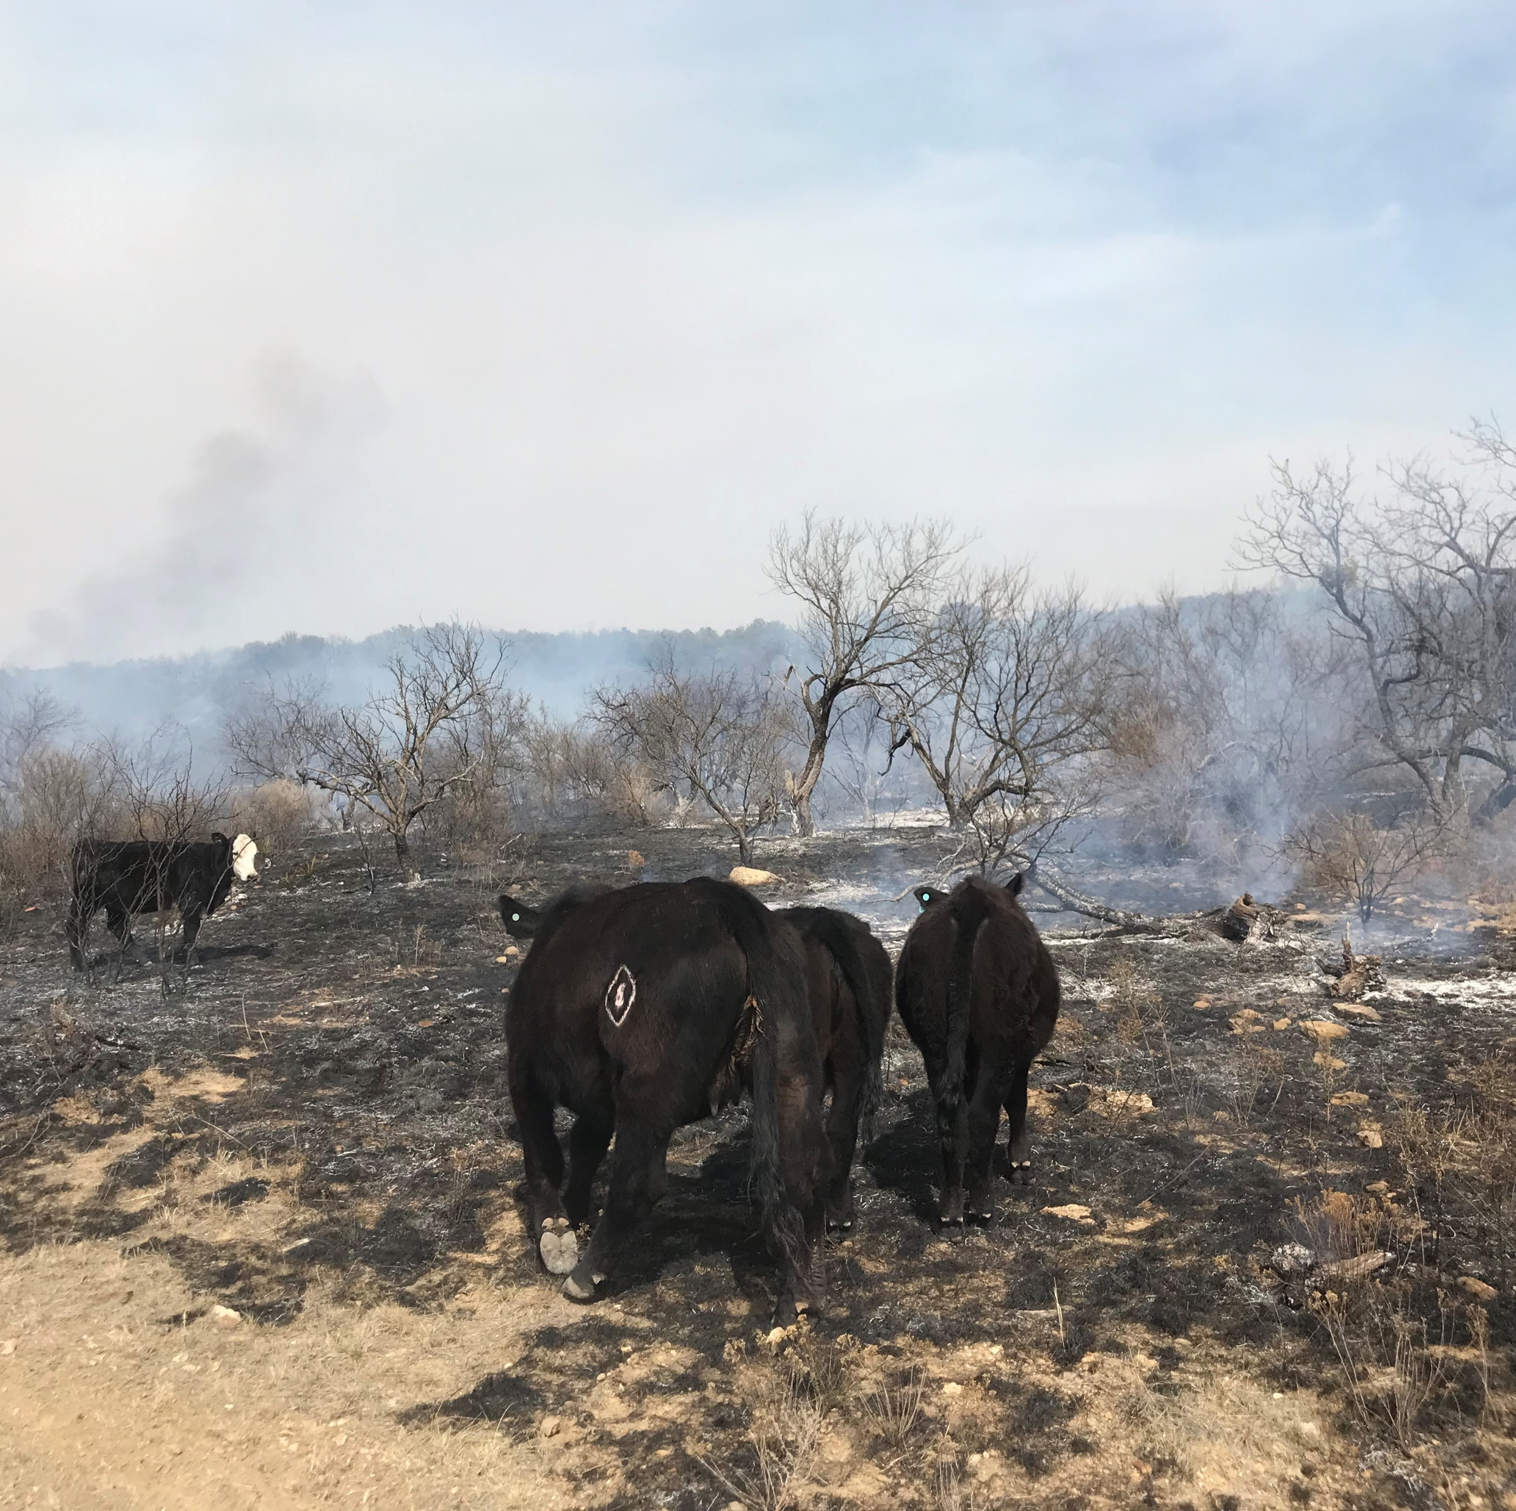
Fire and Grazing
Ultimately the interaction of fire and grazing is pinnacle of native grassland restoration and management efforts
As with any grazing system care must be taken to not abuse a particular pasture, however with planned grazing and observation fire and grazing can work hand in hand

Slide 9
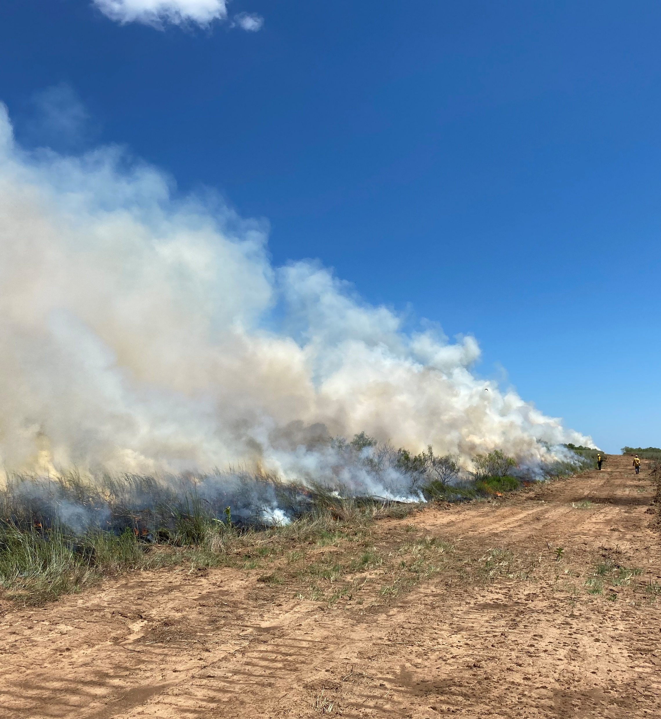
Intensive VS. Extensive Management
Where possible I prefer to do extensive management practices – practices that cover large acreages with a cheaper cost
  Prescribed Fire
  Prescribed Grazing
  Aerial treatments of brush vs. mechanical treatments etc.
Notes:
Keep in mind that some of these will require an intensive approach first followed by extensive afterwards. Restoring a solid mesquite infested cropland field won’t be addressed through fire alone, at least not in a quick timeframe. Jumpstarting the restoration process is often required. There are any combination of methods to start the process but the maintenance efforts will likely be the same and most easily accomplished with extensive methods. Much easier to treat a 200 acre pasture with a prescribed fire that takes 2-3 hours than it would be to spot spray every tree coming in. That’s not to say that some spraying won’t still be needed, the amount is just lessened.

Slide 10
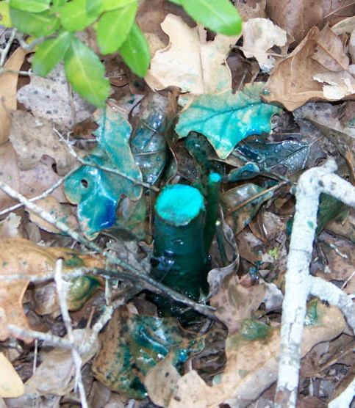
Intensive VS. Extensive Management
Not always possible for extensive management practices
  Small Acreages
  Invasive Species
  Lack of Infrastructure
    Boundary Fencing
    Water
  Smoke Management Issues

Slide 11
Management or Maintenance Plan
Creating a plan for your property is the best first step, then slowly chipping away at the objectives
  Don’t be overwhelmed take one section at a time
  Consider doing one expensive practice and one extensive maintenance practice annually
A management plan doesn’t have to be incredibly detailed, could just be a map with practices listed by year for a particular pasture
  Some practices are more timing specific than others
Notes:
All sorts of systems that could work for this, pick something that works best for you to organize your habitat management activities and stick with it. If a paper system works best for you great, if it’s a laminated map that you mark on with dry erase great. Stay organized.
Good to come up with a 5 year plan, 10 year plan, hopefully management in perpetuity. What do you need to do to ecologically make this work? How are we going to manage this to make it the best that we can.

Slide 12
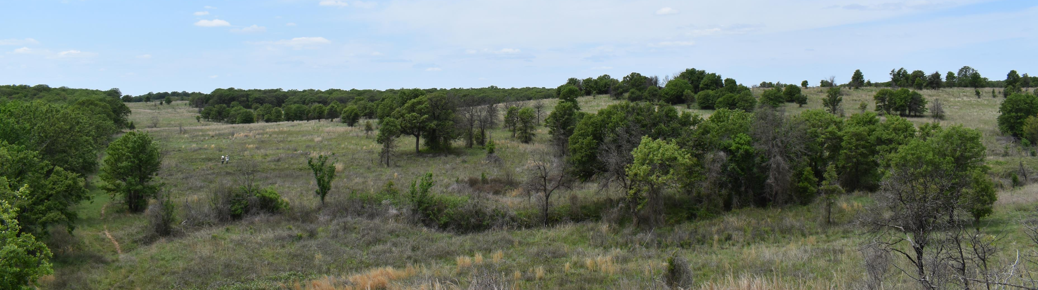

Common Issues with Maintenance
Grazing Management
No Monitoring – easy to overlook gradual change when constantly evaluating the same site, this leads to complacency
Stay Focused
Be Realistic – how much can your operation truly handle in any given year
Notes:
Often consistent overgrazing is an issue, hitting a restored field or pasture too hard one year is OK, consistently is not a good strategy for maintaining grassland health and diversity.
Overlooking encroaching woody cover is easy to do unless there are some established reference points to see the change coming
There are tons of new chemicals, methods, ideas floating around at all times. Landowners that stay focused on their management plan but incorporate new ideas on a small scale to see if they will work first tend to be the most successful. Don’t let yourself be distracted by too many options and do nothing in the end. Pick an avenue and stick with it for a little while. I also run into fear of doing anything because there is a chance of spreading invasive species. At the end of the day if there is that much of an invasive species present, do what you can but manage as much as possible for diversity. We will likely never kill all of a particular invasive species, learn to manage it.
What is your capability to do certain management activities? What are the limiting factors and how can you best address them? Are these capacity issues something that may be fixed quickly or will it take more time/experience?

Slide 13
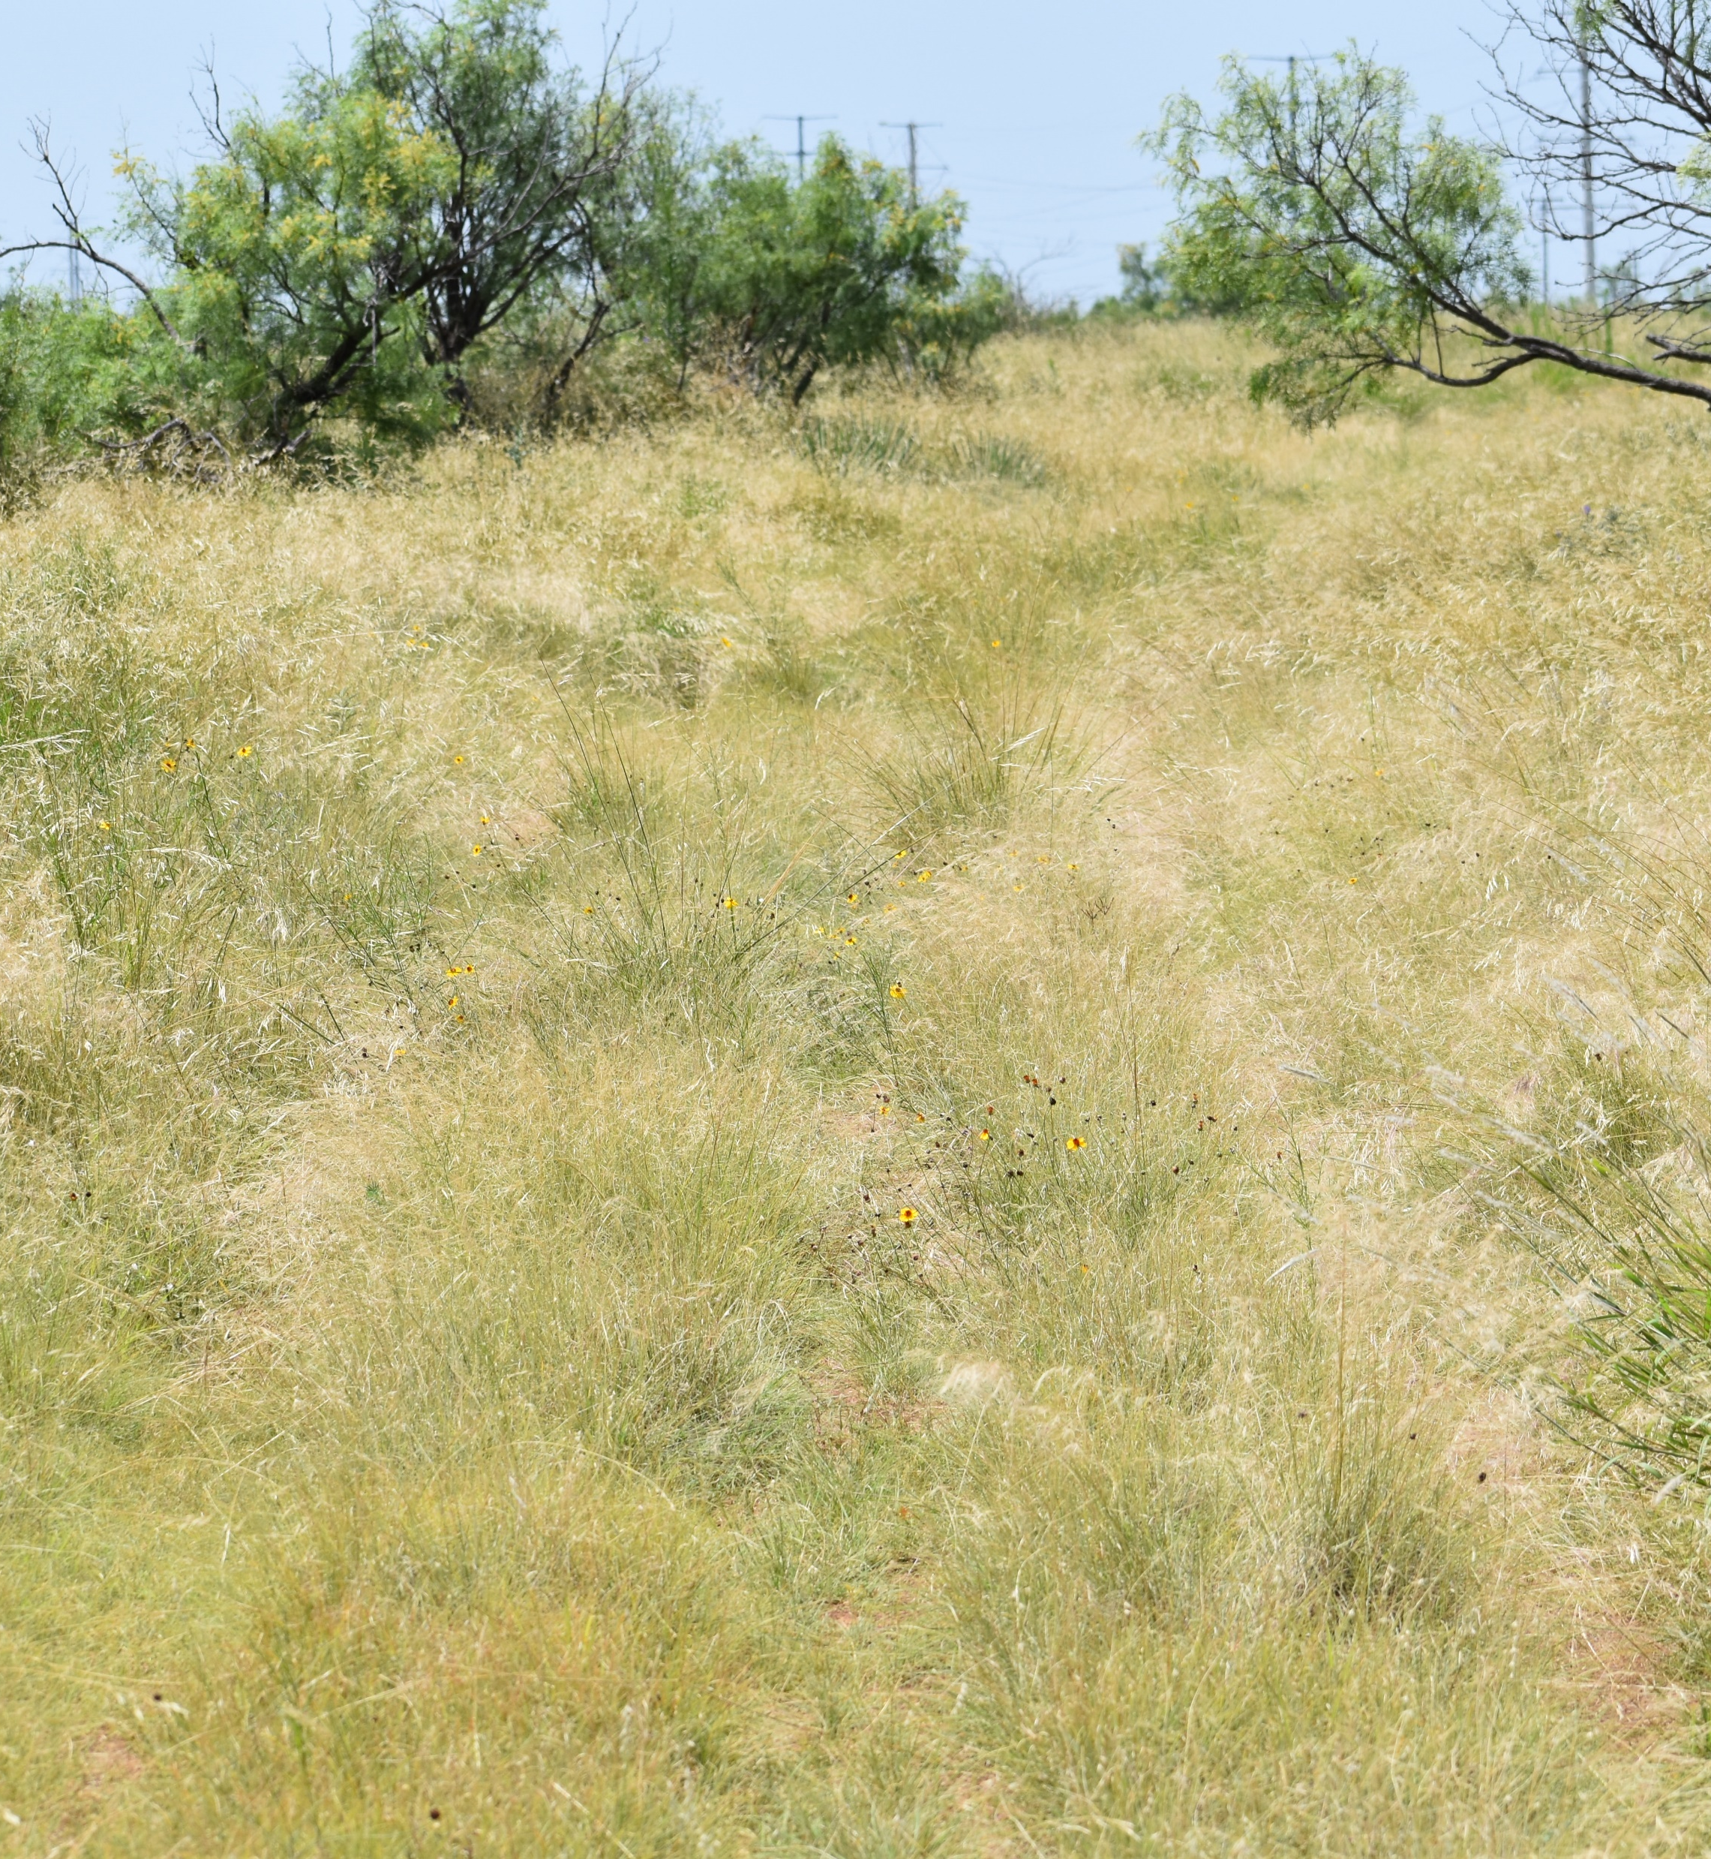
What Do I look for in a GRIP Project?
Ecologically Sound?
What maintenance methods do they intend to use?
What is the stocking rate?
How much of the property is currently in good shape?
Notes:
What do you look for in a GRIP proposal? What is the project wanting to address and is that ecologically sound? I.E. resprouting shrub species being mulched or attempting to kill resprouting large brush with fire. Is this going to move the needle in the right direction for grassland habitat and habitat management for grassland birds and other wildlife? Is there a plan or willingness in place to manage the property appropriately? Is an adequate stocking rate in place? How much of the property is currently grassland and can this make a difference? How close is this to other projects?

Slide 14
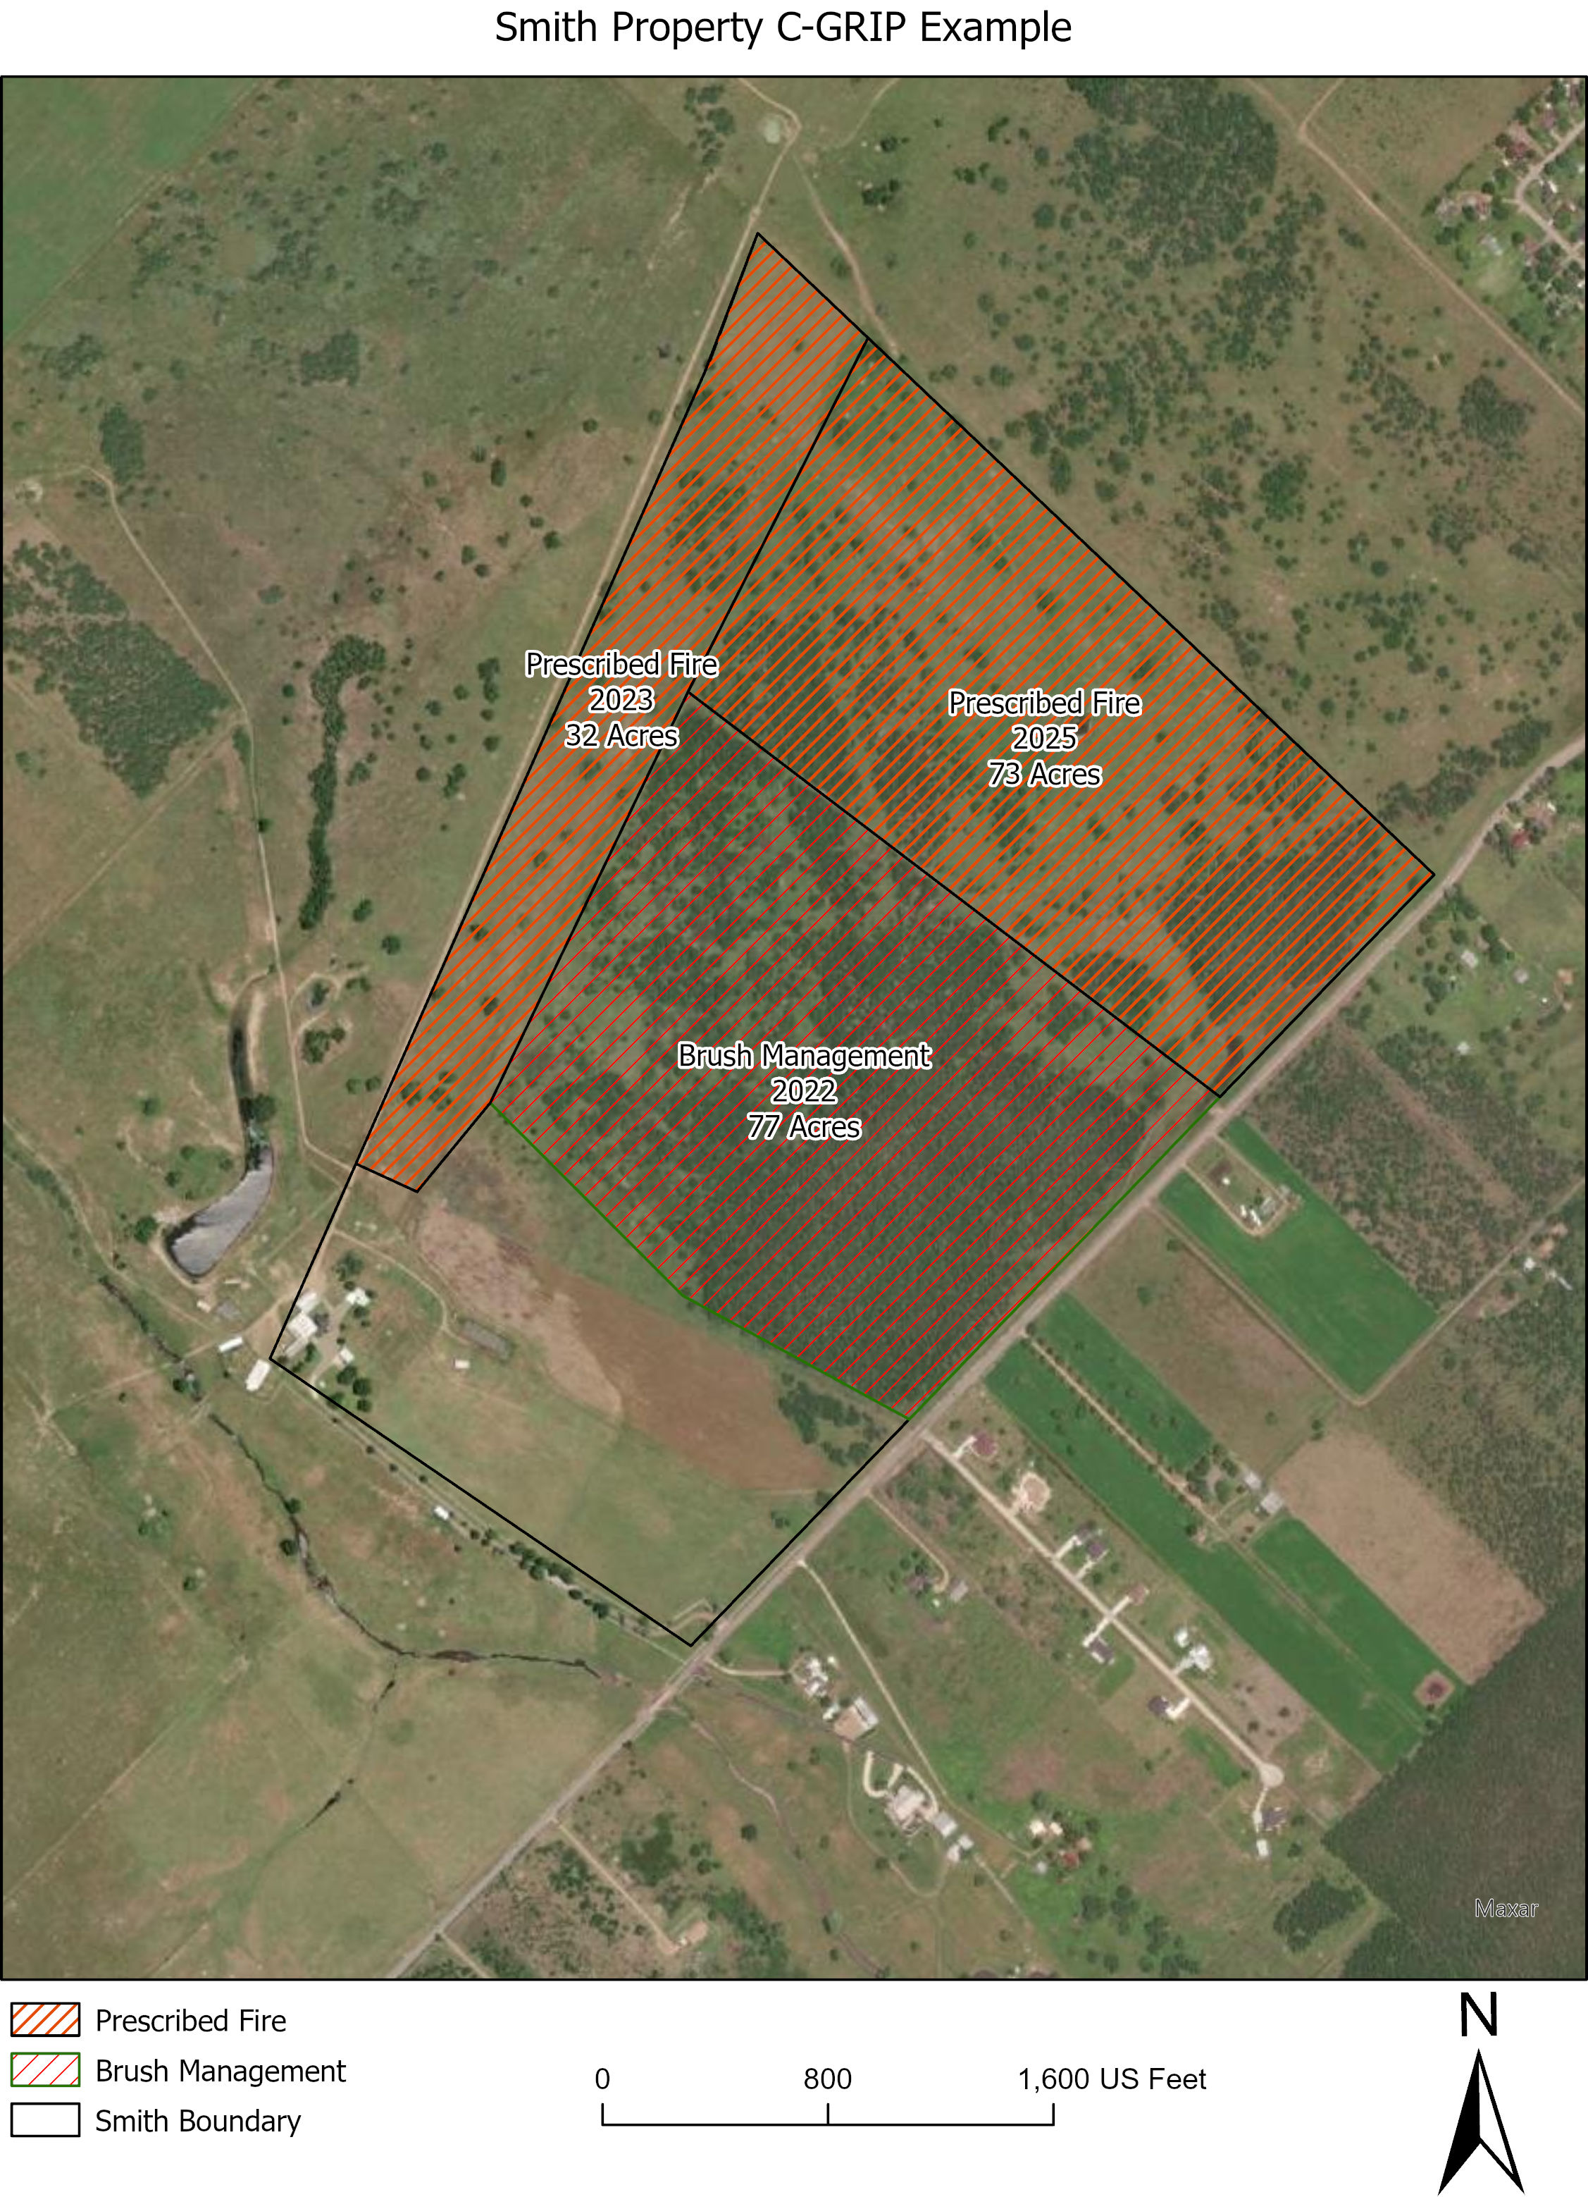
Notes:
This could easily be manipulated to show different practices for the same year on a particular pasture. What would this plan look like 5 years from now? Keeping in mind that management practices need to change seasons and likely intensities (grazing).

Slide 15
THANK YOU
Derek Wiley
Derek.wiley@tpwd.Texas.gov
512-902-7379

