Slide 1
Monitoring Wildlife (But Mostly Birds)
Anna Matthews, OPJV Science Coordinator
amatthews@abcbirds.org

Slide 2
Monitoring
It’s Important!
Evaluate success of programs
Identify treatments that are ineffective
Provide evidence to funders of what their money is doing
More agencies, orgs, funders are asking for evidence of success

Slide 3
Thousands of Way to Monitor Wildlife

Slide 4
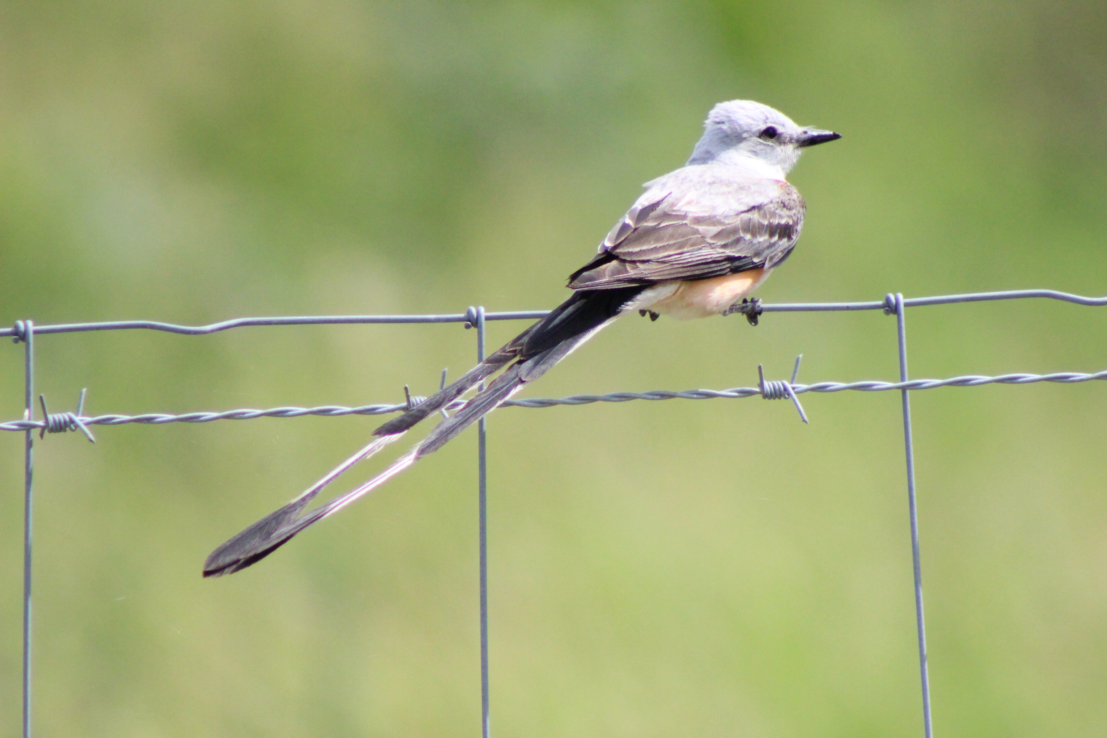
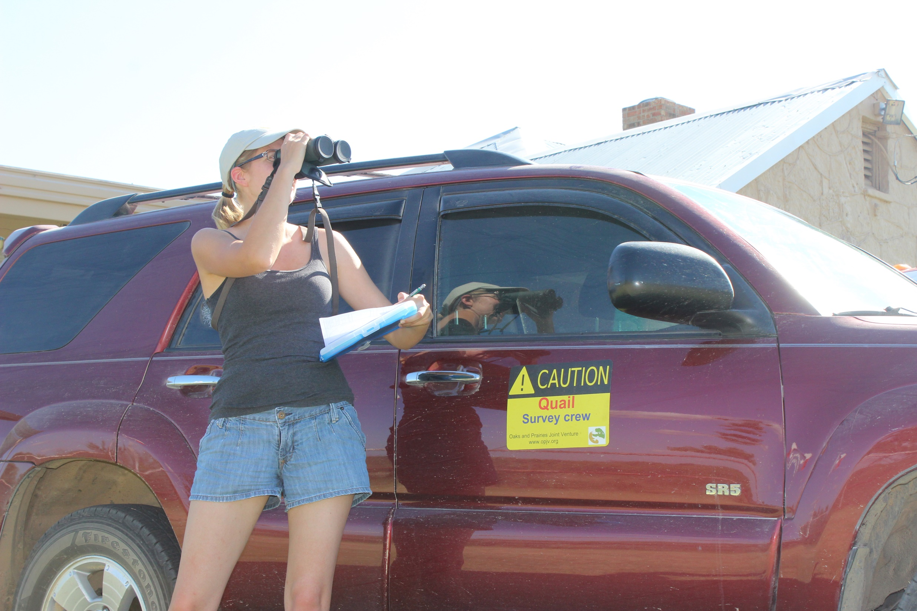
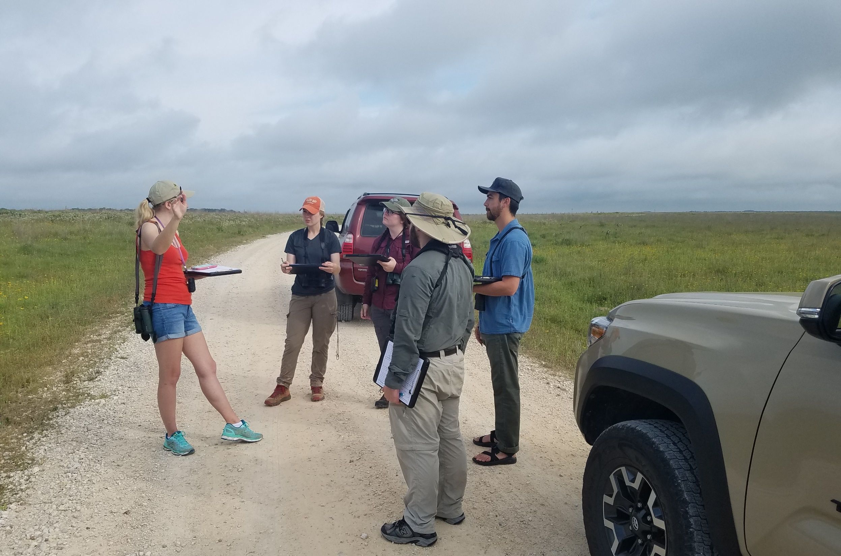
Photo by Sarah Durham
Photo by Sarah Durham

Slide 5
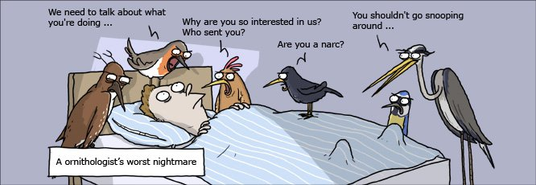
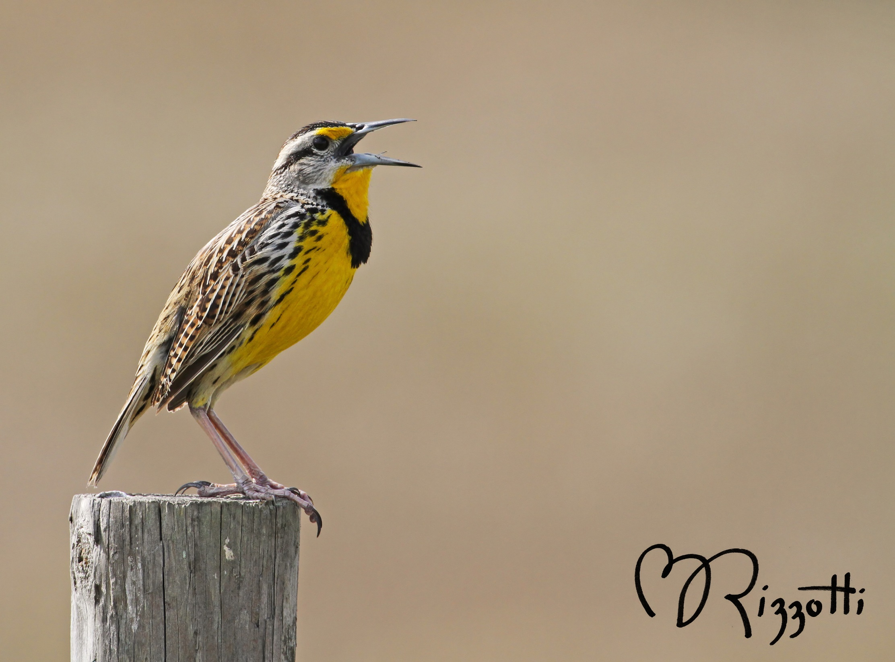
Why Birds?
“Canaries in the coal mine” - great indicator species of habitat that we can easily monitor
Loud and proud in spring – easy to hear and see
  Relatively easy to learn to ID
Can be associated with specific habitat features
Monitoring methods are also mostly non-invasive
  We won’t discuss nest monitoring or banding

Slide 6
How Do We Monitor?
Simple and Complex Options
  Usually can find something out there to tweak to suit your needs. Sometimes simpler is better!
Rule of thumb – Survey in the morning between 30 minutes before sunrise to approximately 10-11 AM
  Can flex in the winter a bit more
Almost always, count each bird only once – the first time you detect it.
3 major kinds – Timed-area search, Point Count, and Line Transect

Slide 7
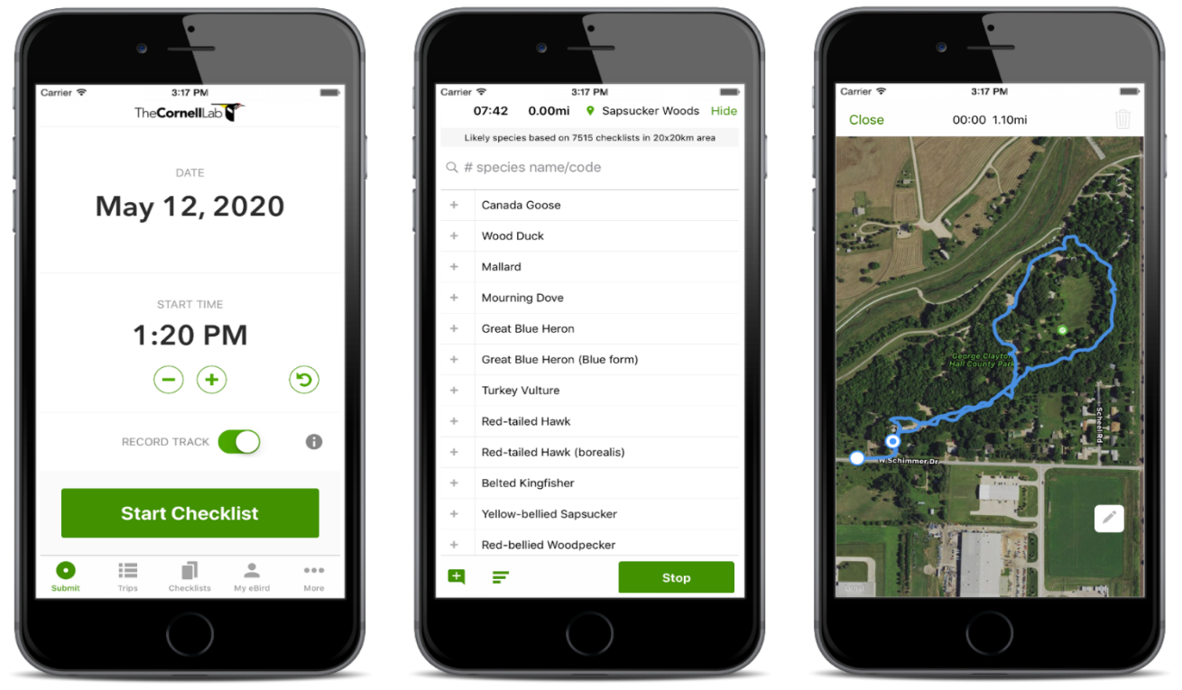
Timed-Area Search
Search a pre-defined area for a set length of time and tally the number of individuals of each species you detect
  EASY, minimal equipment/training
  Works on small sites (<250 acres)
Presence/Absence or Rough Abundance (e.g. Rare, Common, …)
Works really well for community science/volunteers
  VERY well suited for data collection with eBird

Slide 8
Larger Sites and/or More Funding??

Slide 9
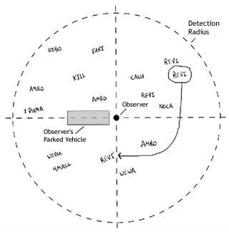
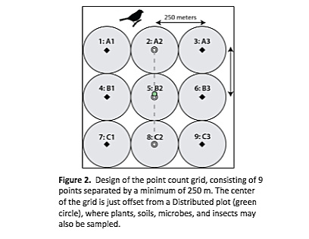
Point Counts
Stand in place for set time and count individuals heard and seen.
Can obtain a rough index of abundance and change over time
If you collect distance estimates for each bird – estimate detection probability and obtain corrected abundance estimates
  Well suited for estimating abundance at a particular site
Allows you to link birds to specific habitat composition in the area of the point count circle
VERY COMMON
Requires more equipment and more training.
Designing points can be difficult sometimes
Notes:
Three possibilities for positioning point counts or beginnings of transects. a. along existing roads or paths; b. entirely random or c. stratified random (after Bibby et al., 1998). (https://www.researchgate.net/publication/240614355_Tips_for_bird_surveys_and_censuses_in_countries_without_existing_monitoring_schemes)
https://www.pwrc.usgs.gov/bbs/participate/training/15.html
(https://blogs.massaudubon.org/distractiondisplays/americas-biggest-ecological-monitoring-project/)

Slide 10
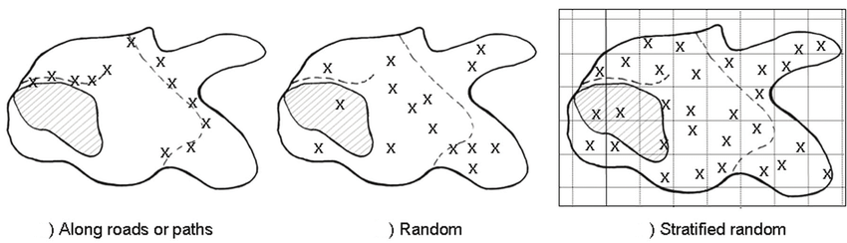
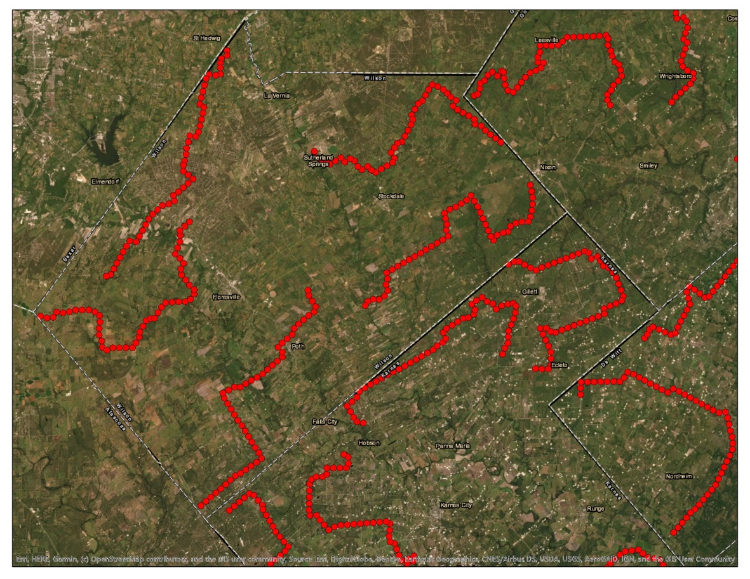
Notes:
Three possibilities for positioning point counts or beginnings of transects. a. along existing roads or paths; b. entirely random or c. stratified random (after Bibby et al., 1998). (https://www.researchgate.net/publication/240614355_Tips_for_bird_surveys_and_censuses_in_countries_without_existing_monitoring_schemes)
https://www.pwrc.usgs.gov/bbs/participate/training/15.html
(https://blogs.massaudubon.org/distractiondisplays/americas-biggest-ecological-monitoring-project/)

Slide 11
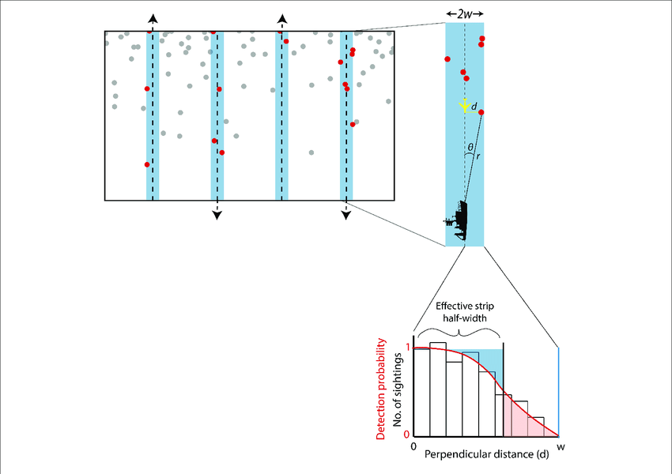
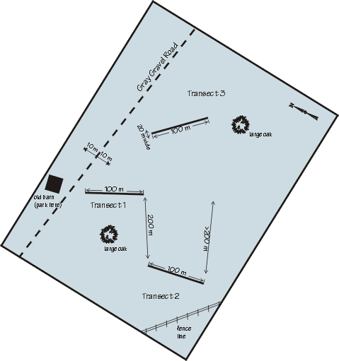
Line Transects
Walk a line and count record individuals seen and heard
  Estimate the perpendicular distance to each bird detected
Potentially detect more species/individuals due to covering more area and by flushing individuals that otherwise would have gone un-detected.
Don’t get as many replicates
Can’t tie directly to habitat like you can with point counts
Check out TPWD’s Project Prairie Bird!
Notes:
(https://www.researchgate.net/publication/354873694_Estimating_the_Abundance_of_Marine_Mammal_Populations)

Slide 12
Winter Is Coming!... Eventually

Slide 13
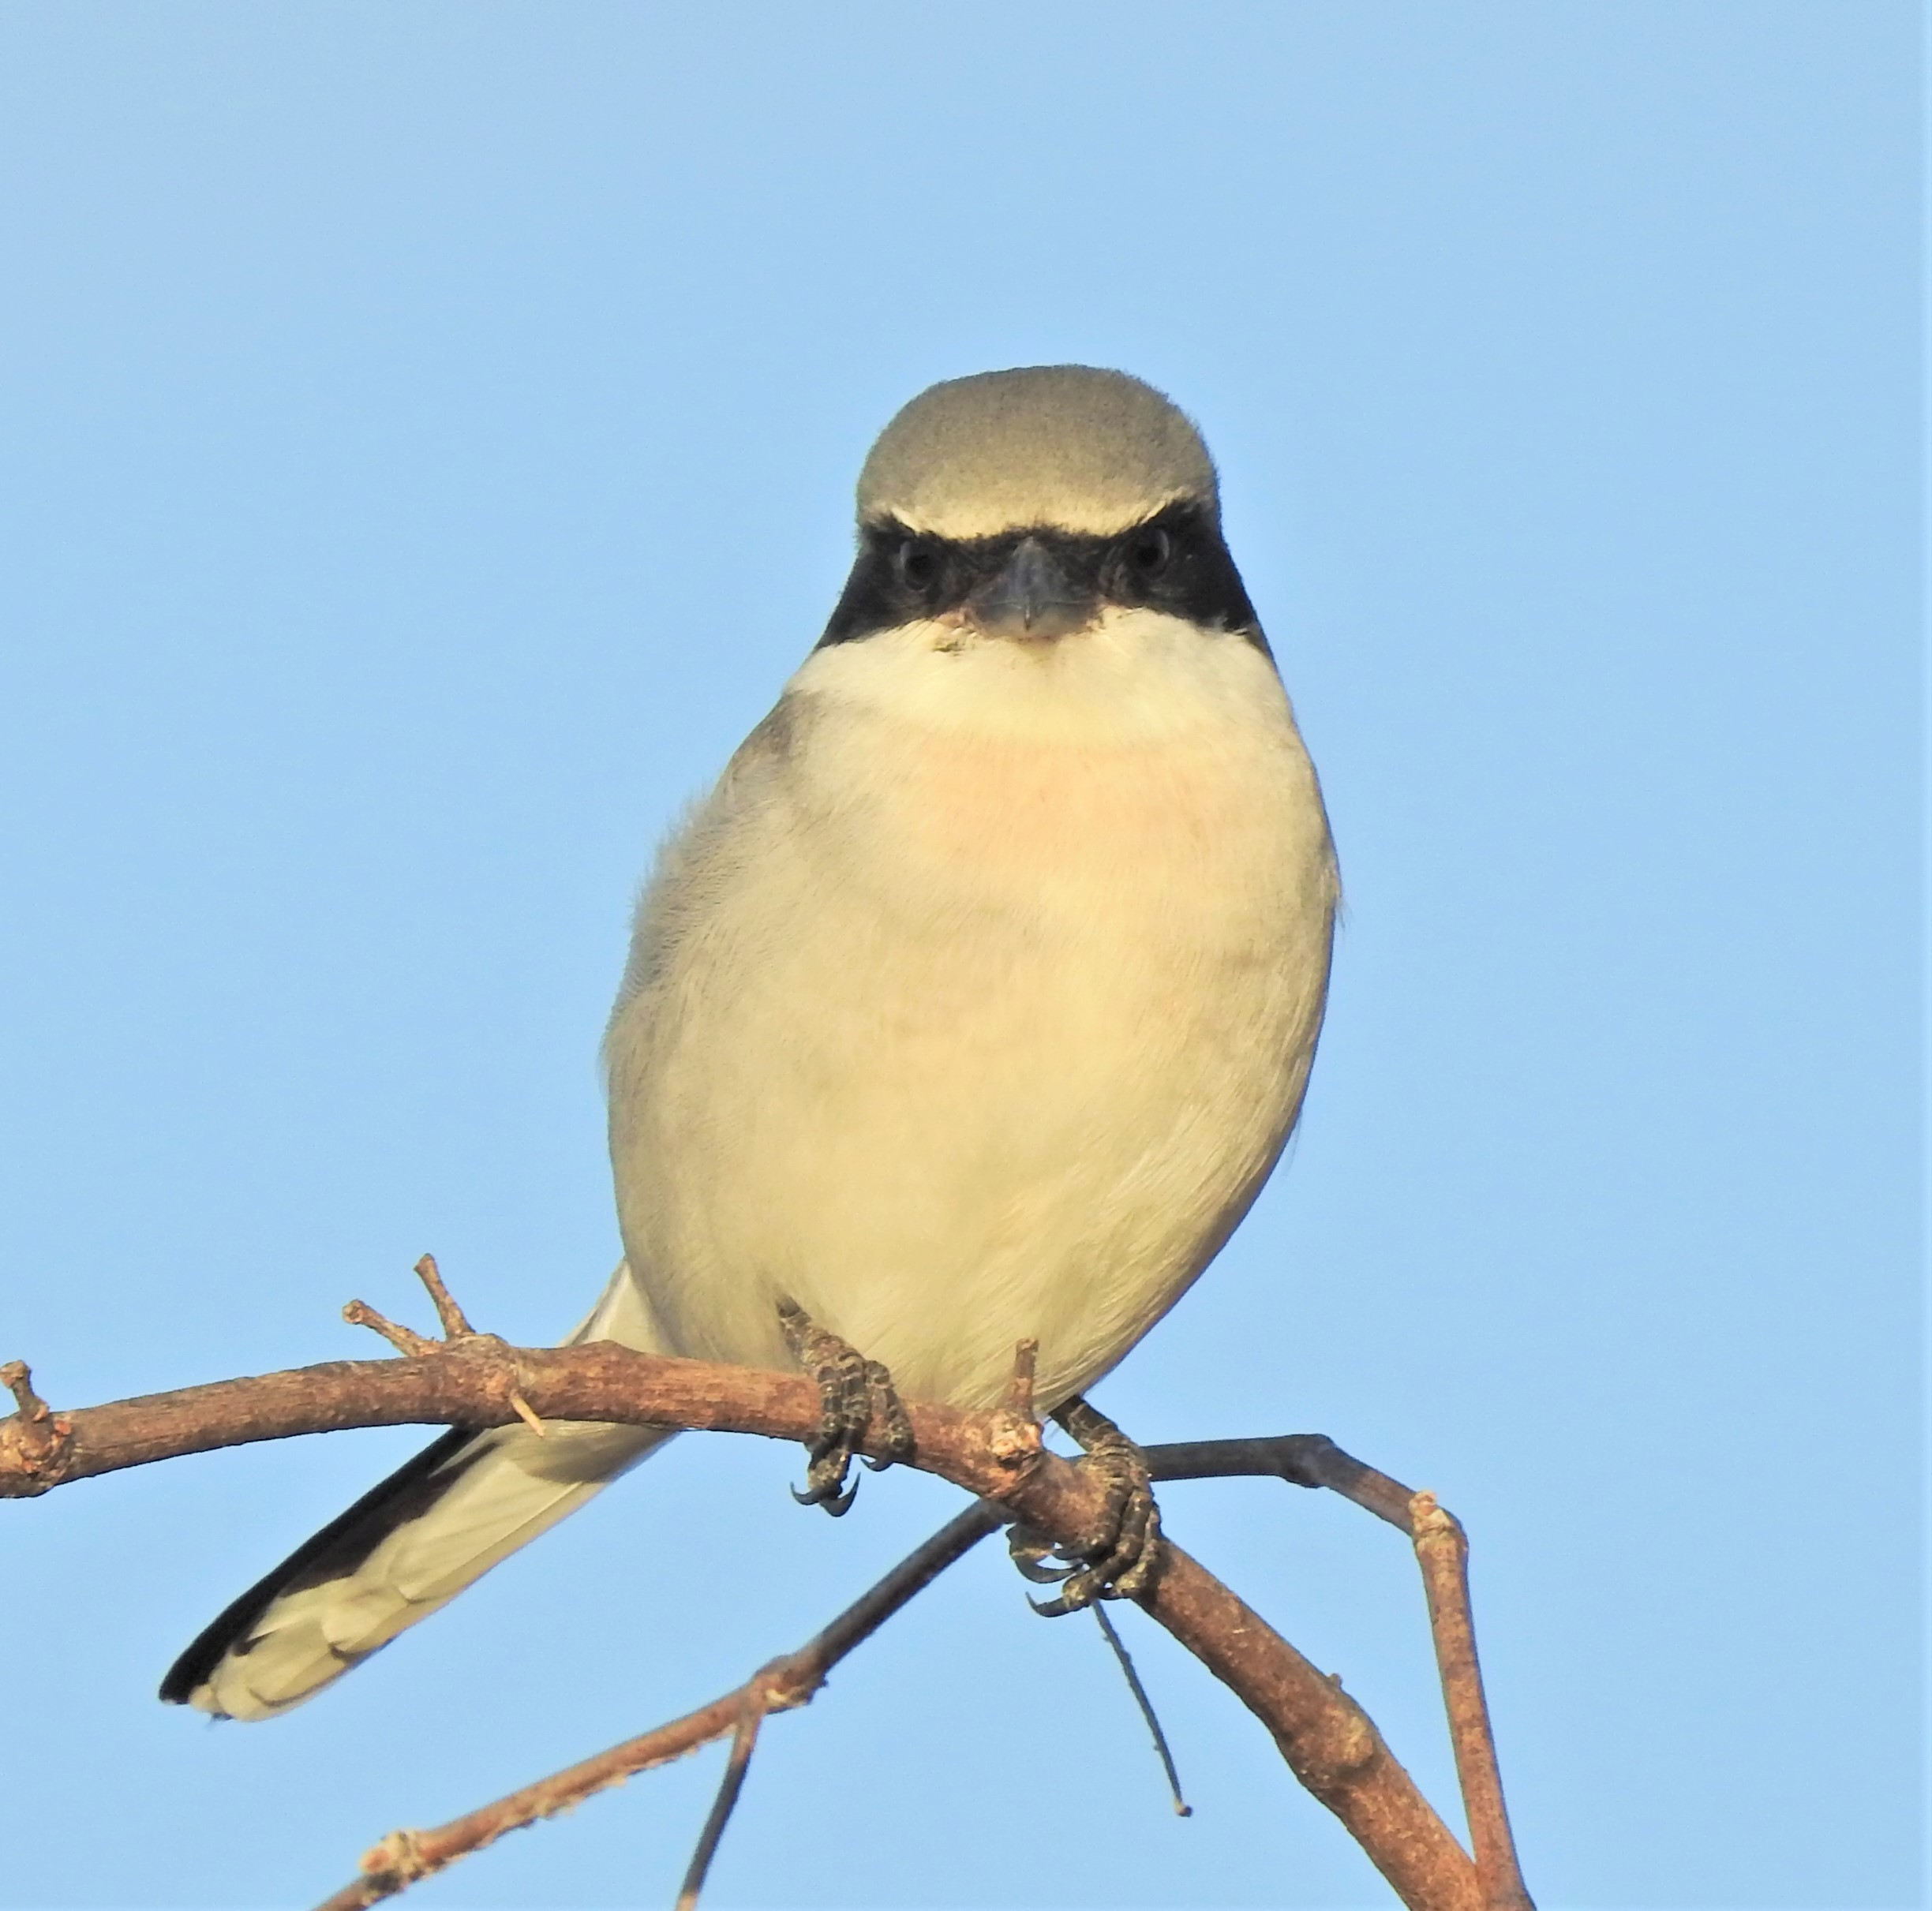
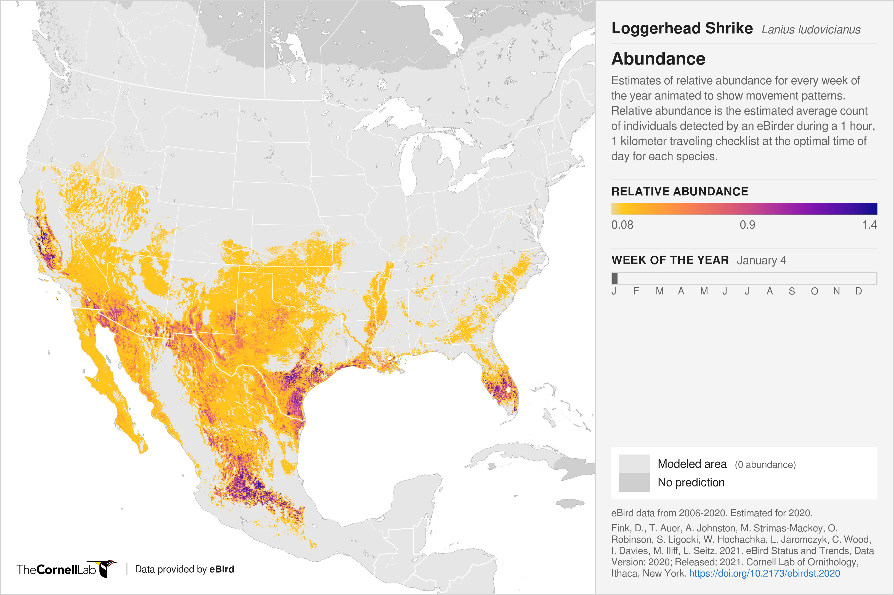
Winter Birds
Super important in coastal grasslands!!
Big knowledge gap
Winter ID is much more difficult. Don’t sing – rely on chips and visual ID
Can use many of same methods as done in spring (except point counts for anything but a few species)
  Timed-area search and transects will flush birds for visual ID
Photo by Craig Hensley

Slide 14
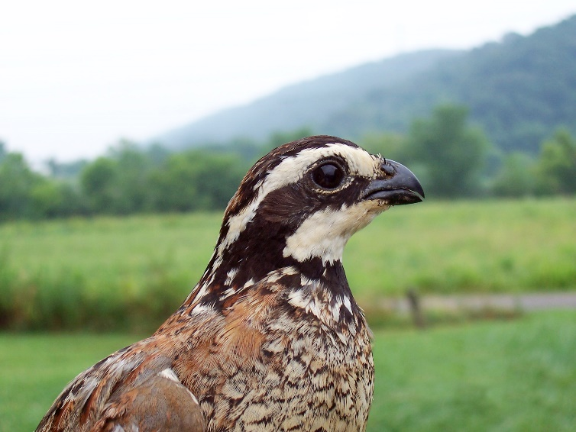
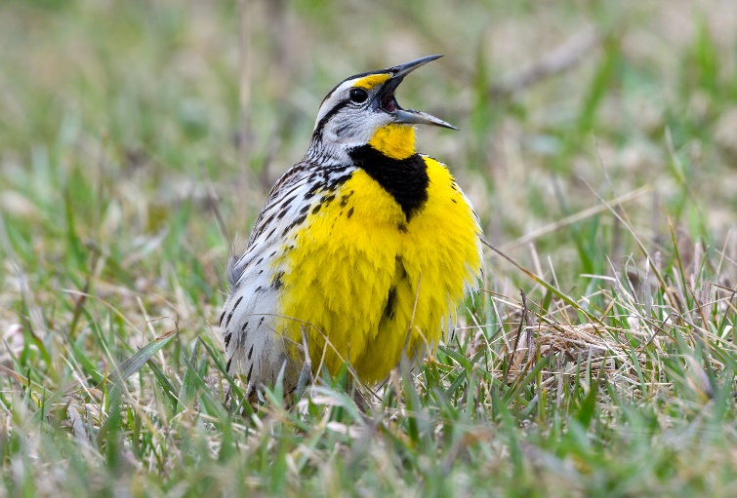
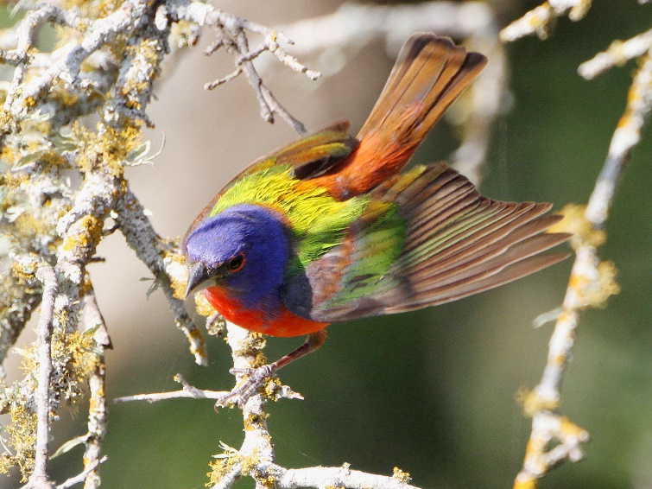
Focal Species
You don’t have to know them all!
Programs may have specific birds they target
Birds can be associated with different habitat components
  Eastern Meadowlark, Northern Bobwhite, Painted Bunting
Partner organizations may have lists you can use as well

Slide 15
Monitoring Treatments
Ideal
  Spring/Winter before treatment
  Spring/Winter after treatment
  Every 3-5 years after that
Before treatment – very difficult to do
  Alternatives
    Nearby pasture that could serve as control
    “Good example” grassland in the area that could serve as point of comparison

Slide 16
What is the OPJV Doing?

Slide 17
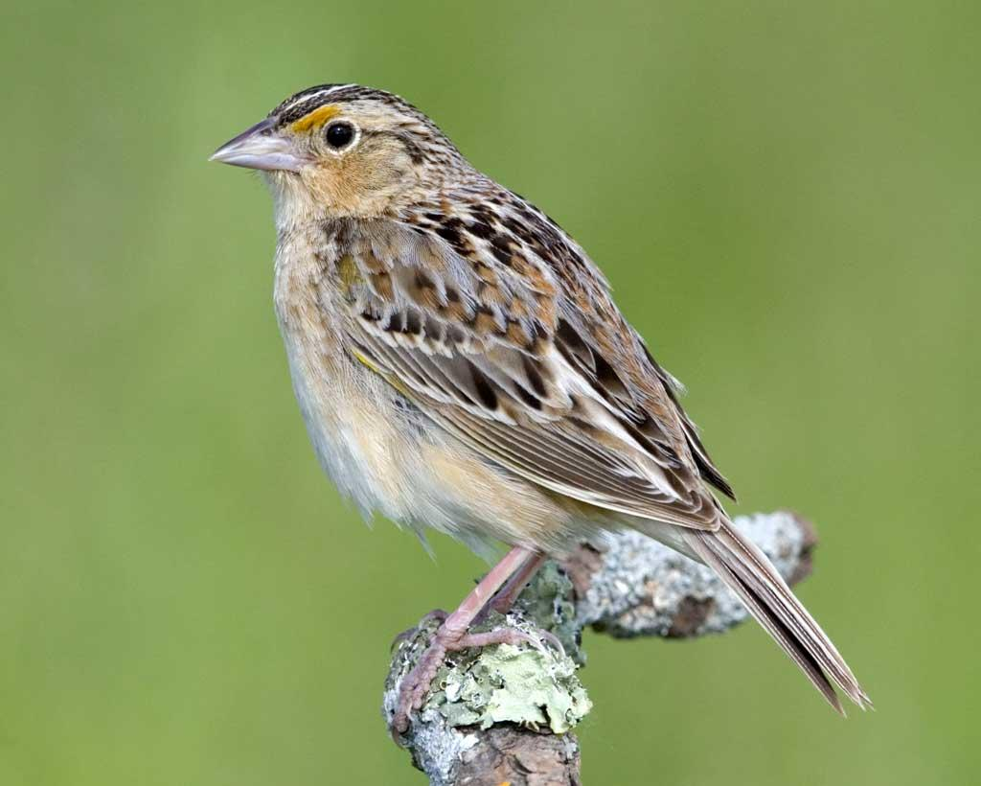
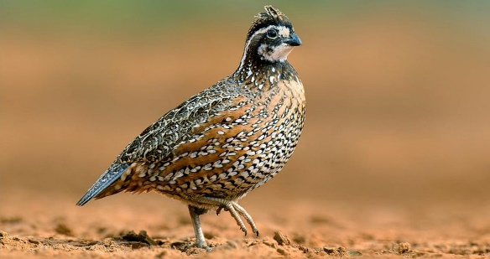
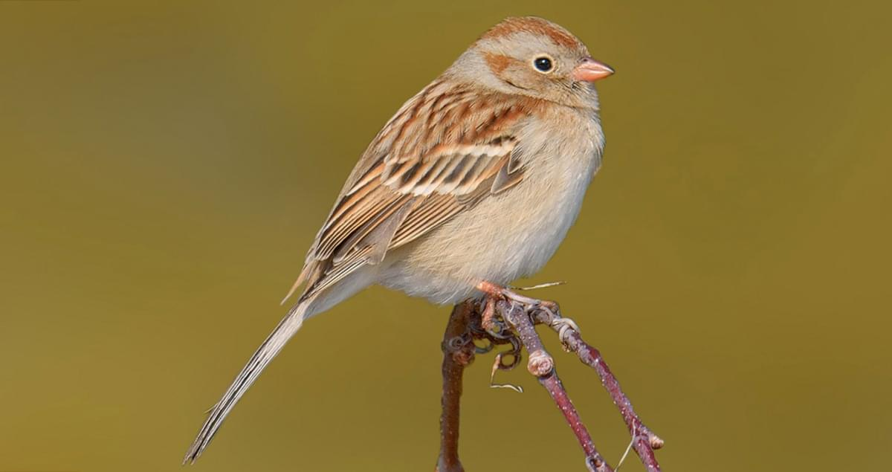
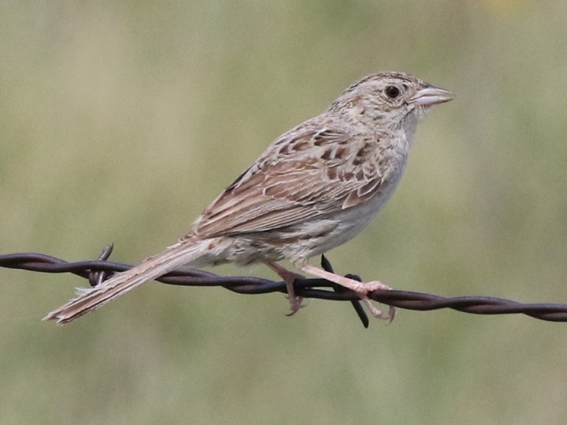
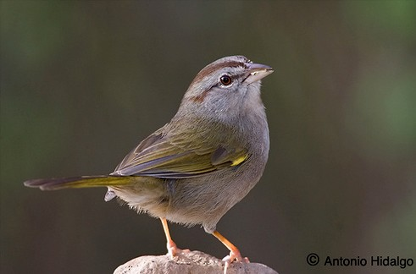
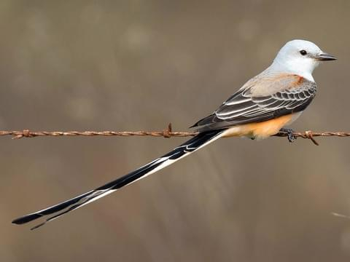
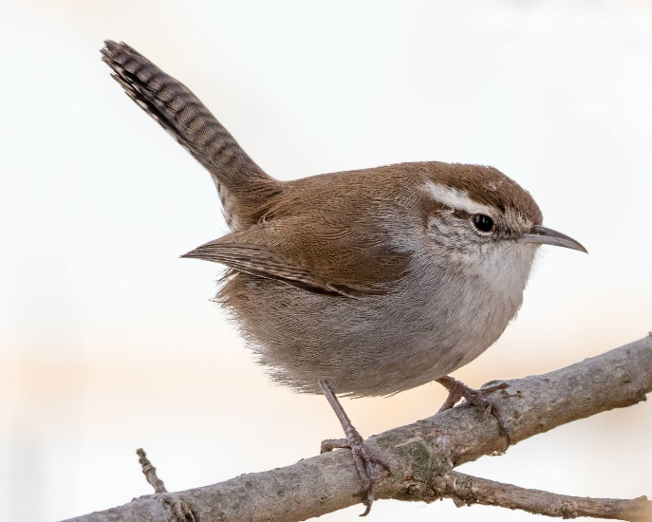
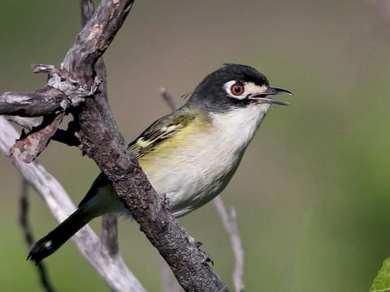
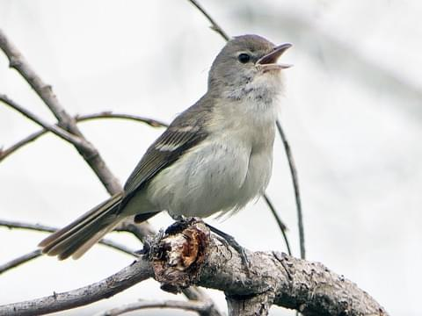
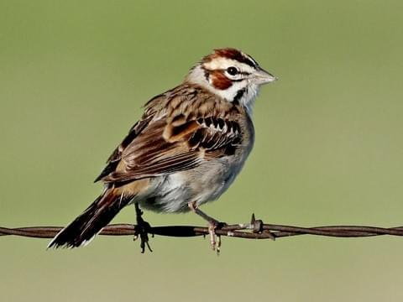
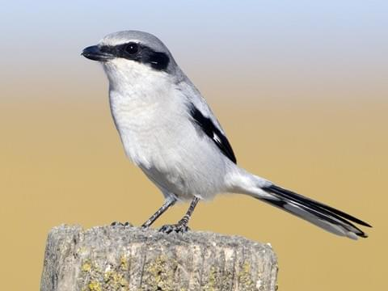
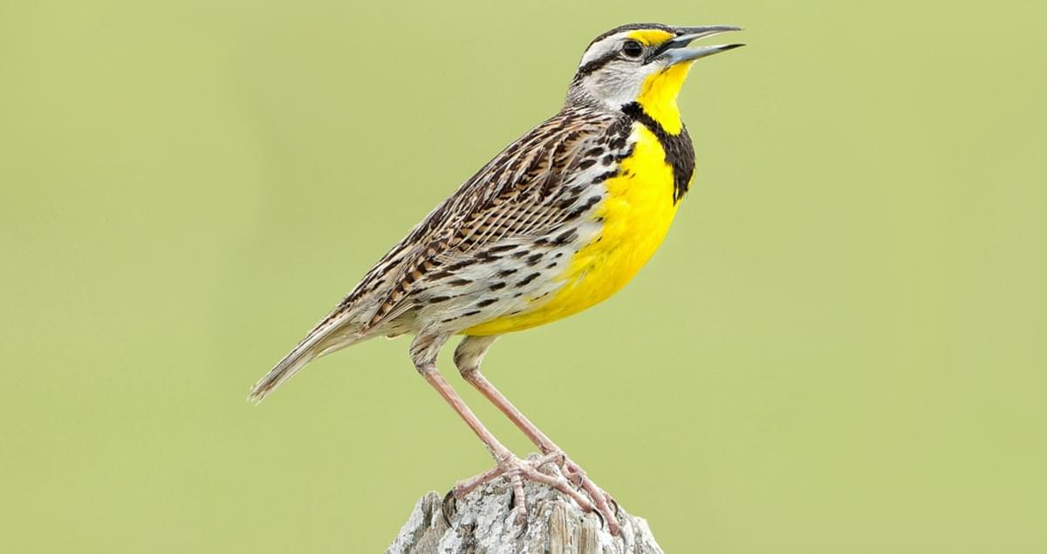
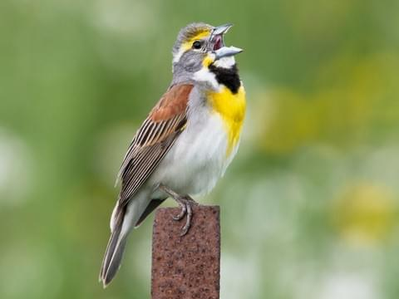
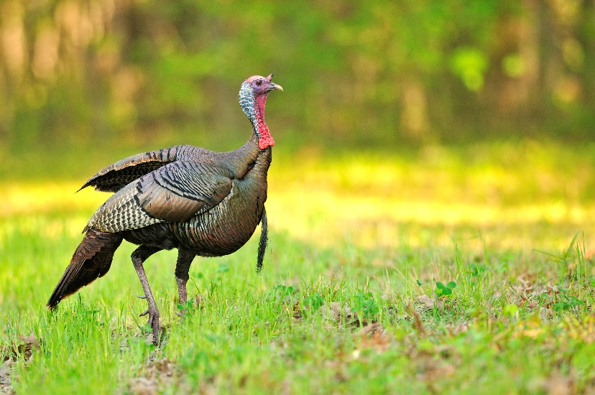
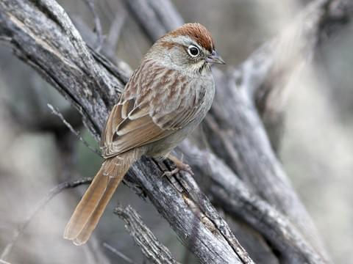
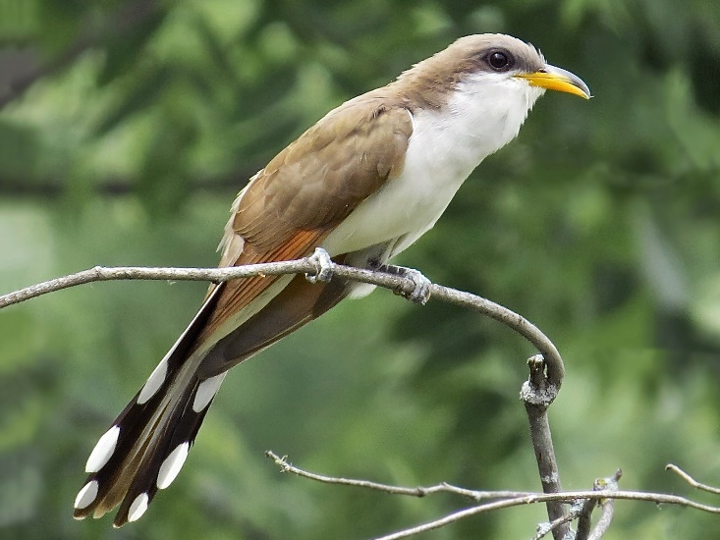
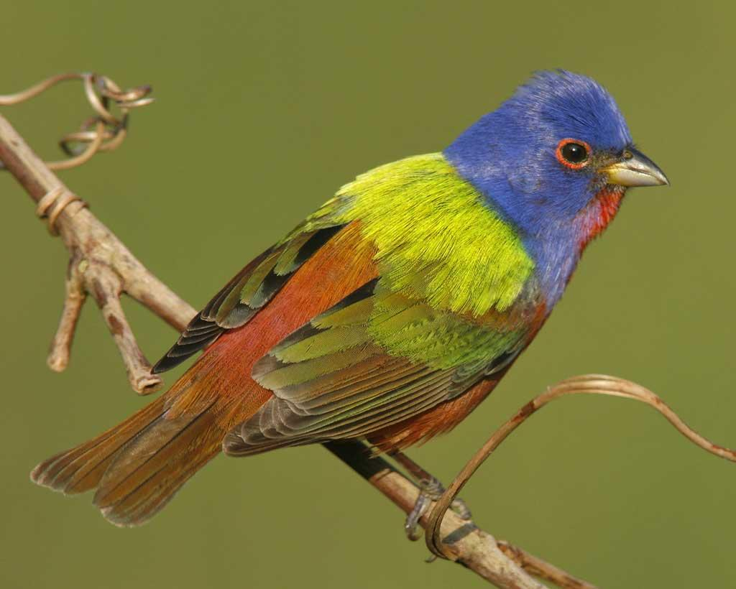
Notes:
And remember that we’ll be focusing on grassland birds today

Slide 18
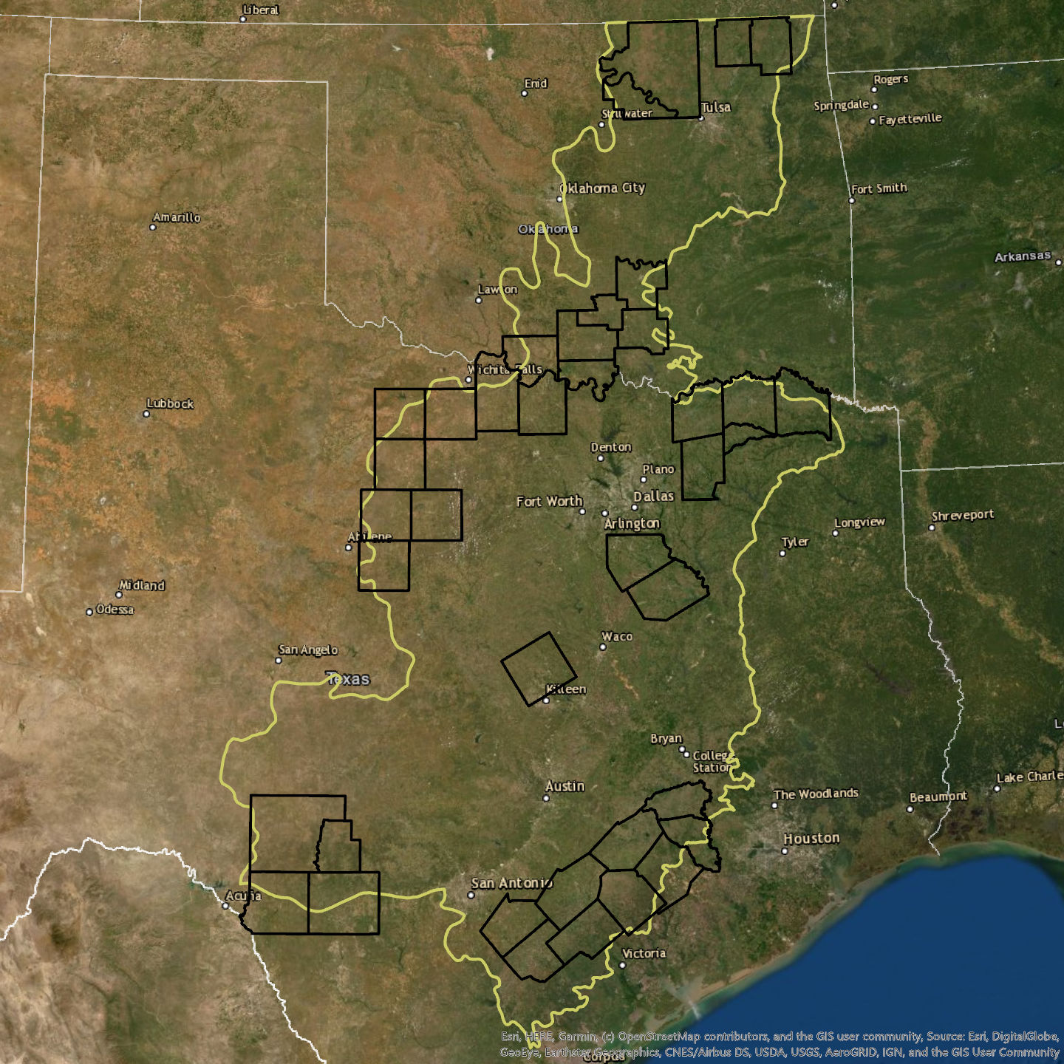

Landscape-level Monitoring
Grassland Restoration Incentive Program
  Survey counties where we implement program
  Breeding Bird Survey-style point counts
  2013-2021
  Track changes over time at a county level

Slide 19
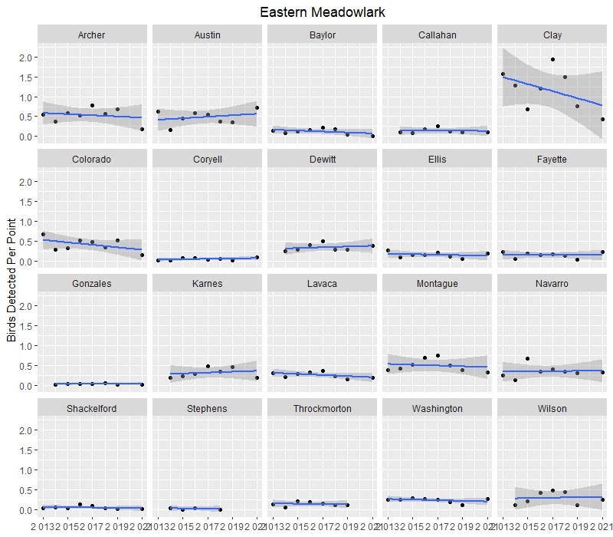
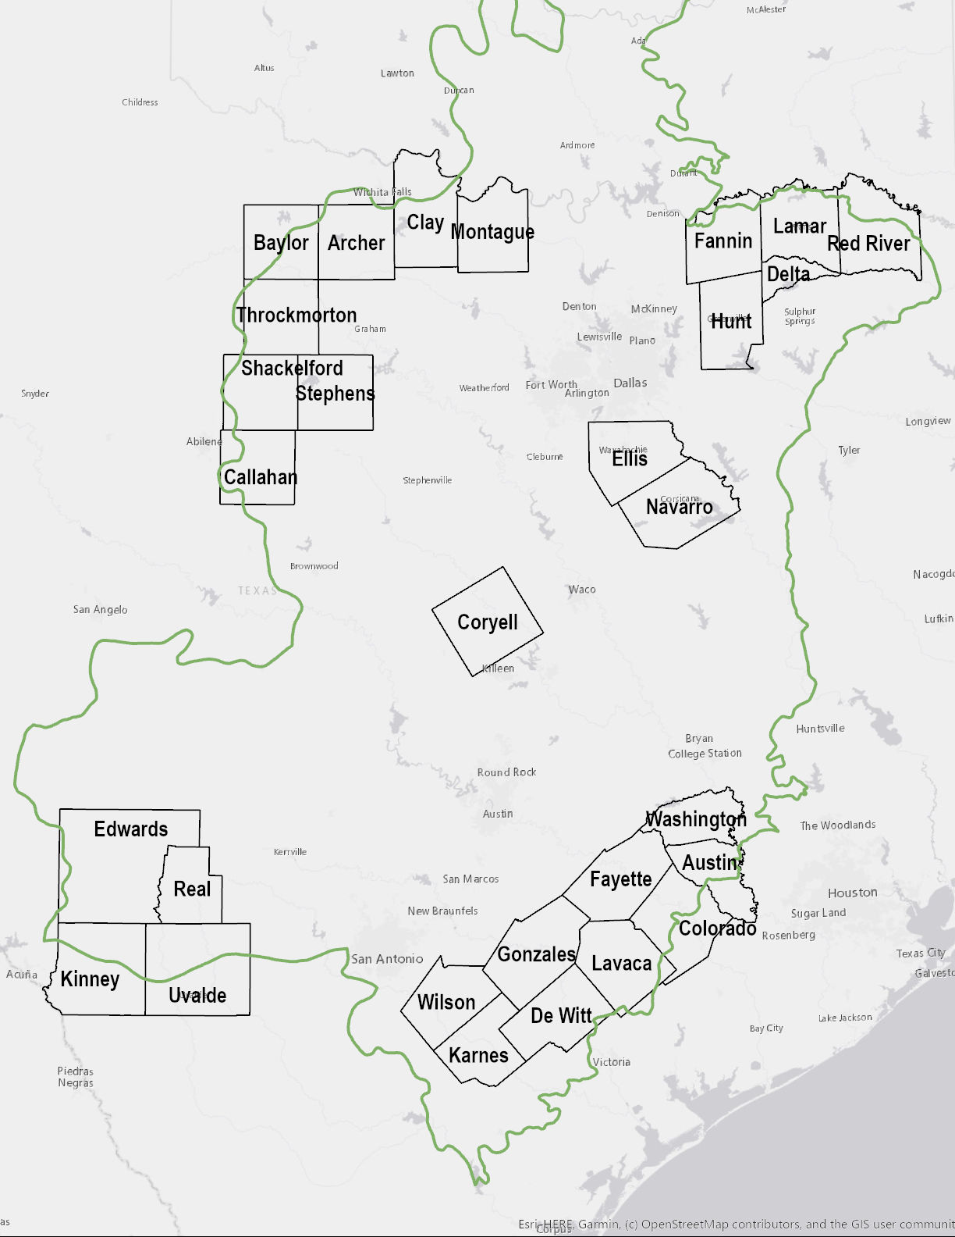
TX

Slide 20
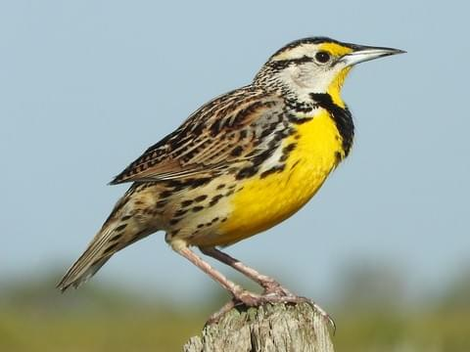
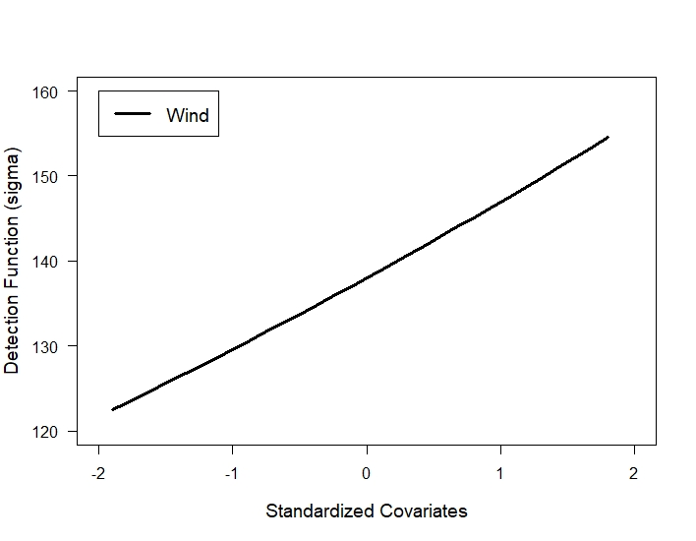
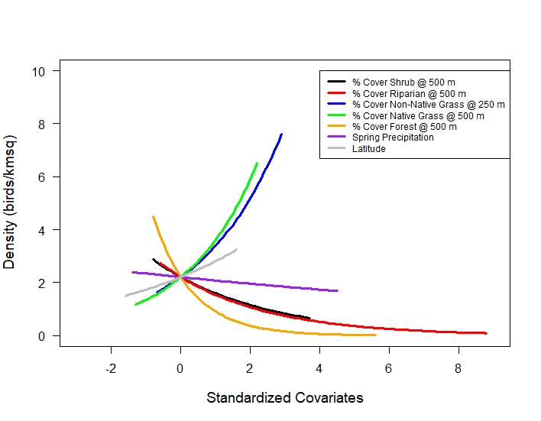
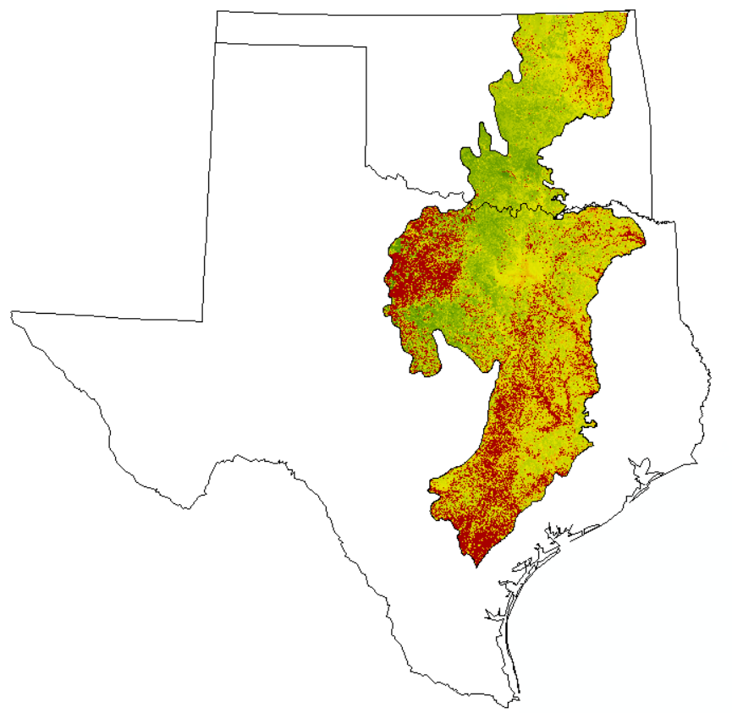
Abundance/Distribution Modeling

Slide 21
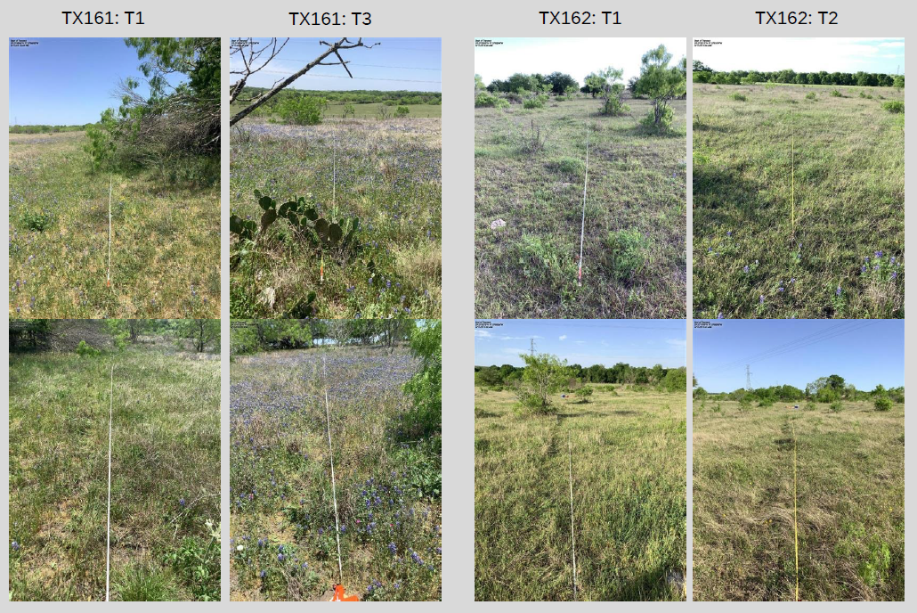
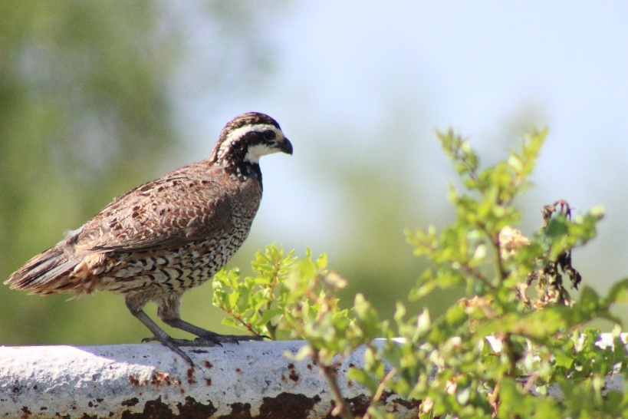
Site-Level Monitoring
Developing a monitoring program for the site-level – directly monitor GRIP projects
  Vegetation Monitoring
  Bird Monitoring
    Gridded point counts on larger properties, random points on smaller properties
    Borrowed Bird Conservancy of the Rockies protocol – don’t re-invent the wheel!
Photo by Sarah Durham

Slide 22
Other Monitoring
Pollinators
Herps/Amphibians
  Houston Toads!
Bats
White-tail
Many More
Don’t forget about ARUs and camera traps!

Slide 23
And People Too!
Human Dimensions
  How do people fit into your habitat management story?
What birds do your landowners/visitors care about? What charismatic/game species might get them engaged?
Opportunities to use monitoring for engagement?
What are their thoughts about your work?
  If you change how you work based on results, does that increase engagement?

Slide 24
Thank you!
Anna Matthews
amatthews@abcbirds.org

